Slide 1





Helping your child cope with worries.
Working in partnership with:
Northumbria Healthcare NHS Foundation Trust
Cumbria, Northumberland, Tyne and Wear NHS Foundation Trust

Slide 2
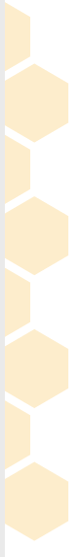
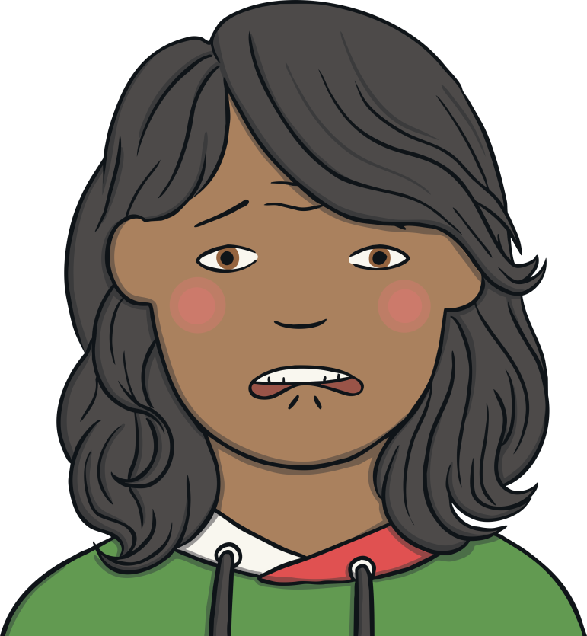

My Child is Feeling Worried
Fear of a place, object or situation (phobia)
Social Phobia, where a child fear that he or she will do something that they will be embarrassed or ashamed by.
General anxiety, worries about what's going on in the world, getting things right, about other people.
Working in partnership with:
Northumbria Healthcare NHS Foundation Trust
Cumbria, Northumberland, Tyne and Wear NHS Foundation Trust
Separation Anxiety, where it is difficult to be apart from their parent or carer.

Slide 3




How Are You Feeling?
Children and adult experience lots of different feelings every day. Sometimes the feelings feel good and sometimes they feel bad. Even feelings we might consider to be bad can be useful, they can help us plan, prepare, keep ourselves safe.
Working in partnership with:
Northumbria Healthcare NHS Foundation Trust
Cumbria, Northumberland, Tyne and Wear NHS Foundation Trust

Slide 4

Feeling Worried
When your child is feeling worried, most commonly they will be thinking something bad is going to happen.
At this time thoughts tend to become focused on the potential threat and how to escape from it, and it can be hard to think about anything else.
It is a useful state to be in when there is danger, for example if they step into a road as a parent you need to be focused on getting your child out the way of oncoming traffic, and not be distracted by other thoughts.
Working in partnership with:
Northumbria Healthcare NHS Foundation Trust
Cumbria, Northumberland, Tyne and Wear NHS Foundation Trust

Slide 5
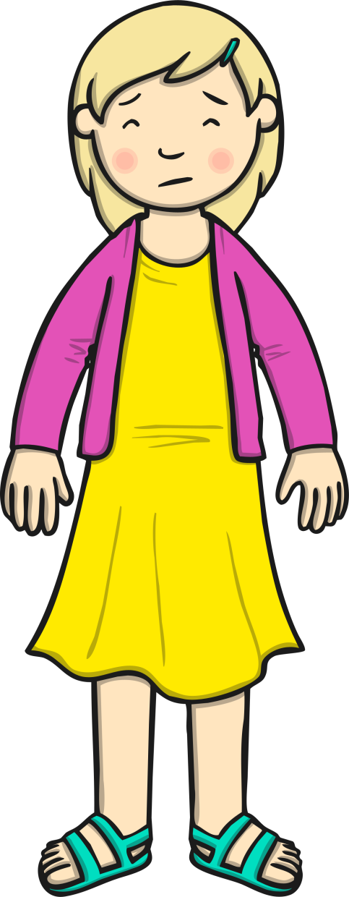
Feeling Worried
When we experience worries/fears we respond in a number of ways.
Muscles become tense
Breathing getting faster.
Heart rate speeding up
Sweating or butterflies in the tummy.
They represent our body getting ready for action, to react quickly, for a Flight or Fight Response.
Working in partnership with:
Northumbria Healthcare NHS Foundation Trust
Cumbria, Northumberland, Tyne and Wear NHS Foundation Trust

Slide 6

If its normal to be anxious, why am I concerned about my child?
Changes we experience in response to anxiety are helpful in the short term, but if these reactions continue to occur when actual danger has passed, or if it was never there, they become more problematic.
Overtime, bodily changes become very uncomfortable, causing tummy aches, headaches, or muscle aches.
When worries become overwhelming, thinking can become dominated by fearing the worst, and their confidence that they can cope with any challenge decreases.
When worries persist it can be exhausting for them, and lead them to miss out on doing things they would otherwise enjoy.
Working in partnership with:
Northumbria Healthcare NHS Foundation Trust
Cumbria, Northumberland, Tyne and Wear NHS Foundation Trust

Slide 7
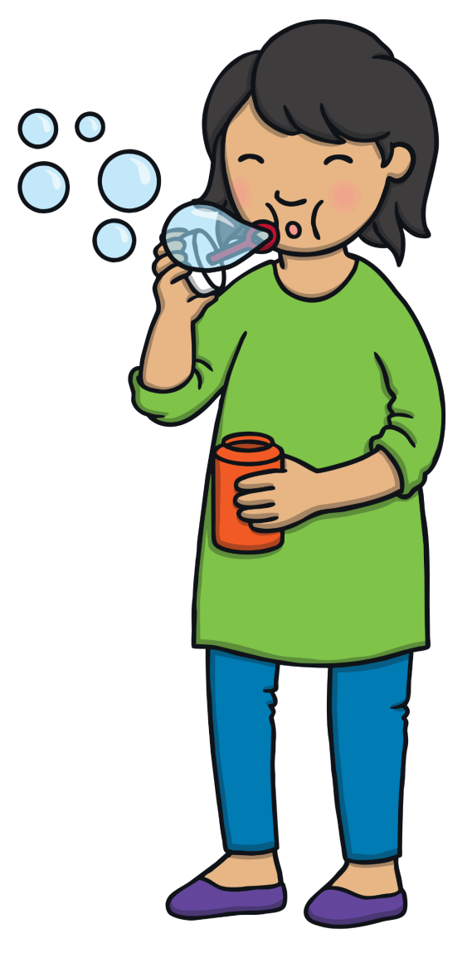
What Can You Do?
There are lots of things you can do to help your child if they are feeling worried.
Encourage them to use their words and say why they are worried.
Listen to them and take them seriously, encourage them to calm
down by taking three deep breaths.
Encourage them to picture their worry in a bubble and blow it away.
Encourage them to think of the times they have worried about things and it has been ok. Help them become a thought detective and see if there is anything that backs up their worry.
Encourage them to have some quiet time, listen to music, go for a walk, do some colouring, play a game.
Working in partnership with:
Northumbria Healthcare NHS Foundation Trust
Cumbria, Northumberland, Tyne and Wear NHS Foundation Trust

Slide 8
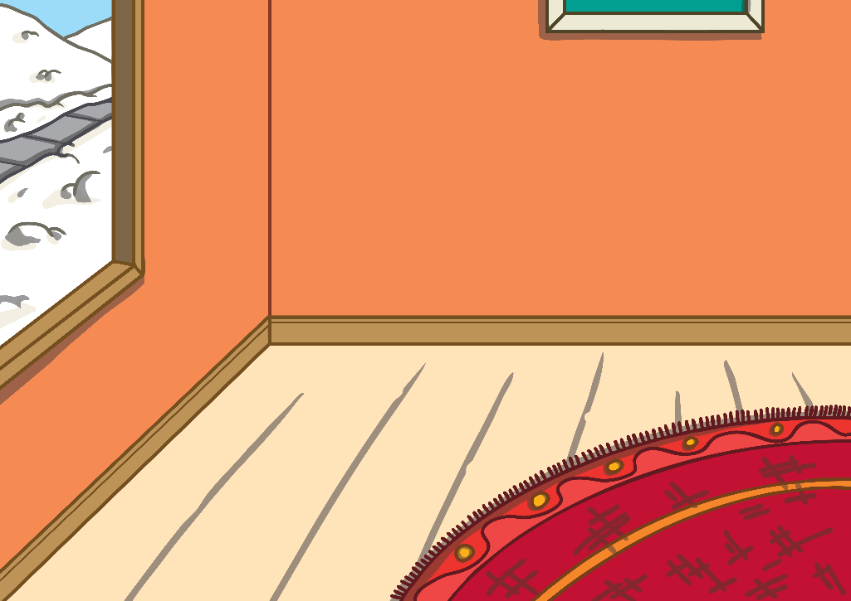


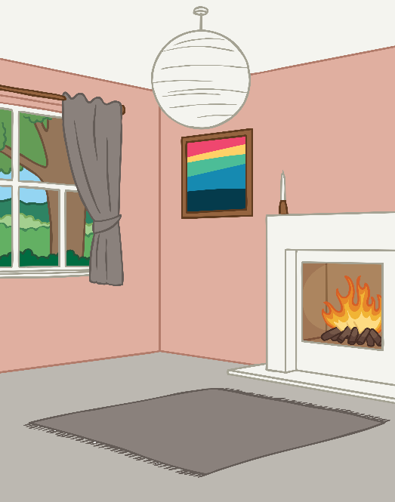

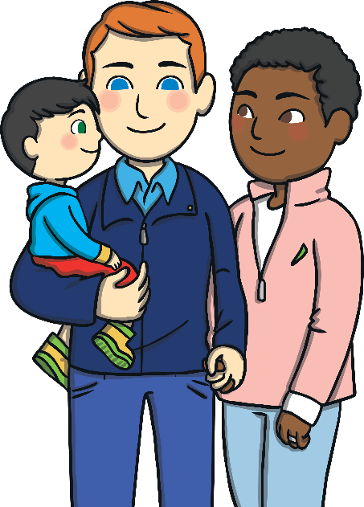

Encouraging you child to share their worries with you or someone they trust can make them feel a little better. Discuss with them who they feel they can talk to when they are worried, this can be their support team. Let the support team know they are involved.
Working in partnership with:
Northumbria Healthcare NHS Foundation Trust
Cumbria, Northumberland, Tyne and Wear NHS Foundation Trust

Slide 9
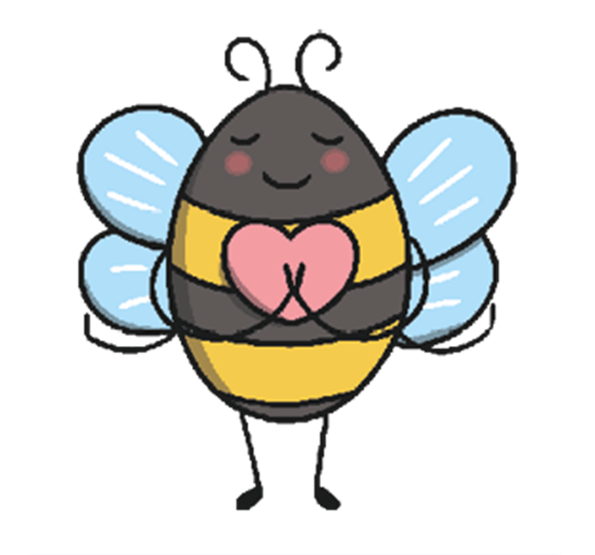
Thankyou
https://youngminds.org.uk/find-help/for-parents/parents-guide-to-support-a-z/parents-guide-to-support-anxiety/
https://www.northumbria.nhs.uk/our-services/childrens-services/be-you/
Northumbria Primary Mental Health Team 01661 864588
Working in partnership with:
Northumbria Healthcare NHS Foundation Trust
Cumbria, Northumberland, Tyne and Wear NHS Foundation Trust

