Slide 1





Exam Stress
Working in partnership with:
Northumbria Healthcare NHS Foundation Trust
Cumbria, Northumberland, Tyne and Wear NHS Foundation Trust
Notes:
Welcome.
Today we will be thinking and talking about Exam Stress.
What it is, how it affects young people and how we can help them plan, prepare and support them through it.

Slide 2
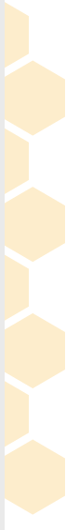
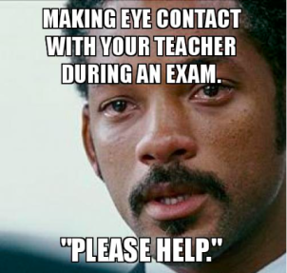

Exam Stress is Normal
Working in partnership with:
Northumbria Healthcare NHS Foundation Trust
Cumbria, Northumberland, Tyne and Wear NHS Foundation Trust
Notes:
Anyone recognise themselves here?
Before we get begin today, we must acknowledge the fact that EXAM STRESS IS NORMAL.
It is completely normal – and HEALTHY – to feel a bit stressed leading up to, during and even after the exam period.
Feeling stressed shows that your child cares about the results and the outcomes, it can motivate them to work a little harder, plan and prepare.

Slide 3
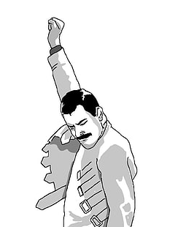
Under Pressure
Exam stress affects everyone differently.
Stress can be good sometimes, it can help us to work harder and focus.
But it can also have a big effect on us and make it hard to cope.
Working in partnership with:
Northumbria Healthcare NHS Foundation Trust
Cumbria, Northumberland, Tyne and Wear NHS Foundation Trust
Notes:
https://www.childline.org.uk/info-advice/school-college-and-work/school-college/exam-stress/
Exam stress affects everyone differently.
However if a young person is struggling to cope, always thinking negatively about their exams, or getting panicky about them impacting on their mood, sleep or appetite this might be a sign of anxiety.
When we are anxious, our bodies go into ”fight or flight mode.”
what is meant be ”fight or flight mode.” – Caveman & Sabretooth Tiger analogy.
Unfortunately, our bodies still work in the same way they did back then, and will often make us feel like we are in danger, when really we are not.

Slide 4

Exam Stress & Mental Health
How can you tell if Exam Stress is beginning to impact on their mental health?
Working in partnership with:
Northumbria Healthcare NHS Foundation Trust
Cumbria, Northumberland, Tyne and Wear NHS Foundation Trust
Notes:
https://www.childline.org.uk/info-advice/school-college-and-work/school-college/exam-stress/
How can you tell if Exam Stress is beginning to impact on their mental health?
We’re going to watch this video to hear about some real life experiences about exam stress and the impact that it can have on your mental health.
Seek feedback from the audience – any questions or comments?

Slide 5
Signs of Stress
Children & Young People who are stressed might:
worry a lot
feel tense
have headaches and stomach pains
not sleep well
be irritable
lose interest in food or eat more than normal
not enjoy activities they previously enjoyed
be negative and have a low mood
feel hopeless about the future
nail biting, skin picking, teeth grinding
feel short of breath or breathe very fast
Working in partnership with:
Northumbria Healthcare NHS Foundation Trust
Cumbria, Northumberland, Tyne and Wear NHS Foundation Trust
Notes:
Signs of Stress
How do you know if your child is stressed?
Let’s have a think about some of the signs of stress that your child may experience during demanding times, such as exam periods.
worry a lot
feel tense
have headaches and stomach pains
not sleep well
be irritable
lose interest in food or eat more than normal
not enjoy activities they previously enjoyed
be negative and have a low mood
feel hopeless about the future
nail biting, skin picking, teeth grinding
feel short of breath or breathe very fast
Do any of these apply to your child?
Are there any other signs of stress that you notice?
If so, make a note of them, and discuss with your child so they can begin to recognise their own signs of stress and plan what they can do to help alleviate this, or talk to about this.
The more aware you are of their signs of stress, the better you will be able to support them to cope with it.

Slide 6
Revision Tips for your Child
Suggest or help them make a realistic revision schedule.
Help them find a revision style that suits them.
Suggest they customise their notes to make them more personal.
If they don’t understand something suggest they look for alternative sources, or ask a teacher or friend.
Encourage them to take regular short breaks approximately 15-20 minutes every 45 mins-hour.
Help them plan a reward for finishing some revision.
Encourage physical activities when not revising.
Suggest they ask for help if stuck or support them with contact at school if necessary.
https://www.childline.org.uk/info-advice/school-college-and-work/school-college/preparing-exams/
https://www.nhs.uk/conditions/stress-anxiety-depression/tips-on-surviving-exams/
Working in partnership with:
Northumbria Healthcare NHS Foundation Trust
Cumbria, Northumberland, Tyne and Wear NHS Foundation Trust
Notes:
How can support our children to make revision feel a bit more manageable?
Be interested in what they are doing and how they are doing it, be a listening ear for them when they have a rant, show your support by bringing them a snack or a drink, or suggest you do something together such as going out for a walk together in one of their breaks. Above all try to stay calm with them, getting into a heated argument will only increase stress levels, which will impact on the whole family.
You can also:
Work with your child to make a realistic revision schedule. Work out how much they have to do and the time they have to do it in, then suggest they break it down into manageable chunks. Help them aim to do a few hours of revision each day, and mix up their subjects so they don't get bored.
Help them find a revision style that suits them. Studying alone in a quiet room suits some people, but not everyone likes working in silence. They may prefer to play music quietly in the background, or revise with a friend.
Suggest they customise their notes to make them more personal. Experiment with colour coding, notes on postcards, diagrams or whatever helps them learn their topic.
If they come across something they don't understand, suggest they find a new source of information that will help them understand it or seek advice from their teacher or friend. Just memorising it won't help them understand it for their exam.
Suggest they look at past exam papers. So they can familiarise themselves with the layout and type of questions they’ll be asked. Practising completing exam papers in the set time limit will help them to improve their exam technique.
Encourage them to take regular short breaks. Studying for hours and hours will only make them feel tired and ruin their concentration, which may make them even more anxious. A break every 45 to 60 minutes is about right. Take them a drink, or a healthy snack to ensure they stay hydrated and energised.
Encourage them to reward themselves. For example, they could take a long bath or watch a good film once they have finished their revision session.
Encourage them to do something physical. When their not revising, it would be good if they could use their spare time to get away from their books and do something active. Exercise is good for taking their mind off stress and keeping them positive, and it will help them sleep better.
Encourage them to ask for help. If they are feeling stressed, it's important for them to talk to someone they trust and feel they wont be judged by, such as a family member, teacher or a friend. Lots of people find exams difficult to deal with, so no one should be embarrassed to ask for support.

Slide 7
More Helpful Tips for Parents
Make sure your child eats well
Help your child get enough sleep
Be flexible during exams
Help them study
Talk about exam nerves
Do not add to the pressure
Know when to get help
https://www.nhs.uk/conditions/stress-anxiety-depression/coping-with-exam-stress/
Working in partnership with:
Northumbria Healthcare NHS Foundation Trust
Cumbria, Northumberland, Tyne and Wear NHS Foundation Trust
Notes:
Make sure your child eats well
A balanced diet is vital for your child's health, and can help them feel well during exam periods.
Some parents find high-fat, high-sugar and high-caffeine foods and drinks, such as energy drinks, cola, make their children hyperactive, irritable and moody.
Where possible, involve your child in shopping for food and encourage them to choose some healthy snacks.
Help your child get enough sleep
Good sleep improves thinking and concentration. Most teenagers need 8 to 10 hours' sleep a night. Allow half an hour or so for your child to wind down between studying, and going to bed, to help them get a good night's sleep.
Cramming all night before an exam is usually a bad idea. Sleep will benefit your child far more than a few hours of panicky last-minute study.
Be flexible during exams
Be flexible around exam time. When your child is revising all day, do not worry about household jobs left undone or untidy bedrooms.
Staying calm yourself can help. Remember, exams do not last forever.
Help them study
Make sure your child has somewhere comfortable to study. Ask them how you can support them with their revision.
To motivate your child, encourage them to think about their goals in life and see how their revision and exams are related to them.
Talk about exam nerves
Remind your child that it's normal to feel anxious. Nervousness is a natural reaction to exams. The key is to put these nerves to positive use.
If anxiety is getting in the way rather than helping, encourage your child to practise the activities they'll be doing on the day of the exam. This will help it feel less scary.
For example, this may involve doing practice papers under exam conditions or seeing the exam hall beforehand. School staff should be able to help with this.
Help your child face their fears and see these activities through, rather than avoiding them.
Encourage them to think about what they know and the time they've already put into studying to help them feel more confident.
Do not add to the pressure
Support group Childline says many children who contact them feel that most pressure at exam time comes from their family.
Listen to your child, give them support and avoid criticism.
Before they go in for a test or exam, be reassuring and positive. Let them know that failing is not the end of the world. If things do not go well they may be able to take the exam again.
After each exam, encourage your child to talk it through with you. Discuss the parts that went well rather than focusing on the questions they found difficult. Then move on and focus on the next test, rather than dwelling on things that cannot be changed.
When to get help
Some young people feel much better when exams are over, but that's not the case for all young people.
Get help if your child's anxiety or low mood is severe, persists and interferes with their everyday life. Seeing a GP is a good place to start.

Slide 8





Mental Health Self-Help & Online Support
https://www.nhs.uk/conditions/stress-anxiety-depression/
https://www.mind.org.uk/information-support/for-children-and-young-people/
https://www.childline.org.uk/
https://www.kooth.com/
https://www.nhs.uk/oneyou/every-mind-matters/
Working in partnership with:
Northumbria Healthcare NHS Foundation Trust
Cumbria, Northumberland, Tyne and Wear NHS Foundation Trust
Notes:
Self-Help
So as we come to the end of the session on exam stress we wanted to point you in the direction of some age appropriate and professional online self-help support that you could pass on to your child.
These websites have been verified by professionals and can provide children and young people with general mental health support in relation to lots of mental health issues, there are also further links on the references page that follows that you might find of interest.
They are all free and can provide you with advice, support and guidance on a number of issues that you might be facing right now.
We hope you have found this useful and wish you and your child all the best during their exam period.

Slide 9
References
https://www.nhs.uk/conditions/stress-anxiety-depression/coping-with-exam-stress/
https://www.familylives.org.uk/advice/teenagers/school-learning/exam-stress/
https://www.childline.org.uk/info-advice/school-college-and-work/school-college/exam-stress/
https://youngminds.org.uk/find-help/for-parents/parents-guide-to-support-a-z/parents-guide-to-support-exam-time/
https://www.samaritans.org/how-we-can-help/schools/deal/deal-resources/coping-strategies/exam-stress-coping-strategies/
Working in partnership with:
Northumbria Healthcare NHS Foundation Trust
Cumbria, Northumberland, Tyne and Wear NHS Foundation Trust

Slide 10
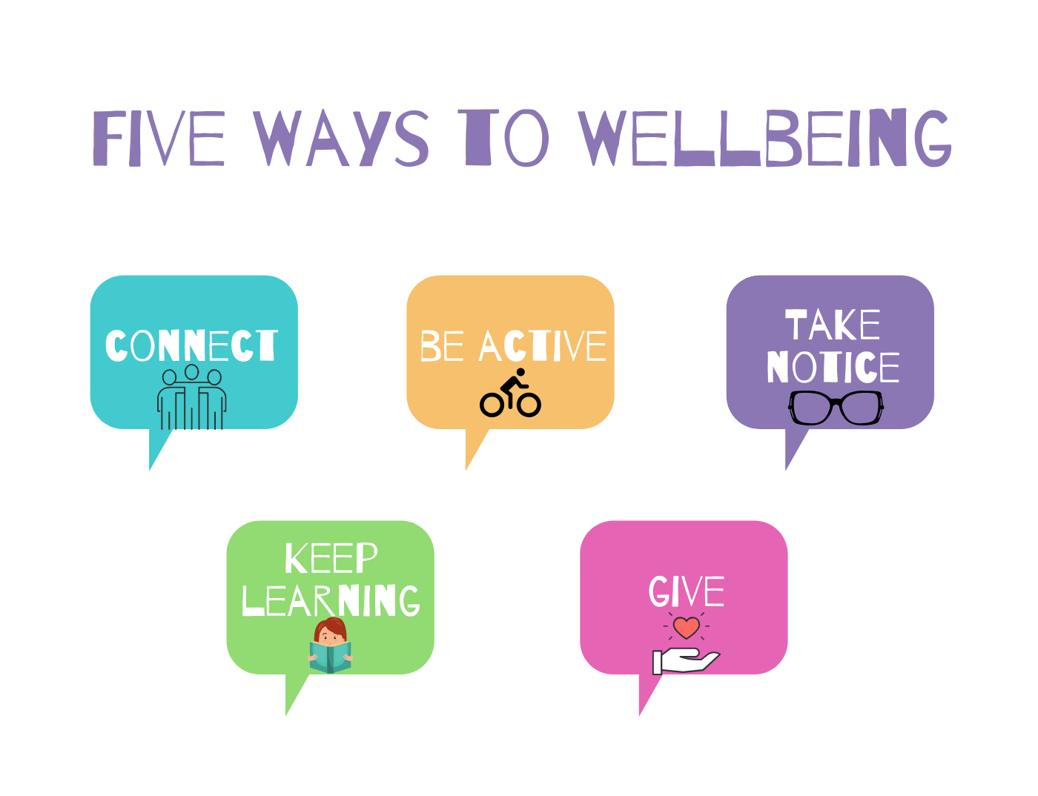
Working in partnership with:
Northumbria Healthcare NHS Foundation Trust
Cumbria, Northumberland, Tyne and Wear NHS Foundation Trust

