Slide 1
Exam Stress
Working in partnership with:
Northumbria Healthcare NHS Foundation Trust
Cumbria, Northumberland, Tyne and Wear NHS Foundation Trust
Notes:
Welcome.
Today we will be thinking and talking about Exam Stress.
What it is, how it affects us and how we can plan and prepare for it.
My Wellness Action Plan
Everyone should have their own copy of a Wellness Action Plan to fill in as we go through the presentation.
I will guide you through this as we go, and hopefully by the end of the presentation, you will have a personal Action Plan to help you identify, plan and monitor how exam stress might be affecting you, with tips and strategies on how to manage it that you know will work for you.

Slide 2
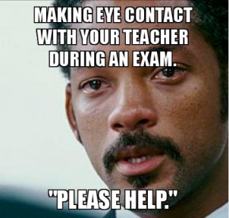
Exam Stress is Normal
Working in partnership with:
Northumbria Healthcare NHS Foundation Trust
Cumbria, Northumberland, Tyne and Wear NHS Foundation Trust
Notes:
Anyone recognise themselves here?
Before we get begin today, we must acknowledge the fact that EXAM STRESS IS NORMAL.
It is completely normal – and HEALTHY – to feel a bit stressed leading up to, during and even after the exam period.
Feeling stressed shows that you care about the results and the outcomes.
Feeling stressed is a sign of Anxiety.
When we are anxious, our bodies go into ”fight or flight mode.”
Ask if the audience understand what is meant be ”fight or flight mode.” – Caveman & Sabretooth Tiger analogy.
Unfortunately, our bodies still work in the same way they did back then, and will often make us feel like we are in danger, when really we are not.

Slide 3
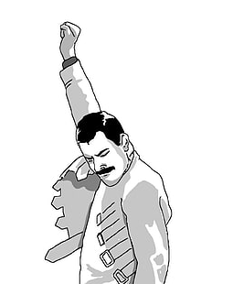
Under Pressure
Exam stress affects everyone differently.
Stress can be good sometimes, it can help you to work harder and focus.
But it can also have a big effect on you and make it hard to cope.
Working in partnership with:
Northumbria Healthcare NHS Foundation Trust
Cumbria, Northumberland, Tyne and Wear NHS Foundation Trust
Notes:
https://www.childline.org.uk/info-advice/school-college-and-work/school-college/exam-stress/
Exam stress affects everyone differently.
Stress can be good sometimes, it can help you to work harder and focus.
But it can also have a big effect on you and make it hard to cope

Slide 4
Exam Stress & Mental Health
How can you tell if Exam Stress is beginning to impact on your mental health?
Working in partnership with:
Northumbria Healthcare NHS Foundation Trust
Cumbria, Northumberland, Tyne and Wear NHS Foundation Trust
Notes:
https://www.childline.org.uk/info-advice/school-college-and-work/school-college/exam-stress/
How can you tell if Exam Stress is beginning to impact on your mental health?
We’re going to watch this video to hear about some real life experiences about exam stress and the impact that it can have on your mental health.
Seek feedback from the audience – any questions or comments?

Slide 5
Signs of Stress
Children & Young People who are stressed might:
worry a lot
feel tense
have headaches and stomach pains
not sleep well
be irritable
lose interest in food or eat more than normal
not enjoy activities you previously enjoyed
be negative and have a low mood
feel hopeless about the future
nail biting, skin picking, teeth grinding
feel short of breath or breathe very fast
Working in partnership with:
Northumbria Healthcare NHS Foundation Trust
Cumbria, Northumberland, Tyne and Wear NHS Foundation Trust
Notes:
Signs of Stress
How do you know if you’re stressed?
Let’s have a think about some of the signs of stress that you experience or that you or your parents, or even your teachers, may notice about your behaviour during stressful times, such as exam periods.
worry a lot
feel tense
have headaches and stomach pains
not sleep well
be irritable
lose interest in food or eat more than normal
not enjoy activities they previously enjoyed
be negative and have a low mood
feel hopeless about the future
nail biting, skin picking, teeth grinding
feel short of breath or breathe very fast
My Wellness Action Plan
Do any of these apply to you?
Are there any other signs of stress that you notice either in yourself?
If so, note them down on your Wellness Action Plan so you can begin to learn how to identify your own signs of stress.
The more aware we are of our signs of stress, the better we will be able to manage them.

Slide 6
Working in partnership with:
Northumbria Healthcare NHS Foundation Trust
Cumbria, Northumberland, Tyne and Wear NHS Foundation Trust
Notes:
https://www.childline.org.uk/info-advice/school-college-and-work/school-college/preparing-exams/
What could be causing you stress?
This short video will begin to introduce us to some basic tips that you can do to help manage your revision.
My Wellness Action Plan
Do any of these apply to you?
Are there any other triggers that you notice in yourself or in your life?
If so, note them down on your Wellness Action Plan so you can begin to learn how to identify your own stress triggers.
The more aware we are of our stress triggers, the better we will be able to plan and prepare for them.

Slide 7
Revision Tips
Make a realistic revision schedule.
Find a revision style that suits you.
Customise your notes to make them more personal.
Make sure you understand everything.
Look at past exam papers.
Take regular short breaks.
Reward yourself.
Do something physical.
Ask for help.
Working in partnership with:
Northumbria Healthcare NHS Foundation Trust
Cumbria, Northumberland, Tyne and Wear NHS Foundation Trust
Notes:
https://www.nhs.uk/conditions/stress-anxiety-depression/tips-on-surviving-exams/
How can we make revision feel a bit more manageable?
Make a realistic revision schedule. Work out how much you have to do and the time you have to do it in, then break it down into manageable chunks. Aim to do a few hours of revision each day, and mix up your subjects so you don't get bored.
Find a revision style that suits you. Studying alone in a quiet room suits some people, but not everyone likes working in silence. Try playing music quietly in the background, or revising with a friend (but don't let them distract you!).
Customise your notes to make them more personal. Experiment with colour coding, notes on postcards, diagrams or whatever helps you learn your topic.
Make sure you understand everything. If you come across something you don't understand, try to find a new source of information that will help you understand it. Just memorising it won't help you understand it for your exam. Don't be afraid to ask your teacher or a friend for help if you need it.
Look at past exam papers. It means you can familiarise yourself with the layout and type of questions you'll be asked. Practise completing exam papers in the set time limit to improve your exam technique.
Take regular short breaks. Studying for hours and hours will only make you tired and ruin your concentration, which may make you even more anxious. A break every 45 to 60 minutes is about right.
Reward yourself. For example, you could take a long bath or watch a good film once you have finished your revision session.
Do something physical. When you're not revising, use your spare time to get away from your books and do something active. Exercise is good for taking your mind off stress and keeping you positive, and it will help you sleep better.
Ask for help. If you're feeling stressed, it's important to talk to someone you trust, such as a family member, teacher or a friend. Lots of people find exams difficult to deal with, so don't be embarrassed to ask for support.

Slide 8
Coping Strategies
Two students are studying for an exam and both fear failure.
Student A copes by working harder, asking for help and letting off steam by playing tennis with friends.
Student B copes by avoiding work, denying that they are worried and letting off steam by drinking with friends.
What are the potential outcomes of these different coping strategies for both students?
Which method is likely to have the more positive outcome?
Working in partnership with:
Northumbria Healthcare NHS Foundation Trust
Cumbria, Northumberland, Tyne and Wear NHS Foundation Trust
Notes:
https://www.samaritans.org/how-we-can-help/schools/deal/deal-resources/coping-strategies/exam-stress-coping-strategies/
It’s helpful to start thinking about how you currently cope with stress/ pressure and exam stress in particular so that you can begin to prepare yourself and choose positive coping strategies that will benefit you.
Everyone copes in different ways and that’s OK – you just need to find a way that benefits you and your personality type – keeping in mind your future goals.
Let’s look at two different students’ way of coping with exam stress and then have a conversation about the positives and negatives of each.
Two students are studying for an exam and both fear failure.
Student A copes by working harder, asking for help and letting off steam by playing tennis with friends.
Student B copes by avoiding work, denying that they are worried and letting off steam by drinking with friends.
What are the potential outcomes of these different coping strategies for both students?
Which method is likely to have the more positive outcome?
So let’s now think about what coping strategies you all use and the positive and negative consequences of these.
**Each student gets a copy of the Coping Planner to complete and then discuss**
My Wellness Action Plan
Do any of these apply to you?
Are there any other coping strategies that you use either with exam stress or to manage other stresses in your life?
If so, note them down on your Wellness Action Plan so you can begin to learn how to identify your own helpful coping strategies. Idea’s that you have tried and tested.
The more aware we are of our helpful and unhelpful coping strategies, the better we will be able to put them in to practice.

Slide 9
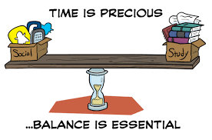
Relax
No matter how much work you have to do, it’s important to take regular breaks and find ways to relax.
Taking a break can leave you feeling more able to cope, and even make it easier to concentrate when you start working again.
Working in partnership with:
Northumbria Healthcare NHS Foundation Trust
Cumbria, Northumberland, Tyne and Wear NHS Foundation Trust
Notes:
https://www.childline.org.uk/info-advice/school-college-and-work/school-college/exam-stress/
No matter how much work you have to do, it’s important to take regular breaks and find ways to relax.
Taking a break can leave you feeling more able to cope, and even make it easier to concentrate when you start working again.
It’s all about balance!

Slide 10
Set a timer to take a 20 minute break every hour so you don’t forget.
Give yourself something to look forward to, like a treat or an activity you enjoy.
Plan when you’re going to start and finish your revision so you know when to stop.
Working in partnership with:
Northumbria Healthcare NHS Foundation Trust
Cumbria, Northumberland, Tyne and Wear NHS Foundation Trust
Notes:
How do you balance revision and relaxing?
There are lots of things you can do to take a break and relax:
Set a timer to take a 20 minute break every hour so you don’t forget.
Give yourself something to look forward to, like a treat or an activity you enjoy. Exercise is always a great option!
Plan when you’re going to start and finish your revision so you know when to stop.

Slide 11
Teen Tips
Working in partnership with:
Northumbria Healthcare NHS Foundation Trust
Cumbria, Northumberland, Tyne and Wear NHS Foundation Trust
Notes:
https://www.nhs.uk/conditions/stress-anxiety-depression/coping-with-exam-stress/

Slide 12
Helpful Tips for Parents
Make sure your child eats well
Help your child get enough sleep
Be flexible during exams
Help them study
Talk about exam nerves
Encourage exercise during exams
Do not add to the pressure
Make time for treats
Know when to get help
Working in partnership with:
Northumbria Healthcare NHS Foundation Trust
Cumbria, Northumberland, Tyne and Wear NHS Foundation Trust
Notes:
Make sure your child eats well
A balanced diet is vital for your child's health, and can help them feel well during exam periods.
Some parents find high-fat, high-sugar and high-caffeine foods and drinks, such as energy drinks, cola, sweets, chocolate, burgers and chips, make their children hyperactive, irritable and moody.
Where possible, involve your child in shopping for food and encourage them to choose some healthy snacks.
Help your child get enough sleep
Good sleep improves thinking and concentration. Most teenagers need 8 to 10 hours' sleep a night. Allow half an hour or so for your child to wind down between studying, watching TV or using a computer and going to bed, to help them get a good night's sleep.
Cramming all night before an exam is usually a bad idea. Sleep will benefit your child far more than a few hours of panicky last-minute study.
Be flexible during exams
Be flexible around exam time. When your child is revising all day, do not worry about household jobs left undone or untidy bedrooms.
Staying calm yourself can help. Remember, exams do not last forever.
Help them study
Make sure your child has somewhere comfortable to study. Ask them how you can support them with their revision.
Help them come up with practical ideas that will help them revise, such as drawing up a revision schedule or getting hold of past papers for practice.
To motivate your child, encourage them to think about their goals in life and see how their revision and exams are related to them.
Talk about exam nerves
Remind your child that it's normal to feel anxious. Nervousness is a natural reaction to exams. The key is to put these nerves to positive use.
If anxiety is getting in the way rather than helping, encourage your child to practise the activities they'll be doing on the day of the exam. This will help it feel less scary.
For example, this may involve doing practice papers under exam conditions or seeing the exam hall beforehand. School staff should be able to help with this.
Help your child face their fears and see these activities through, rather than avoiding them.
Encourage them to think about what they know and the time they've already put into studying to help them feel more confident.
Encourage exercise during exams
Exercise can help boost energy levels, clear the mind and relieve stress. It does not matter what it is – walking, cycling, swimming, football and dancing are all effective. Activities that involve other people can be particularly helpful.
Do not add to the pressure
Support group Childline says many children who contact them feel that most pressure at exam time comes from their family.
Listen to your child, give them support and avoid criticism.
Before they go in for a test or exam, be reassuring and positive. Let them know that failing is not the end of the world. If things do not go well they may be able to take the exam again.
After each exam, encourage your child to talk it through with you. Discuss the parts that went well rather than focusing on the questions they found difficult. Then move on and focus on the next test, rather than dwelling on things that cannot be changed.
Make time for treats
With your child, think about rewards for doing revision and getting through each exam.
Rewards do not need to be big or expensive. They can include simple things like making their favourite meal or watching TV.
When the exams are over, help your child celebrate by organising an end-of-exams treat.
When to get help
Some young people feel much better when exams are over, but that's not the case for all young people.
Get help if your child's anxiety or low mood is severe, persists and interferes with their everyday life. Seeing a GP is a good place to start.

Slide 13
Parents Helpline
Helping your child cope with exam stress
You’re not alone either!
Working in partnership with:
Northumbria Healthcare NHS Foundation Trust
Cumbria, Northumberland, Tyne and Wear NHS Foundation Trust
Notes:
https://youngminds.org.uk/find-help/for-parents/parents-guide-to-support-a-z/parents-guide-to-support-exam-time/
This video is taken from the Young Minds Parents Helpline, which is a great resource to provide you with support during exam time also.

Slide 14
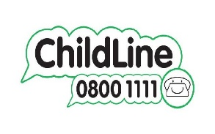
Mental Health Self-Help & Online Support
https://www.nhs.uk/conditions/stress-anxiety-depression/
https://www.mind.org.uk/information-support/for-children-and-young-people/
https://www.childline.org.uk/
https://www.kooth.com/
https://www.nhs.uk/oneyou/every-mind-matters/
Working in partnership with:
Northumbria Healthcare NHS Foundation Trust
Cumbria, Northumberland, Tyne and Wear NHS Foundation Trust
Notes:
Self-Help
We also wanted to point you in the direction of some age appropriate and professional online self-help support.
These websites have been verified by professionals and can provide children and young people with general mental health support in relation to lots of mental health issues.
They are all free and can provide you with advice, support and guidance on a number of issues that you might be facing right now.

Slide 15
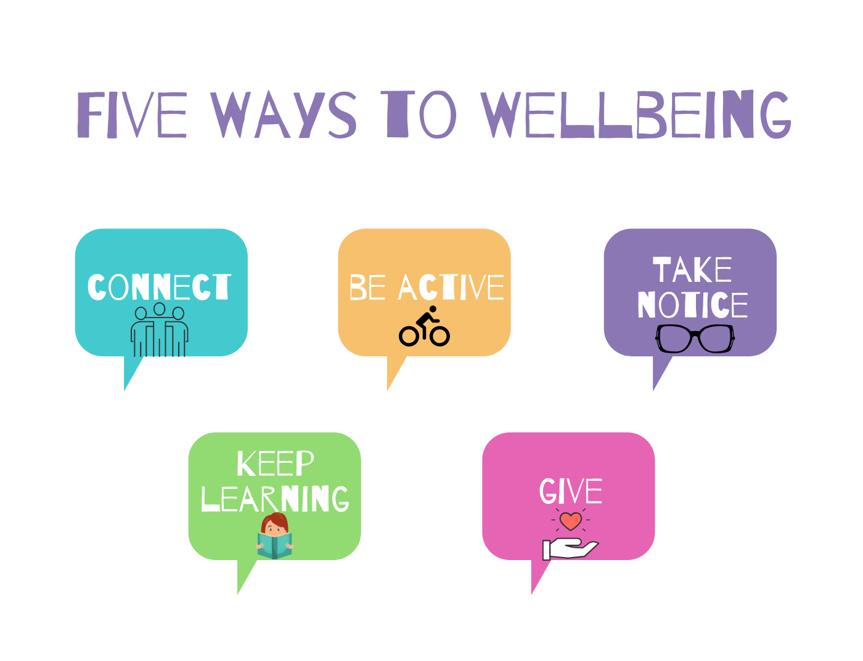
Working in partnership with:
Northumbria Healthcare NHS Foundation Trust
Cumbria, Northumberland, Tyne and Wear NHS Foundation Trust

Slide 16
References
https://www.nhs.uk/conditions/stress-anxiety-depression/coping-with-exam-stress/
https://www.familylives.org.uk/advice/teenagers/school-learning/exam-stress/
https://www.childline.org.uk/info-advice/school-college-and-work/school-college/exam-stress/
https://youngminds.org.uk/find-help/for-parents/parents-guide-to-support-a-z/parents-guide-to-support-exam-time/
https://www.samaritans.org/how-we-can-help/schools/deal/deal-resources/coping-strategies/exam-stress-coping-strategies/
Working in partnership with:
Northumbria Healthcare NHS Foundation Trust
Cumbria, Northumberland, Tyne and Wear NHS Foundation Trust

