Slide 1





Low mood
Working in partnership with:
Northumbria Healthcare NHS Foundation Trust
Cumbria, Northumberland, Tyne and Wear NHS Foundation Trust
Notes:
Introduce self and role/service
We all know the importance of looking after our bodies, our physical health- making sure we are fit and strong
But we also have mental health, which relates to our thoughts, feelings, mood and behaviour.
It is important to understand how to look after our mental health, in the same way we look after our physical health.
Today we are going to explore low mood.

Slide 2
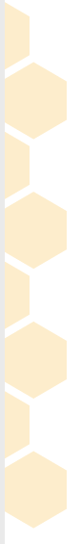

Aims/objectives
To understand and recognise:
What is low mood
How low mood can affect our children’s thoughts, feelings and behaviour.
How to improve/boost our children’s mood by using the ‘5 Ways to Wellbeing’.
Working in partnership with:
Northumbria Healthcare NHS Foundation Trust
Cumbria, Northumberland, Tyne and Wear NHS Foundation Trust
Notes:
Aims/objectives
To understand and recognise:
what low mood is
How low mood affects our child’s thoughts, feelings and behaviour
How to increase/boost our child’s mood by using different techniques and strategies.
Safe Space Ground Rules
During the session I will be asking you to reflect on your own emotions and experiences.
You will have the opportunity to share your thoughts, if you would like to.
It is important to listen when someone is sharing their thoughts and ideas.
We all have different thoughts and experiences – please respect each others.
Only share what you feel comfortable sharing.

Slide 3

What is low mood?
Low mood is an emotional state characterised by sadness, anxiety, low self-esteem, tiredness, and frustration. In its most severe form it becomes an ongoing problem that impacts your daily life
People experiencing low mood tend think negatively about themselves and withdraw from activities and social interaction.
Working in partnership with:
Northumbria Healthcare NHS Foundation Trust
Cumbria, Northumberland, Tyne and Wear NHS Foundation Trust
Notes:
What is low mood?
Ask the parents/carers first!
What words come to mind when you think of low mood?-Use these to create discussion
e.g. down, low, blue, down in the dumps, sad, tired, isolating/lonely
How we feel is always changing. Sometimes we are excited and happy; at other times, we feel sad, bored or stressed out. It’s perfectly normal to feel low, anxious or overwhelmed, especially when things are difficult.
Mostly these feelings will pass quite quickly, however sometimes they develop into more serious problems and begin to affect our children’s day to day lives.
With low mood, these feelings of sadness seem to continue for a longer period of time and often stop our children from enjoying the things they normally like to do.
Some people describe feeling low as ‘being under a dark heavy cloud’’

Slide 4

What can cause low mood?
Working in partnership with:
Northumbria Healthcare NHS Foundation Trust
Cumbria, Northumberland, Tyne and Wear NHS Foundation Trust
Notes:
Discussion- What can cause low mood?
We can feel low for a variety of reasons.
However low mood often follows difficult experiences
Ask the group to discuss events or situations which may contribute to a young person feeling low.
e.g. bullying, loss/bereavement, friendship difficulties, transitions/moving school, home, negative comments from others, not experiencing success.
BUT sometimes periods of low mood happen for no obvious reason.
Feedback to larger group

Slide 5
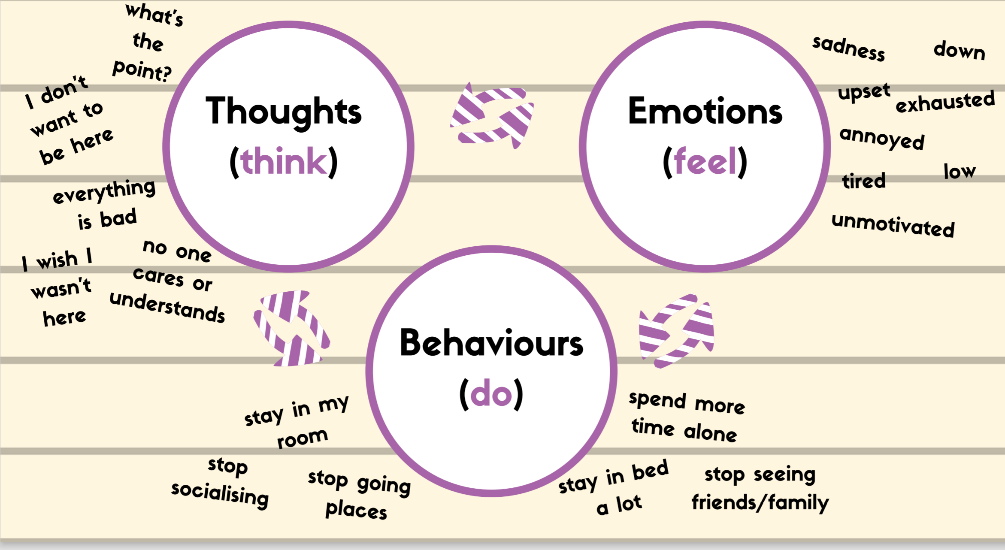
Thoughts, Emotions and Behaviours
Working in partnership with:
Northumbria Healthcare NHS Foundation Trust
Cumbria, Northumberland, Tyne and Wear NHS Foundation Trust
Notes:
Our thoughts, emotions, physical symptoms and behaviours are all connected and influence one another.
Low mood can affect the way a person feels, how they think and the things they do.
When feeling low, people may find themselves thinking negatively about themselves, perhaps thinking that other people do not like them. This can make them feel sad and tired. A common symptom of low mood is that people tend to withdraw or avoid certain activities or social interaction.
This avoidance can often make the person feel worse…. Causing them to withdraw or isolate themselves further.
We sometimes call this the vicious cycle of low mood.

Slide 6
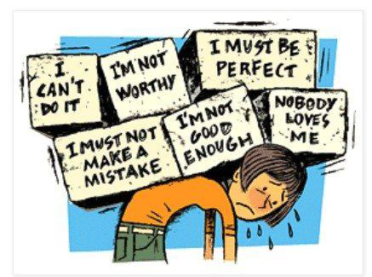
Signs of low mood
Thoughts
Working in partnership with:
Northumbria Healthcare NHS Foundation Trust
Cumbria, Northumberland, Tyne and Wear NHS Foundation Trust
https://bcove.video/2mmEsTx
Notes:
When a child or young person feels low, it is easy for them to fall into the trap of thinking negatively about themselves, others and the world around them, and this has a negative impact on their mood.
Someone who is feeling low may:
…Lose confidence in themselves (I cant do it, I’m rubbish, I’ll make a mistake, I’m not good enough, no-one likes me),
...Expect bad things to happen (they will laugh at me, I’m going to fail, everything is hopeless, nothing will ever change)
…think like they hate themselves (I’m useless/worthless, I’m a horrible person, what’s the point!)
These are really upsetting thoughts but are a very common symptom of low mood. These thoughts are not based on truth, but often feel believable at the time. We call these Negative Automatic Thoughts (NATs). Young people can dwell on these thoughts repeatedly, mulling over things, asking themselves why, or taking things personally,
Helping to normalise- Ask parents to share with a partner, if they have experienced any of these thoughts, how they had overcome them or how they could help someone experiencing these thoughts- presenter to model. ( could talk about child if it’s easier)
Please watch the video to see how some of these thoughts can be challenged.

Slide 7

Signs of low mood
Feelings/ emotions
Upset/tearful
Angry or Irritable
frustrated
Sad/ unhappy
Anxious/worried
Guilty/ worthless/ alone
Scared
Working in partnership with:
Northumbria Healthcare NHS Foundation Trust
Cumbria, Northumberland, Tyne and Wear NHS Foundation Trust
Notes:
It is important to be able to identify the signs and symptoms of low mood, in order to help our children affectively.
There are a number of symptoms of low mood and they affect everyone in different ways.
Not everyone will have the same experience.
low mood affects our feelings and emotions
When a person thinks negatively about themselves or others, it can often make them feel:
Sad/Low/Flat
Upset, Tearful,
Irritable,
Lonely/ worthless
Anxious/scared
Unmotivated- not wanting to do things
Guilty/ worthless.

Slide 8

Signs of low mood
Physical Symptoms
Crying or feel like crying
Can’t think straight/ confused
Agitated/bad tempered
Headaches
Always tired/
Little energy
Lump in throat
Heaviness
Tense muscles
Stomach Complaints
Loss of motivation
Working in partnership with:
Northumbria Healthcare NHS Foundation Trust
Cumbria, Northumberland, Tyne and Wear NHS Foundation Trust
Notes:
Low mood can also affect our bodies physically.
When someone is feeling happy they might smile, laugh, have energy, enthusiasm, feel relaxed etc.
When someone has low mood it may evoke feelings linked to anxiety
You may notice your child present with some of the following symptoms if they are feeling low:
Present with Stomach pains or butterflies
Always feeling tired or appear to have little energy or motivation
May appear tense, agitated or bad tempered
They may cry or have more difficulty managing their emotions.
You may notice them:
Weight gain or weight loss- due to a change in appetite.
These body clues arnt dangerous, it is just the natural way our body responds when feeling low or anxious. And when we see these in our child, its sign for us to gather thoughts, recognise feelings and decide how to respond.
Take a moment to think about your childs body clues, and how do they respond physically. It is important be able to recognise these signs.

Slide 9

Signs of low mood
What we do/behaviour
Appetite changes
Avoid seeing friends
Poor sleep
Stop doing things
Spending time alone
Poor concentration
Reduced social interaction
Working in partnership with:
Northumbria Healthcare NHS Foundation Trust
Cumbria, Northumberland, Tyne and Wear NHS Foundation Trust
Notes:
Behaviour
If we experience unhelpful thoughts and feelings, it can affect the way we behave.
So, a child/young person who is feeling low may:
Find it difficult to make decisions
Avoid seeing or communicating with friends/family
Lose interest in hobbies and activities they once enjoyed/ put things off
Avoid going to school
Stop going places- Isolate themselves- Spending more time alone/ in their bedroom/ become quiet- may find a place to go where no one will find them.
Have difficulty concentrating or remembering things
Have difficulty sleeping- Sleeping too much or too little. They may sleep more through the day feeling they don’t have much energy, negative thoughts could also stop you getting to sleep. Lack of sleep can have a massive effect on how a child manages their thoughts.
Anger outbursts

Slide 10
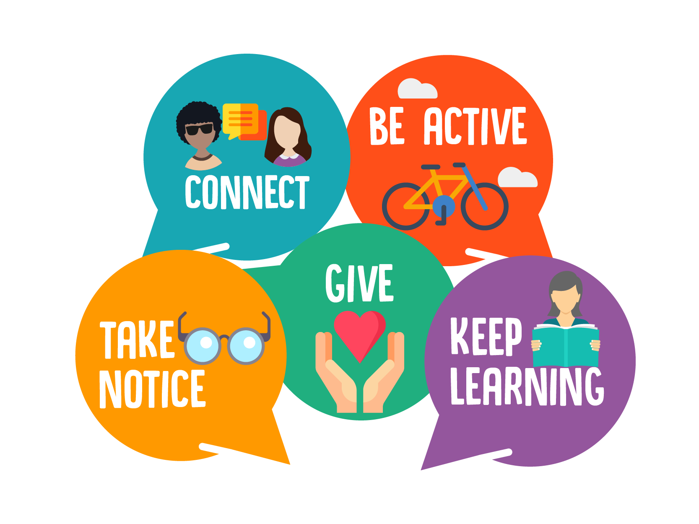
5 ways to wellbeing
Working in partnership with:
Northumbria Healthcare NHS Foundation Trust
Cumbria, Northumberland, Tyne and Wear NHS Foundation Trust
Notes:
We can improve our child’s mood using the 5 ways to wellbeing.
Everyone is individual and we all have different things that make us feel good, but researchers have recently come up with 5 ways to improve our mood and boost our emotional wellbeing that are proven to be affective.
To Connect
Be active
Take notice
Give and
Keep learning.
These 5 ways to well being are just as applicable to adults as they are to children and young people, so we can practice them and become role models for our children too.

Slide 11
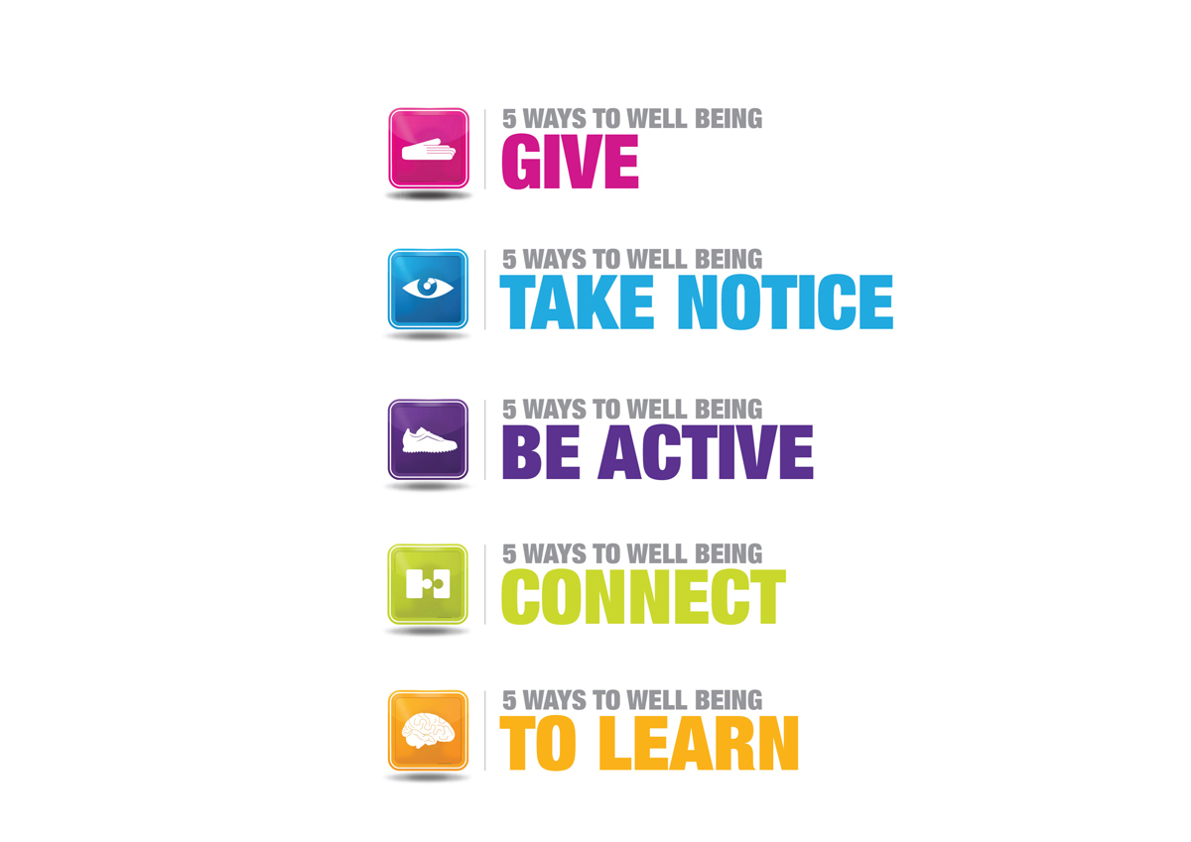

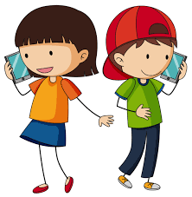

5 ways to wellbeing
Connect: Strengthening relationships with others and feeling close to and valued by others is critical to boosting wellbeing.
Working in partnership with:
Northumbria Healthcare NHS Foundation Trust
Cumbria, Northumberland, Tyne and Wear NHS Foundation Trust
Notes:
Okay, less look at each one individually.
Number 1: Connect
Good relationships are important for young peoples mental wellbeing. Healthy Relationships can:
help them to build a sense of belonging and self-worth
give them an opportunity to share positive experiences
provide emotional support and allow them to support others
Discussion- I want you to think how your young person connect with others. Maybe you could think of some examples where you can make this better for them? Stop the recording and write a few things down (give examples below if necessary)
Here are a few suggestions to help your child build stronger and closer relationships:
Spend time together as a family
Encourage them to talk/communicate with others- face to face, over the phone or online
Help or encourage them to arrange a day out with friends or invite a friend over
Join a club at school
Participate in activities that involve other families and give your child an opportunity to meet and connect with other children.
visit a friend or family member who needs support or company
Write a letter or thank you card to someone
Play a game
Activity- On 5 ways to wellbeing sheet, write down 5 ways you could suggest that your person do to connect with others this week.
If you want, you could also think about: Who could you connect with? What could you do?

Slide 12
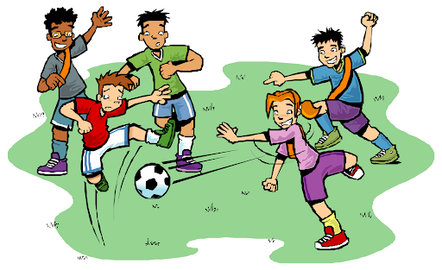

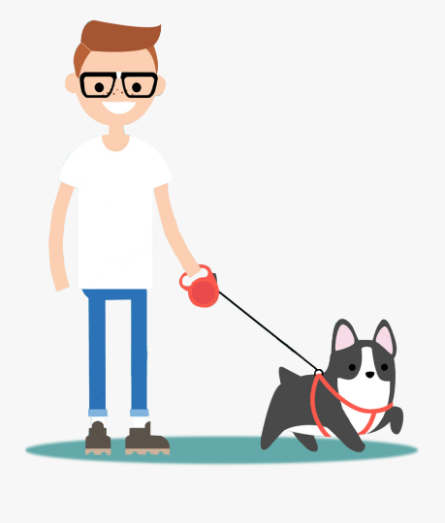

5 ways to wellbeing
Be Active: Being physically active, improves our physical health and can improve our mood and wellbeing.
Working in partnership with:
Northumbria Healthcare NHS Foundation Trust
Cumbria, Northumberland, Tyne and Wear NHS Foundation Trust
Notes:
2. Be Active
Increasing activity and exercise levels can boost a young persons mood significantly:
It can…
Make our child feel better about themselves/ more hopeful/positive
Improves their ability to think more clearly
Improve energy and motivation levels
Help our child/young person to think about something else – takes the focus off their unhelpful thoughts
Give a sense of achievement
Give a sense of enjoyment
Give them opportunities to socialise with others
Becoming more active will help your child to overcome low mood.
Encourage your child to complete activities which make them feel good, for example
Playing a sport with friends, walking the dog or dancing to their favourite song.
This helps to break low mood cycle.
Activity
When a child feels low in mood, it can be difficult to plan activities or know what to do to help themselves feel better. By creating a list of meaningful activities with your child , it is much easier to choose something to do and make a plan to do it. There are some ideas here which you might want to put on your list but the most important thing is that your list is THEIRS - it should be full of things that THEY enjoy doing.
Try to make sure the list has a good mixture of different activities (for example, make sure there's a mix of things you can do with others and things you can do alone, things you can do inside and things you can do outside, things that can be done easily and things that need more planning). This way, you will always have something you're able to do
Help your child to make a list of 5 activities that they enjoy or make them feel good.
Activity- On 5 ways to wellbeing sheet, write 5 ways your child could be active this week. (this would be a good talking point for you and your child - they may have quite different ideas)

Slide 13

5 ways to wellbeing
Take Notice: Paying more attention to the present moment, to thoughts and feelings and to the world around, boosts our wellbeing.
Working in partnership with:
Northumbria Healthcare NHS Foundation Trust
Cumbria, Northumberland, Tyne and Wear NHS Foundation Trust
Notes:
Take notice
Our own and children’s lives can be very busy… school, home, friends, homework, clubs etc. We often forget to notice our surroundings and reflect on the day and experiences.
This is about being mindful – appreciating what is around us and enjoying the moment.
Encourage your children to take a break from what they are doing, and just notice how they are feeling, to be aware of their surroundings. Being outdoors helps us to feel relaxed and grounded, being able to engage with our 5 senses.
In order to help your child take notice you could:
Ask them to reflect on what went well today.
Encourage them to relax and look around- maybe clouds moving across the sky, the noise of the wind in the trees, the feel of sunshine on your face.
Encourage them to take a few deep breaths – model it.
Go on a walk and notice the shades of green/blue around you
Draw a picture of something from their day
Read a book in the sunshine
Grounding exercise- We can encourage our young people to stay in the moment by using out 5 senses. A simple way to do this is by asking your child to:
5: Acknowledge FIVE things they see
4: Acknowledge FOUR things they can touch
3: Acknowledge THREE things they can hear
2: Acknowledge TWO things they can smell
1: Acknowledge ONE thing they can taste
Alternative activity- Mindful eating, Raisin exercise
Give each person a raisin- ask them to only look at it, noticing its shape, colour, lumps and bumps, how the light hits it (1-2 mins)
Ask them to roll the raisin in their hand , noticing the texture. Is it smooth/rough, how would they describe it (1 minute)
Ask them to then smell the raisin. Sweet or sour (30 seconds)
Place the raisin on their tongue (without eating it). Notice what it feels like? Hard, soft, round
slowly, take a bite into the raisin and notice the effects in your mouth. Notice any tastes that are released. Feel the texture as your teeth bite into the chewy raisin skin.
Notice how your tongue moves the raisin around your mouth. Raisin can be eaten or put in the bin.
How did that feel/feedback
This activity could be adapted for any type of food
Activity- On 5 ways to wellbeing sheet, write down 5 ways you could suggest that your person do to take notice this week.

Slide 14

5 ways to wellbeing
Give: Any acts of kindness, whether small or large can make you feel happier and more satisfied about life.
Working in partnership with:
Northumbria Healthcare NHS Foundation Trust
Cumbria, Northumberland, Tyne and Wear NHS Foundation Trust
Notes:
4. Giving
Any acts of kindness, whether small or large can make us feel happier and more satisfied about life. Encouraging your young person to ‘give’, can have a positive impact on how they see and value themselves, and how they continue to contribute to society as they grow and develop.
Discussion- What type of things could we encourage our children to do to give/be kind to others?
It doesn’t have to be a large gesture
Say thank you to someone who has helped you.
• Give unwanted items to a local charity shop
Give someone a compliment
• Donate your time to do something for someone else
• Offer to help your parents
• Bake a cake and give it to someone
• Do some volunteering
• Nominate someone for an award
• Give someone a hug
• Be a mentor for someone
• Raise money for charity
• Help an elderly neighbour
• Be a good role model
Fill in 5 ways to wellbeing sheet
Write down 5 things you could encourage your child to do to help others this week

Slide 15

5 ways to wellbeing
Keep Learning: Being curious and seeking out new experiences in life, positively stimulates the brain.
Working in partnership with:
Northumbria Healthcare NHS Foundation Trust
Cumbria, Northumberland, Tyne and Wear NHS Foundation Trust
Notes:
5. Keep learning
Research shows that learning new skills can also improve children’s mental health and emotional wellbeing by:
boosting self-confidence and self-esteem
Helping to build a sense of purpose
helping to connect with others
Even if your child or young person feels they do not have enough time, or may not need to learn new things, there are lots of different ways to bring learning into their lives.
Discussion- What simple things could young people do to increase their learning in a variety or areas?
Try something new
Learn a new skill/hobby
Be creative- start a project
Read something new
Complete a puzzle
Make a cake
Learn how to play a musical instrument
Join a club
Learn a new word
Learn how to draw
Research something they are interested in.
Learn something new about the people around you
Write a story
Visit a new place
The list is endless.
Activity- On 5 ways to wellbeing sheet, write down 5 ways you could suggest that your person do to learn something new this week.

Slide 16
Looking after your own mental health
As well as thinking about the children or young people in your care, it is important to take care of your own mental health and wellbeing.
Children and young people react, in part, to what they see from the adults around them.
When parents and caregivers deal with a situation calmly and confidently, they can provide the best support for their children and young people.
Seek support from friends, family and professionals.
Working in partnership with:
Northumbria Healthcare NHS Foundation Trust
Cumbria, Northumberland, Tyne and Wear NHS Foundation Trust
Notes:
As a parent our children always come first, but it is important to make sure that you don’t forget to look after yourself. If you don’t look after your health and wellbeing it can make it harder for you to support your children, especially if they are struggling with their mental health.
It’s important not to blame yourself if your child is having problems. It can be an incredibly distressing situation to be in, but it doesn’t
make you a bad parent.
For some people, talking to a friend or family member will help them to put the situation into perspective. For others, talking to people who have been through or are experiencing a similar thing proves beneficial as they can share their challenges and coping strategies.

Slide 17

Key Points
We all feel low from time to time- this is normal.
Low mood can affect our thoughts, feeling and actions.
Pay attention to their body signs and symptoms.
Mood can be increased by following the 5 Ways to Wellbeing.
Its alright to ask for help
Working in partnership with:
Northumbria Healthcare NHS Foundation Trust
Cumbria, Northumberland, Tyne and Wear NHS Foundation Trust
Notes:
We all experience low mood from time to time.
Low mood can affect the way we think, feel and what we do.
Live positively by using the 5 ways of wellbeing.
Possible home activity- Talk with your children about the 5 Ways to Wellbeing – they could draw their own 5 ways to wellbeing poster/ draw around their hand and include their planned activities for the week.

Slide 18





Low mood Online Support
https://www.nhs.uk/conditions/stress-anxiety-depression/ways-relieve-stress/
https://youngminds.org.uk/
https://www.childline.org.uk/
https://www.mind.org.uk/information-support/for-children-and-young-people/
https://www.kooth.com/
Working in partnership with:
Northumbria Healthcare NHS Foundation Trust
Cumbria, Northumberland, Tyne and Wear NHS Foundation Trust
Moodjuice. www.moodjuice.scot.nhs.uk/
Notes:
Online Support
There is an abundance of online support and guidance in relation to Low mood.
We only recommend using websites and apps that have been verified and deemed appropriate for children and young people by professionals.
So please explore, investigate and find techniques and practices that work for you and your family.
They are all free and can provide you and your child with advice, support and guidance on a number of issues that they might be facing right now.

Slide 19






Apps
Headspace (mindfulness)
Mindshift
Calm
Stop Breath Think
Thought diary
This app is supportive for family and friends of a young person who has mental ill health.

Slide 20
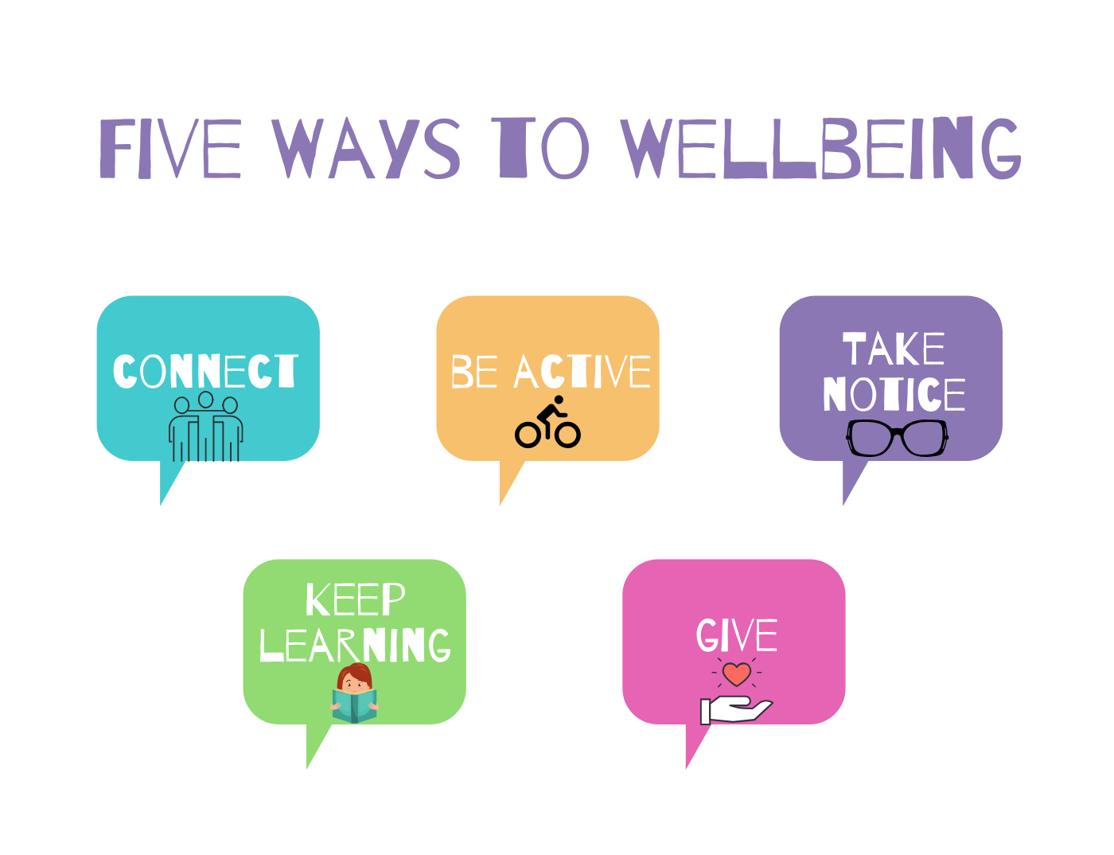
Thank You for Listening
Working in partnership with:
Northumbria Healthcare NHS Foundation Trust
Cumbria, Northumberland, Tyne and Wear NHS Foundation Trust

