Slide 1
Low mood
Working in partnership with:
Northumbria Healthcare NHS Foundation Trust
Cumbria, Northumberland, Tyne and Wear NHS Foundation Trust
Notes:
Introduce self and role/service
We all know the importance of looking after our bodies, our physical health- making sure we are fit and strong
But we also have mental health, which relates to our thoughts, feelings, mood and behaviour. It is important to understand how to look after our mental health, in the same way we look after our physical health.
Today we are going to talk about low mood.

Slide 2
Aims/objectives
To understand and recognise:
What low mood is
How low mood affects our thoughts, feelings and behaviour
How to increase our mood by using the 5 ways to wellbeing.
Working in partnership with:
Northumbria Healthcare NHS Foundation Trust
Cumbria, Northumberland, Tyne and Wear NHS Foundation Trust
Notes:
Aims/objectives
To understand and recognise:
what low mood is
How low mood affects our thoughts, feelings and behaviour
How to increase/boost our mood by using different techniques and strategies.

Slide 3
What is low mood?
Working in partnership with:
Northumbria Healthcare NHS Foundation Trust
Cumbria, Northumberland, Tyne and Wear NHS Foundation Trust
Notes:
What is low mood?
Ask the audience first!
What words come to mind when you think of low mood?-Use these to create discussion
e.g. down, low, blue, down in the dumps, sad, tired, isolating/lonely
How we feel is always changing, just as things around us are changing. Sometimes we are excited and happy; at other times, we feel sad, bored or stressed out. It’s perfectly normal to feel low, anxious or overwhelmed, especially when things are difficult. Mostly these feelings will pass quite quickly, however sometimes they develop into more serious problems and begin to affect our day to day lives.
With low mood, these feelings of sadness seem to continue for a longer period of time and often stops us from enjoying the things we normally like to do.
Some people describe feeling low as ‘being under a dark heavy cloud’’

Slide 4
Discussion
What can cause low mood?
Working in partnership with:
Northumbria Healthcare NHS Foundation Trust
Cumbria, Northumberland, Tyne and Wear NHS Foundation Trust
Notes:
Discussion- What can cause low mood?
We can feel low for a variety of reasons.
However low mood often follows difficult experiences
Ask the class/table groups to discuss events or situations which may contribute to someone feeling low.
e.g. Bullying, loss/bereavement, friendship difficulties, transitions/moving school, home
but sometimes periods of low mood happen for no obvious reason.
Feedback to larger group
If children struggle- give examples of things which make us feel happy e.g. laughing with out friends, winning an award etc.

Slide 5
Low mood can affect our:
Working in partnership with:
Northumbria Healthcare NHS Foundation Trust
Cumbria, Northumberland, Tyne and Wear NHS Foundation Trust
Notes:
When a person has Low Mood, it can affect:
The way they think about themselves and others,
the way they feel, emotionally and physically and
What they do and how they behave.
Our thoughts, feelings and behaviours are all connected.
Emphasise- Think, Feel, Do
We are going to look at these in a little more detail.

Slide 6
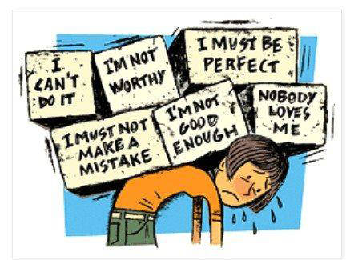
Signs of low mood
Thoughts
Working in partnership with:
Northumbria Healthcare NHS Foundation Trust
Cumbria, Northumberland, Tyne and Wear NHS Foundation Trust
Notes:
When we feel low, it is easy for us to fall into the trap of thinking negatively about ourselves, others and the word around us, and this has a negative impact on our mood.
It is like we have an internal bully, telling us how awful we are, or as if we looking through a pair of gloomy spectacles.
Someone who is feeling low may:
Lose confidence in themselves (I cant do it, im rubbish, I’ll make a mistake, im not good enough, no-one likes me),
expect bad things to happen (they will laugh at me, im going to fail, everything is hopeless)
thinking you hate yourself (im useless/worthless, im a horrible person, whats the point!)
These are really upsetting thoughts but are a very common symptom of low mood. These thoughts are not based on truth, but often feel believable at the time. We call these Negative Automatic Thoughts (NATs). We can dwell on these thoughts repeatedly, mulling over things, asking ourselves why, thinking regretful things about the past, what we should or shouldn't have done.
Helping to normalise- Ask children to discuss with a partner, if they have experienced any of these thoughts, how they had overcome them or how they could help someone experiencing these thoughts- teacher to model.
Feedback to wider group

Slide 7
Signs of low mood
Feelings/ emotions
Sad/ unhappy
Less enjoyment
Working in partnership with:
Northumbria Healthcare NHS Foundation Trust
Cumbria, Northumberland, Tyne and Wear NHS Foundation Trust
Notes:
How low mood affects our feelings and emotions
The way we think about things, often affects the way we feel
Explain diagram and ask children for suggestions/group work.
If someone was having unhelpful thoughts e.g. im not good enough/no-one likes me, how do you think it would make them feel?
Can you think of any more?

Slide 8
Signs of low mood
Feelings/ emotions
Upset/tearful
Angry or Irritable
frustrated
Sad/ unhappy
Anxious/worried
Guilty/ worthless/ alone
Scared
Working in partnership with:
Northumbria Healthcare NHS Foundation Trust
Cumbria, Northumberland, Tyne and Wear NHS Foundation Trust
Notes:
How low mood affects our feelings?
When we think negatively about ourselves or others, it can often make us feel:
Sad/Low/Flat
Upset, Tearful,
Irritable,
Lonely/ worthless
Anxious/scared
Unmotivated- not wanting to do things
Guilty/ worthless.

Slide 9
Signs of low mood
Physical Symptoms
Crying or feel like crying
Can’t think straight/ confused
Agitated/bad tempered
Headaches
Always tired/
Little energy
Lump in throat
Heaviness
Tense muscles
Stomach Complaints
Loss of motivation
Working in partnership with:
Northumbria Healthcare NHS Foundation Trust
Cumbria, Northumberland, Tyne and Wear NHS Foundation Trust
Notes:
Low mood can also affect our bodies physically.
When someone is feeling happy they might smile, laugh, have energy, enthusiasm, feel relaxed etc.
When someone feels nervous they might have a sore stomach, feel sick, shake etc.
Discussion- how do you think someone might feel, if they are experiencing low mood?
Talk through diagram

Slide 10
Signs of low mood
What we do/behaviour
Appetite changes
Avoid seeing friends
Poor sleep
Stop doing things
Spending time alone
Poor concentration
Reduced social interaction
Working in partnership with:
Northumbria Healthcare NHS Foundation Trust
Cumbria, Northumberland, Tyne and Wear NHS Foundation Trust
Notes:
Behaviour
Because we experience unhelpful thoughts and feelings, it affects the way we behave.
Someone who is feeling low may:
Find it difficult to make decisions
Avoid seeing friends/family
Isolate themselves- Spending more time alone/ in their bedroom/ become quiet
Stop going places
Stop socialising/contacting friends
Lose interest in hobbies and activities they once enjoyed/ put things off
Have difficulty concentrating or remembering things
Have difficulty sleeping- Sleeping too much or too little. They may sleep more through the day feeling they don’t have much energy, negative thoughts could also stop you getting to sleep.
Anger outbursts
Avoid going to school

Slide 11
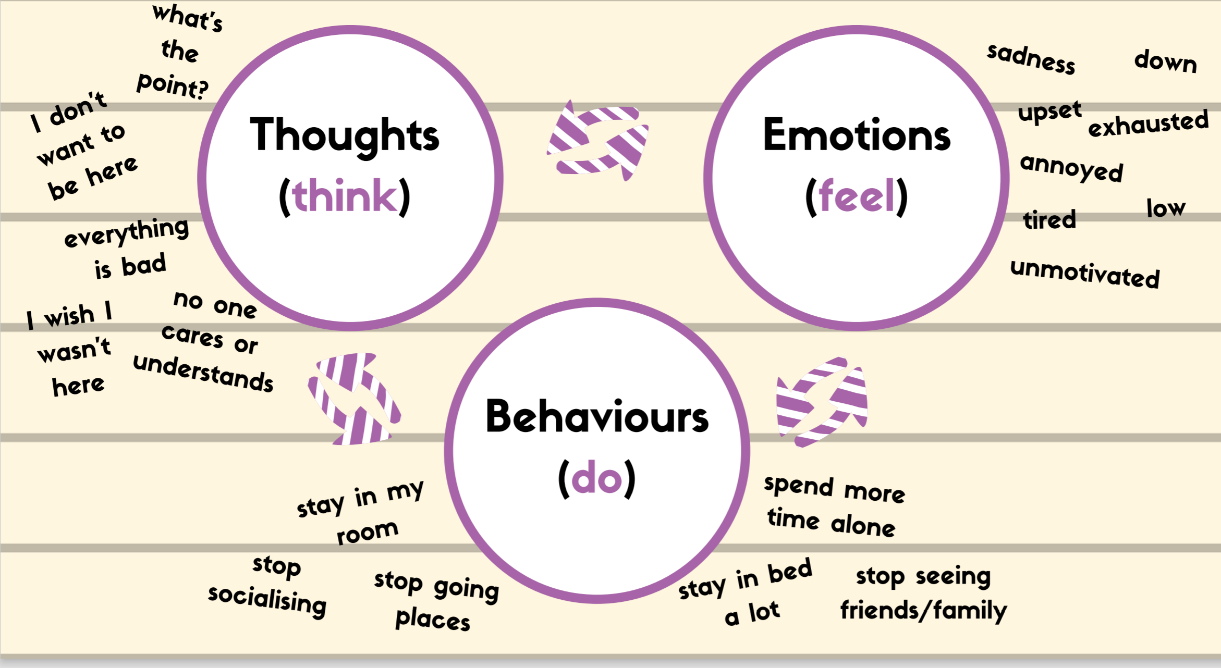
Working in partnership with:
Northumbria Healthcare NHS Foundation Trust
Cumbria, Northumberland, Tyne and Wear NHS Foundation Trust
Notes:
To summarise- our thoughts, feelings and behaviour are all connected- Talk through the diagram using the examples.
e.g. When we experience unhelpful thoughts such as… this can make us feel… because of this we may…which then increases our unhelpful thoughts and makes us feel low.
When this happens we tend to do less and less. We stop doing the things we used to do and enjoy. We might want to stay in bed, or stay at home doing very little. We might isolate ourselves from friends and family. The more we do this, the worse we might feel…. and the worse we feel, the less we do! We sometimes call this the vicious cycle of low mood.
However…

Slide 12
5 ways to wellbeing
Working in partnership with:
Northumbria Healthcare NHS Foundation Trust
Cumbria, Northumberland, Tyne and Wear NHS Foundation Trust
Notes:
We can improve our mood using the 5 ways to wellbeing.
Everyone is individual and we all have different things that make us feel good, but researchers have recently come up with 5 ways to improve our mood and boost our emotional wellbeing that have been shown to work.
Connect
Be active
Take notice
Give
Keep learning.

Slide 13
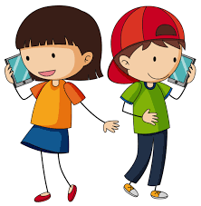
5 ways to wellbeing
Connect: Strengthening relationships with others and feeling close to and valued by others is critical to boosting wellbeing.
Working in partnership with:
Northumbria Healthcare NHS Foundation Trust
Cumbria, Northumberland, Tyne and Wear NHS Foundation Trust
Notes:
Connect
Good relationships are important for your mental wellbeing. They can:
help you to build a sense of belonging and self-worth
give you an opportunity to share positive experiences
provide emotional support and allow you to support others
Discussion- How could you connect with others? (give examples below if necessary)
There are lots of things you could try to help build stronger and closer relationships:
if possible, take time each day to be with your family
Talk to someone new
arrange a day out with friends
Join a club at school
have lunch with a friend
visit a friend or family member who needs support or company
Talk to someone on the phone/facetime
Connect with pets
Play with brothers/sisters
Write a letter to someone
Activity- On 5 ways to wellbeing sheet, write 5 ways you would/could connect with others this week.
Who would you connect with? What would you do?

Slide 14
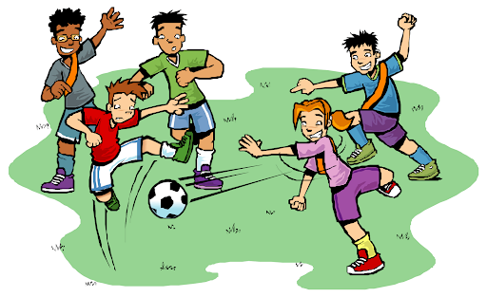
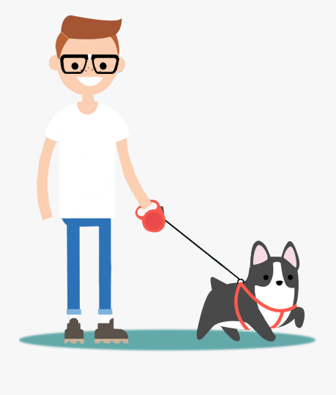
5 ways to wellbeing
Be Active: Being physically active, improves our physical health and can improve our mood and wellbeing.
Working in partnership with:
Northumbria Healthcare NHS Foundation Trust
Cumbria, Northumberland, Tyne and Wear NHS Foundation Trust
Notes:
Be Active
Increasing our activity and exercise levels can make an enormous impact on our mood:
Makes us feel better about ourselves/ more hopeful/positive
improves our ability to think more clearly
Greater energy and motivation
Helping us think about something other than focussing on our unhelpful thoughts
Giving us a sense of achievement
Enjoyment
Socialise with others
Becoming more active will help to overcome low mood because, when you do something you enjoy, you feel happier and more positive about life and the world! Doing more meaningful things, make you feel better! This helps to break the cycle of low mood.
Activity
When we feel low in mood, it can be difficult to plan activities or know what we can do to help us feel better. By creating a list of meaningful activities, it is much easier to choose something to do and make a plan to do it. There are some ideas here which you might want to put on your list but the most important thing is that your list is YOURS - it should be full of things that YOU enjoy doing.
Try to make sure your list has a good mixture of different activities (for example, make sure there's a mix of things you can do with others and things you can do alone, things you can do inside and things you can do outside, things that can be done easily and things that need more planning). This way, you will always have something you're able to do
Make a list of 5 activities that you enjoy or make you feel good!
Dance to your favourite song
Listen to music
Walk the dog
Cycle
Play a sport with friends
Join a club
Run in the playground
gardening
Activity- On 5 ways to wellbeing sheet, write 5 ways you could be active this week.

Slide 15
5 ways to wellbeing
Take Notice: Paying more attention to the present moment, to thoughts and feelings and to the world around, boosts our wellbeing.
Working in partnership with:
Northumbria Healthcare NHS Foundation Trust
Cumbria, Northumberland, Tyne and Wear NHS Foundation Trust
Notes:
Take notice
Our lives can be very busy… school, home, friends, homework, clubs etc. .we often forget to notice our surroundings and reflect on the day and experiences. This is about being mindful – appreciating what is around us and enjoying the moment.
In order to take notice you could:
Reﬂect on how you feel and what went well that day.
notice how your friends or family are feeling today
Relax and look around you- maybe clouds moving across the sky
listen to music or the sound outside.
take a few deep breaths.
paint or draw a picture of what you've seen today
Reading a book in the sunshine
Grounding exercise- We can stay in the moment by using out 5 senses
Children can work in pairs or individually.
Encourage them to control their breathing, slowly and deeply
Then ask them to:
5: Acknowledge FIVE things you see around you.
4: Acknowledge FOUR things you can touch around you
3: Acknowledge THREE things you hear.
2: Acknowledge TWO things you can smell.
1: Acknowledge ONE thing you can taste.
Alternative activity- Mindful eating, Raisin exercise
Give each person a raisin- ask them to only look at it, noticing its shape, colour, lumps and bumps, how the light hits it (1-2 mins)
Ask them to roll the raisin in their hand , noticing the texture. Is it smooth/rough, how would they describe it (1 minute)
Ask them to then smell the raisin. Sweet or sour (30 seconds)
Place the raisin on their tongue (without eating it). Notice what it feels like? Hard, soft, round
slowly, take a bite into the raisin and notice the effects in your mouth. Notice any tastes that are released. Feel the texture as your teeth bite into the chewy raisin skin.
Notice how your tongue moves the raisin around your mouth. Raisin and be eaten or put in the bin.
How did that feel/feedback

Slide 16
5 ways to wellbeing
Give: Any acts of kindness, whether small or large can make you feel happier and more satisfied about life.
Working in partnership with:
Northumbria Healthcare NHS Foundation Trust
Cumbria, Northumberland, Tyne and Wear NHS Foundation Trust
Notes:
Giving
Any acts of kindness, whether small or large can make you feel happier and more satisfied about life.
Discussion- What type of things could someone do to give/be kind to others?
Say thank you to someone who has helped you.
• Give unwanted items to a local charity shop
Give someone a compliment
• Donate your time to do something for someone else
• Offer to help your parents
• Bake a cake and give it to someone
• Do some volunteering
• Nominate someone for an award
• Give someone a hug
• Be a mentor for someone
• Raise money for charity
• Help an elderly neighbour
• Be a good role model
Fill in 5 ways to wellbeing sheet
Write down 5 things you could do to help others this week

Slide 17
5 ways to wellbeing
Keep Learning: Being curious and seeking out new experiences in life, positively stimulates the brain.
Working in partnership with:
Northumbria Healthcare NHS Foundation Trust
Cumbria, Northumberland, Tyne and Wear NHS Foundation Trust
Notes:
Keep learning
Research shows that learning new skills can also improve your mental wellbeing by:
boosting self-confidence and self-esteem
helping you to build a sense of purpose
helping you to connect with others
Even if you feel like you do not have enough time, or you may not need to learn new things, there are lots of different ways to bring learning into your life.
Discussion- ask the class, what they/someone could do to increase their learning- provide examples
Try something new
Learn a new skill/hobby
Be creative- start a project
Read something new
Complete a puzzle
Make a cake
Learn how to play a musical instrument
Join a club
Learn a new word
Learn how to draw
Research something they are interested in.
Learn something new about the people around you
Write a story
Visit a new place
Talk about their interests with a partner.
Complete Learn section on 5 ways to Wellbeing sheet- what 5 activities could they could do this week to boost their learning

Slide 18
Key points to remember:
We all feel low from time to time- this is normal.
Low mood can affect the way we think, feel and act.
We can improve our mood by following the 5 ways to positive wellbeing.
If you are struggling with low mood, it is important to talk to someone.
Working in partnership with:
Northumbria Healthcare NHS Foundation Trust
Cumbria, Northumberland, Tyne and Wear NHS Foundation Trust
Notes:
We all experience low mood from time to time.
Low mood can affect the way we think, feel and what we do.
Live positively by using the 5 ways of wellbeing.
Possible extension activity- Children could draw their own 5 ways to wellbeing poster/ draw around their hand and include their planned activities
If you feel low it is important to talk to someone, who will be able to support you. At school…

Slide 19
Low mood Online Support
https://www.nhs.uk/conditions/stress-anxiety-depression/ways-relieve-stress/
https://youngminds.org.uk/
https://www.childline.org.uk/
https://www.mind.org.uk/information-support/for-children-and-young-people/
https://www.kooth.com/
Working in partnership with:
Northumbria Healthcare NHS Foundation Trust
Cumbria, Northumberland, Tyne and Wear NHS Foundation Trust
Moodjuice. www.moodjuice.scot.nhs.uk/
Notes:
Online Support
There is an abundance of online support and guidance in relation to Low mood.
We only recommend using websites and apps that have been verified and deemed appropriate for children and young people by professionals.
So please explore, investigate and find techniques and practices that work for you – just be careful.
They are all free and can provide you with advice, support and guidance on a number of issues that you might be facing right now.

Slide 20
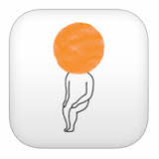
Apps
Headspace (mindfulness)
Mindshift
Calm
Stop Breath Think
Thought diary
This app is supportive for family and friends of a young person who has mental ill health.

Slide 21
THANK YOU
for listening and taking part
Working in partnership with:
Northumbria Healthcare NHS Foundation Trust
Cumbria, Northumberland, Tyne and Wear NHS Foundation Trust

