Slide 1


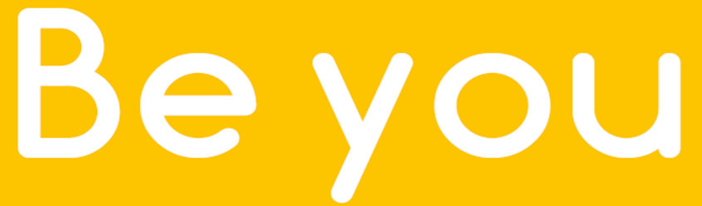
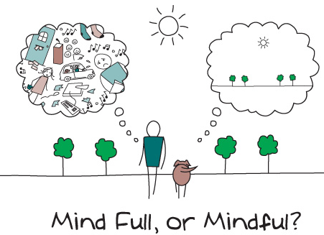


Mindful Breathing
Working in partnership with:
Northumbria Healthcare NHS Foundation Trust
Cumbria, Northumberland, Tyne and Wear NHS Foundation Trust
Notes:
Thank You for joining us today.
Introduce facilitators.
Today’s workshop if focussed around ‘Mindful breathing’ and how we can use different breathing techniques and exercises to help reduce the physical and emotional symptoms associated with anxiety and stress.
Our aim today is for you all to learn some new positive coping strategies to use within your daily routines, either yourself, or with your child/family.

Slide 2
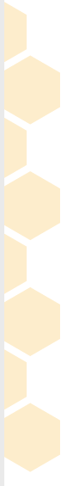


Working in partnership with:
Northumbria Healthcare NHS Foundation Trust
Cumbria, Northumberland, Tyne and Wear NHS Foundation Trust
Notes:
https://www.youtube.com/watch?v=cEqZthCaMpo
Before we begin to think about what Mindful Breathing is and why we practice it – let’s start the workshop off by all engaging in this 1-minute deep breathing exercise to quiet our minds, focus our attention and introduce us to what it feels like to practice Mindful Breathing.
This video was taken from the ‘Headspace’ website. Headspace is an NHS recommended website/ app containing guided meditations, animations, articles and videos to help and improve peoples health and happiness.
What was it like for you?
What did you notice?
Was it easy/difficult?
When was the last time you took some time to do this?
We all have busy lives and things move quickly. As we are always on the move, we tend to neglect our surroundings and focus on other things/tasks/worries- often completing tasks on ‘auto pilot’. Mindfulness is the opposite of this.

Slide 3
When we are anxious, emotional, angry or worried our bodies go into ”fight or flight mode.”
We think we are in danger when really we are not.
When this happens our breathing changes.
We take shallow, short and quick breaths.
This can make us feel more anxious or stressed.
When we go into “fight or flight” mode, our body sends more oxygen out to our arms and legs to prepare us either to fight against threats or run away from them (flight.)
But when this happens, we tense up and less oxygen gets to our brains. And this makes it difficult for us to think clearly.
So here’s the thing:
We need to get more oxygen back to our brain.
But how can we do that?
Working in partnership with:
Northumbria Healthcare NHS Foundation Trust
Cumbria, Northumberland, Tyne and Wear NHS Foundation Trust
Notes:
The THEORY is…
When we are anxious, emotional, angry or worried our bodies go into ”fight or flight mode.”
Ask if the audience understand what is meant be ”fight or flight mode.” – Caveman & Sabretooth Tiger analogy- A survival mechanism which developed millions of years ago which our body uses to protect us from danger.
Unfortunately, our bodies still work in the same way they did back then, and will often make us feel like we are in danger, when really we are not.
When this happens, we often experience a number of different uncomfortable physical symptoms,
Including changes to our breathing.
We tend to take shallow, short and quick breaths.
This can make us feel more anxious or stressed.
When we go into “fight or flight” mode, our body sends more oxygen out to our arms and legs to prepare us either to fight against threats or run away from them (flight.)
But when this happens, we tense up and less oxygen gets to our brains. And this makes it difficult for us to think clearly.
So here’s the thing:
We need to get more oxygen back to our brain.
But how can we do that?

Slide 4
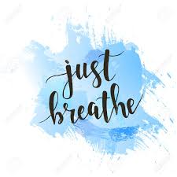
Working in partnership with:
Northumbria Healthcare NHS Foundation Trust
Cumbria, Northumberland, Tyne and Wear NHS Foundation Trust
Notes:
By Breathing!
By Breathing Mindfully!
By Breathing Slowly!
By Breathing deeply!
By Just Breathing!

Slide 5
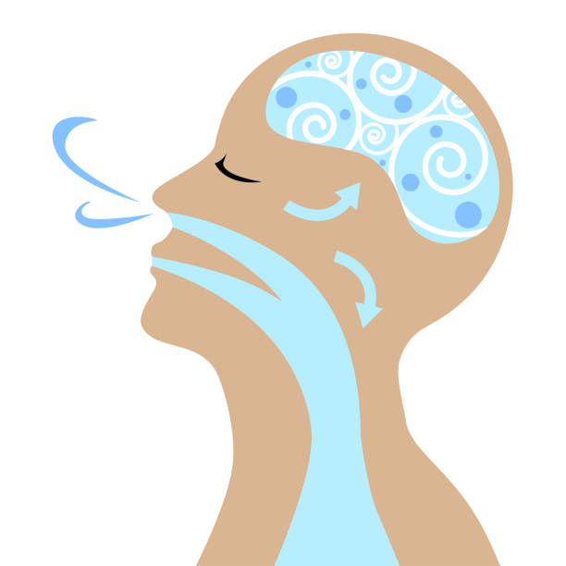
What is Mindful Breathing?
Mindful Breathing is a basic, yet powerful technique that helps you:
focus your attention on your breathing
develop a sense of calm and focus
bring awareness to your senses
Working in partnership with:
Northumbria Healthcare NHS Foundation Trust
Cumbria, Northumberland, Tyne and Wear NHS Foundation Trust
Notes:
So, WHAT is Mindful Breathing?
Mindful Breathing is a simple, yet powerful and effective technique that helps you to:
Focus your attention on your breathing.
Develop a sense of calm and focus.
And bring a greater awareness to your senses.
The idea that we can choose what to focus on, rather than passively allowing our attention to be dominated by the things which distresses us and takes us away from the present moment.
Mindful Breathing Exercises are:
Simple
Relativity short (2-3 minutes, while others take 30-60 minute)
can be used anywhere, at anytime.

Slide 6
Why should we practice Mindful Breathing?
A way to build resilience to:
Stress
Anxiety
Anger
Studies have shown that the ability to focus attention on your breath can actually help you deal with everyday stress, anxiety and emotional ups and downs.
Working in partnership with:
Northumbria Healthcare NHS Foundation Trust
Cumbria, Northumberland, Tyne and Wear NHS Foundation Trust
Notes:
WHY should we practice Mindful Breathing?
Mindful Breathing is used by lots of people as a technique to build resilience against:
Stress
Anxiety
Anger
Resilience is our ability to cope and bounce back following difficult or challenging times.
Studies have shown that the ability to focus attention on your breath can actually help you deal with everyday stress, anxiety and emotional ups and downs.
Remembering that ‘resilience’ is, according to the Oxford Dictionary: “the ability of people or things to feel better, quickly, after something unpleasant, such as shock, injury, etc.”
So with that in mind, Mindful Breathing aims to help people feel better, quicker, during and after experiencing unpleasant feelings or situations.
Research suggests that mindfulness helps to:
Improve our cognitive performance, engagement and reduce anxiety. Parts of the brain related to attention, sensory processing, emotion and stress regulation and empathy, are strengthened.
Decrease stress and increase emotional wellbeing
Respond to difficult situations in an appropriate way- Reducing aggressive and disruptive behaviour

Slide 7
Benefits of Mindful Breathing
Reduces stress and anxiety
Promotes happiness
Ignites peace and calmness
Lowers blood pressure and heart rate
Reduces tension in the body
Improves focus and concentration
Working in partnership with:
Northumbria Healthcare NHS Foundation Trust
Cumbria, Northumberland, Tyne and Wear NHS Foundation Trust
Notes:
What are the BENEFITS of Mindful Breathing?
Mindful breathing is seen to:
Reduce stress and anxiety
Promote happiness
Give a feeling of peace and calmness
Lower blood pressure and heart rate
Reduces tension in the body
And Improves our focus and concentration
These are just some benefits that people believe Mindful Breathing has.
It is important to remember, that Mindful Breathing will benefit different people in different ways.
For some, it may be just a really relaxing way to stop and take stock of your feelings and experience a few moments of peace and calm.
For others, it may be a therapeutic tool that becomes part of your daily routine, helping to reduce physical and emotional distress.
However Mindful Breathing benefits us, we must remind ourselves that it should feel natural, and aim to reduce our stress - not add to it.
Can help with sleep.

Slide 8
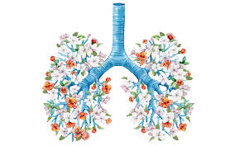
How do we practice Mindful Breathing?
The basic technique is to focus your attention on your breath
** the inhale and the exhale **
with openness and curiosity.
Reminding yourself to take notice of your thoughts, feelings and body sensations.
Working in partnership with:
Northumbria Healthcare NHS Foundation Trust
Cumbria, Northumberland, Tyne and Wear NHS Foundation Trust
Notes:
HOW do we practice Mindful Breathing?
The basics of Mindful Breathing is focussing on inhaling and exhaling. Something that most of us do naturally and without thinking too much about.
But Mindful Breathing encourages us to focus our attention on the breaths that we take.
When doing this, we should be in much more calm and relaxed state to begin recognising our feelings.
Feeling our breath enter the body through the nose and exit through the mouth
It’s normal that your thoughts will wander during mindfulness meditation. At times, it might
feel like a constant battle to maintain focus on your breathing. Don’t worry—that’s normal.
Whenever you become distracted, turn your focus back to breathing.
Notice the sensation of air as it passes through your nose or mouth, the rise and fall of your belly, and the feeling of air being exhaled, back into the world.
Notice the sounds that accompany each inhalation and exhalation.

Slide 9
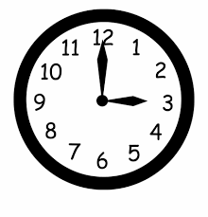
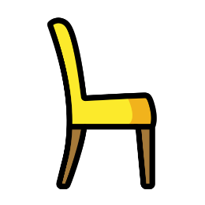
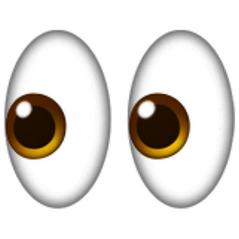

Where and When do we practice Mindful Breathing?
The beauty of mindful breathing is that you can practice it anywhere and anytime.
You can do this while standing, but ideally you’ll be sitting or even lying in a comfortable position.
Your eyes may be open or closed, but you may find it easier to maintain your focus if you close your eyes.
It can help to set aside a designated time for this exercise, but it can also help to practice it when you’re feeling particularly stressed or anxious.
Working in partnership with:
Northumbria Healthcare NHS Foundation Trust
Cumbria, Northumberland, Tyne and Wear NHS Foundation Trust
Notes:
WHERE and WHEN do we practice Mindful Breathing?

Slide 10
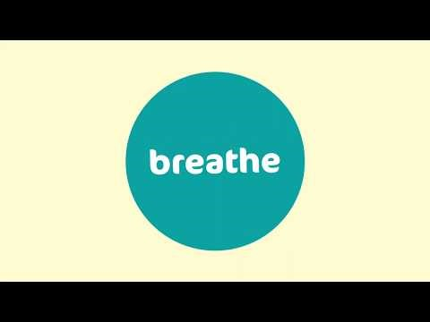
Every Mind Matters
Every Mind Matters has been created by Public Health England, with tips and advice developed with experts and approved by the NHS to help you manage and maintain your mental health.
Working in partnership with:
Northumbria Healthcare NHS Foundation Trust
Cumbria, Northumberland, Tyne and Wear NHS Foundation Trust
Notes:
https://www.youtube.com/watch?v=wfDTp2GogaQ&app=desktop

Slide 11
Let’s practice some Mindful Breathing techniques together
We want to give you the chance to practice a few Mindful Breathing techniques that you can do anywhere, anytime, without needing an audio or visual guide.
*If at any time you feel faint or light-headed, stop and return to normal steady breathing*
Working in partnership with:
Northumbria Healthcare NHS Foundation Trust
Cumbria, Northumberland, Tyne and Wear NHS Foundation Trust
Notes:
These are techniques that you could use at home yourself or with your children.
These can be used during times of stress/anxiety, or incorporated into a routine- e.g. bedtime routine.

Slide 12
Belly Breathing
Place one hand on your belly.
Inhale slowly for 4 seconds through the nose.
Pretend you are blowing up a balloon inside your belly.
You should be able to feel your belly inflate.
Pause for 2 seconds, and then slowly exhale through the mouth.
Pretend that you are emptying the balloon of air.
You should feel your belly deflate.
Pause for 2 seconds, and then repeat.
Working in partnership with:
Northumbria Healthcare NHS Foundation Trust
Cumbria, Northumberland, Tyne and Wear NHS Foundation Trust
Notes:
Belly Breathing
As babies, we used to breath with our bellies, more so than we do as teenagers or adults. If you ever see a baby lying on it’s back, you will notice as it breathes, it’s tummy will inflate and deflate with each breathe in and out.
We forget to do this as we grow up and it’s our chests that tend to inflate and deflate with each breath.
This technique encourages you to practice that deep belly breathing by pretending you’re inflating a balloon inside your belly so that you push out your abdomen.
This technique works great with younger children also. They can lie on the backs and choose a soft toy to place on their belly. As they inhale and exhale, they should be able to watch their soft toy rise and fall with each breath.

Slide 13
One Nostril Breathing
Place your thumb over one nostril, then breathe in deeply through your nose.
Hold for 3 seconds.
Switch your index finger to the other nostril and release your thumb as you breathe out through your nose.
Once you have exhaled slowly, breathe in again.
Hold for 3 seconds.
Switch your thumb to the other nostril and release your index finger as you breathe out through your nose.
Practice this exercise for no more than 2 minutes.
This is an ideal breathing exercise for when you are feeling angry, anxious or tense.
Working in partnership with:
Northumbria Healthcare NHS Foundation Trust
Cumbria, Northumberland, Tyne and Wear NHS Foundation Trust
Notes:
One Nostril Breathing
A simple technique that uses the thumb and index finger to block off one nostril at a time.
Due to only being able to breathe through one nostril, it decreases the amount of oxygen your body can take in at one time, therefore forcing you to take deeper, longer breaths.

Slide 14
Mountain Breathing
Inhale through your nose and raise your arms high above your head.
Bring your palms together above the top of your head.
Imagine you are as tall as a mountain.
Ground your feet into the floor. Imagine your feet like roots, you are strong, sturdy and tall.
Exhale through your mouth and bring your palms together in front of your chest.
Repeat this sequence 5 times.
Working in partnership with:
Northumbria Healthcare NHS Foundation Trust
Cumbria, Northumberland, Tyne and Wear NHS Foundation Trust
Notes:
Mountain Breathing
This exercise can be done sitting or standing but it does have the most impact if done standing up.
Place your feet shoulder width apart on the floor.

Slide 15
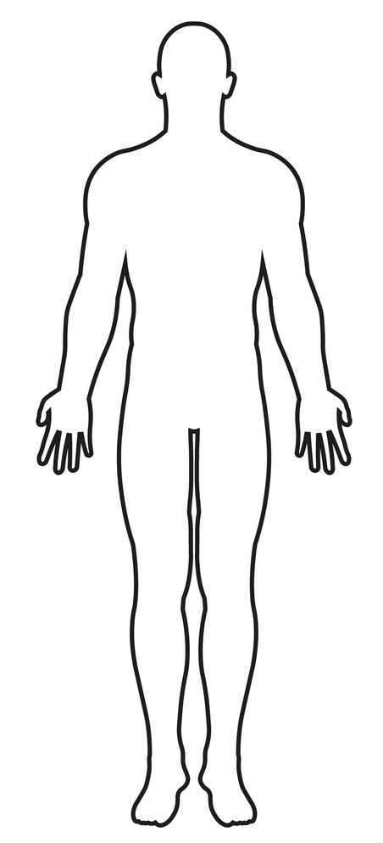


Colour breathing
Working in partnership with:
Northumbria Healthcare NHS Foundation Trust
Cumbria, Northumberland, Tyne and Wear NHS Foundation Trust
Notes:
5 minute breathing activity
Think of a relaxing/positive colour
Think of a colour that represents stress, sadness or anger- which ever applies to how you are feeling
Imaging breathing in the relaxing colour and visualise it filling your lungs
Then imagine breathing out the stress, sadness or anger colour
Colour breathing is a useful exercise to help us relax, and feel calmer. This is particularly helpful if we feel worried, angry or low.
Give it a go and see if its helpful for you.
Im going start by asking you to think of a negative colour or colour you don’t like- I often use black
Next I want you to think of a positive calming colour a colour you do like- I like to use the colour blue, but its entirely up to you which colours you want to use.
In a moment ill be asking you to take a deep breath in through your nose. I want you to hold it for 3-4 seconds and then breath out slowly through your mouth.
I want you to imagine that your negative colour is inside your body. Your negative colour is your worry or the thing which is bothering you. And when you breath out of your mouth you imagine the negative colour or worry, leaving your body
Sit back, close your eyes if you feel comfortable.
Now take a deep breath in through your nose. Imagine your calming colour filling your body.
Now breathe out through your mouth slowly..imagining your negative colour or worry leaving you
You can do this as many times as you need to.

Slide 16
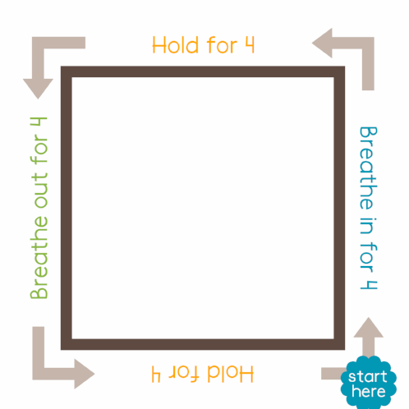
Square Breathing
Working in partnership with:
Northumbria Healthcare NHS Foundation Trust
Cumbria, Northumberland, Tyne and Wear NHS Foundation Trust
Notes:
Square breathing
•breathe in for four counts
•hold for four counts
•breathe out for four counts
•hold for four counts

Slide 17
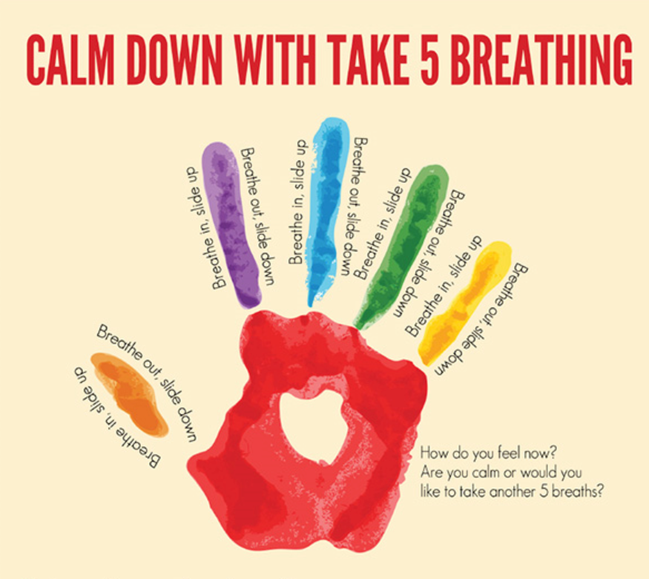
Five finger breathing
Working in partnership with:
Northumbria Healthcare NHS Foundation Trust
Cumbria, Northumberland, Tyne and Wear NHS Foundation Trust
Notes:
Describe and demonstrate exercise

Slide 18
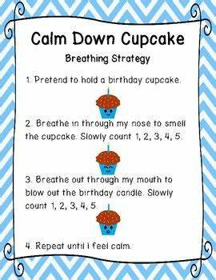
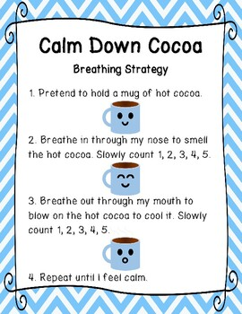
Cake Breathing
Working in partnership with:
Northumbria Healthcare NHS Foundation Trust
Cumbria, Northumberland, Tyne and Wear NHS Foundation Trust
Notes:
To end, I wanted to share a technique with you that is particularly useful and affective when working with younger children.
This is a fun and simple way to truly experience the power of deep breathing.
Ask the child or young person to imagine that it is their birthday and their favourite cake is in front of them with a candle on the top.
Using their senses and imagination, Ask them to smell the cake, through their nose, for a count of 5.
Then ask them to slowly breathe out, through their mouth, to blow out the candle. Do this for a count of 5.
Some for younger children may respond to:
smell the hot chocolate and cool it down.
Smell the cake and blow out the candles
Smelling a flower and blowing the leaf.

Slide 19
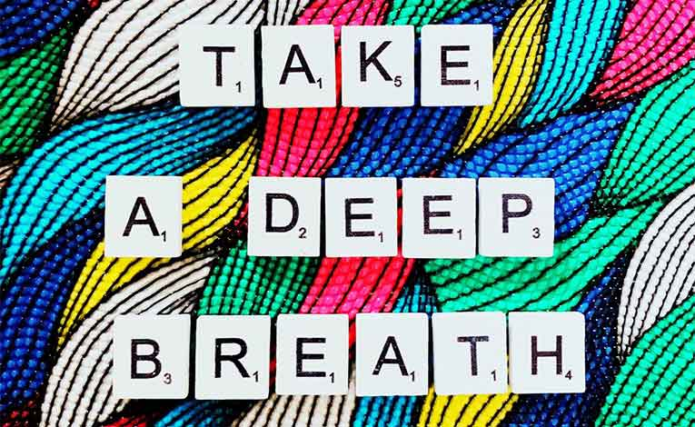
Key Points
Mindful breathing is a powerful technique, which can help us and our children to remain calm, relaxed and in the present moment
Focuses on our breathing and 5 senses.
Proven to reduce stress and anxiety.
Can be practiced anytime and anywhere.
There are hundreds of breathing exercises available. Find exercises which work for you and your family
Working in partnership with:
Northumbria Healthcare NHS Foundation Trust
Cumbria, Northumberland, Tyne and Wear NHS Foundation Trust
Notes:
We all experience low mood from time to time.
Low mood can affect the way we think, feel and what we do.
Live positively by using the 5 ways of wellbeing.
Possible home activity- Talk with your children about the 5 Ways to Wellbeing – they could draw their own 5 ways to wellbeing poster/ draw around their hand and include their planned activities for the week.

Slide 20


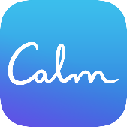
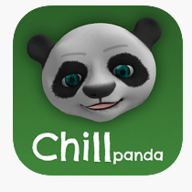

Mindful Breathing Online Support
https://www.nhs.uk/conditions/stress-anxiety-depression/ways-relieve-stress/
https://youngminds.org.uk/find-help/looking-after-yourself/take-time-out/
https://www.calm.com/breathe
https://www.nhs.uk/apps-library/chill-panda/
https://www.headspace.com/meditation/breathing-exercises
Working in partnership with:
Northumbria Healthcare NHS Foundation Trust
Cumbria, Northumberland, Tyne and Wear NHS Foundation Trust
Notes:
Online Support
There is an abundance of online support and guidance in relation to Mindful Breathing.
We only recommend using websites and apps that have been verified and deemed appropriate for children and young people by professionals.
So please explore, investigate and find techniques and practices that work for you – just be careful.
These are some of the NHS recommended apps and websites for Mindful Breathing.

Slide 21

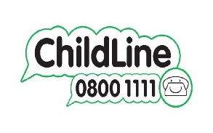


Mental Health Self-Help & Online Support
https://www.nhs.uk/conditions/stress-anxiety-depression/
https://www.mind.org.uk/information-support/for-children-and-young-people/
https://www.childline.org.uk/
https://www.kooth.com/
https://www.nhs.uk/oneyou/every-mind-matters/
Working in partnership with:
Northumbria Healthcare NHS Foundation Trust
Cumbria, Northumberland, Tyne and Wear NHS Foundation Trust
Notes:
Self-Help
We also wanted to point you in the direction of some age appropriate and professional online self-help support.
These websites have been verified by professionals and can provide children and young people with general mental health support in relation to lots of mental health issues.
They are all free and can provide you with advice, support and guidance on a number of issues that you might be facing right now.

Slide 22
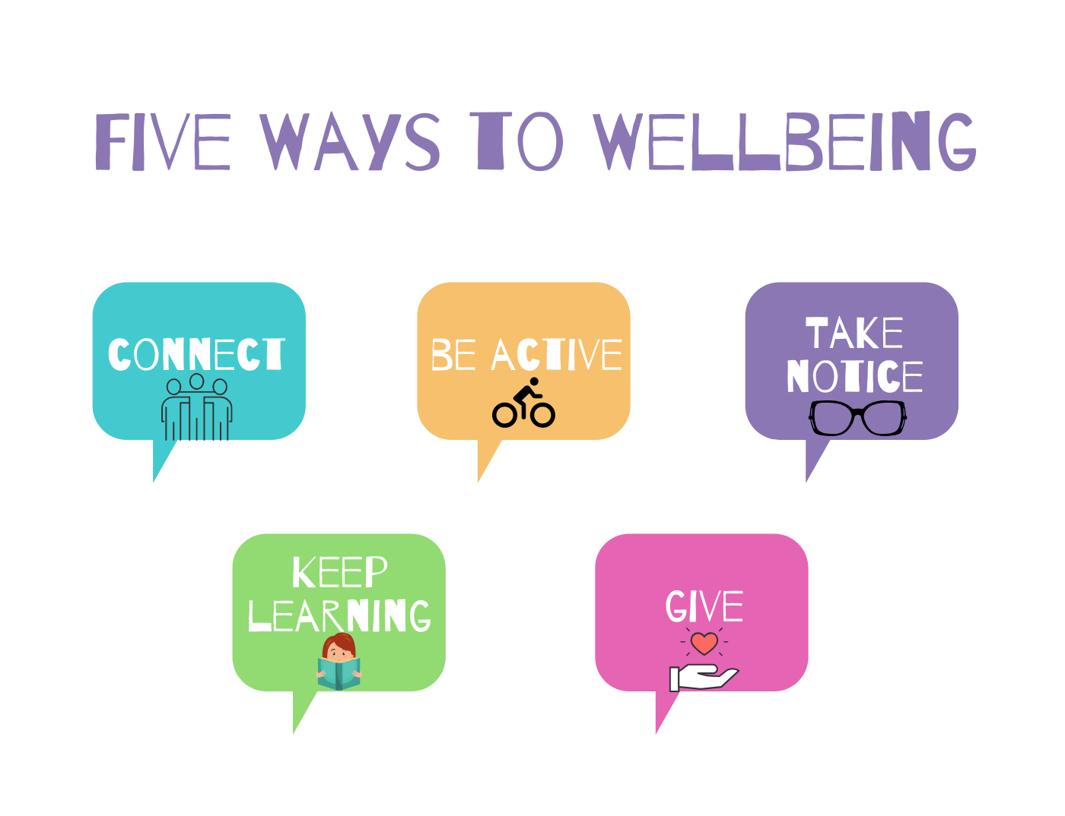
Thank You for Listening
Working in partnership with:
Northumbria Healthcare NHS Foundation Trust
Cumbria, Northumberland, Tyne and Wear NHS Foundation Trust

