Slide 1
Mindful
Breathing
Working in partnership with:
Northumbria Healthcare NHS Foundation Trust
Cumbria, Northumberland, Tyne and Wear NHS Foundation Trust
Notes:
Thank You for joining us today.
Introduce facilitators.
We are part of Northumberland’s Mental Health Support Team, which consists of professionals who work with children and young people across the NHS, Education and the County Council.
The Mental Health Support Team here in Northumberland is called the ‘Be You’ Team, the name of which was actually chosen by a student from a school in Blyth.
Today’s workshop if focussed around ‘Mindful Breathing’ and how we can use different breathing techniques to help reduce the physical and emotional symptoms associated with anxiety and stress.
Our aim today is for you all to learn some new positive coping strategies to use within your daily routines and hopefully continue exploring and experiencing the benefits of Mindful Breathing.

Slide 2
Working in partnership with:
Northumbria Healthcare NHS Foundation Trust
Cumbria, Northumberland, Tyne and Wear NHS Foundation Trust
Notes:
https://www.headspace.com/meditation/breathing-exercises
Before we begin to think about what Mindful Breathing is and why we practice it – let’s start the workshop off by all engaging in this 1-minute deep breathing exercise to quiet our minds, focus our attention and introduce us to what it feels like to practice Mindful Breathing.
This video was taken from the ‘Headspace’ website. Headspace is an NHS recommended website/ app containing guided meditations, animations, articles and videos to help and improve peoples health and happiness.
Seek feedback from audience on how they feel after the video.

Slide 3
When we are anxious, emotional, angry or worried our bodies go into ”fight or flight mode.”
We think we are in danger when really we are not.
When this happens our breathing changes.
We take shallow, short and quick breaths.
This can make us feel more anxious or stressed.
When we go into “fight or flight” mode, our body sends more oxygen out to our arms and legs to prepare us either to fight against threats or run away from them (flight.)
But when this happens, we tense up and less oxygen gets to our brains. And this makes it difficult for us to think clearly.
So here’s the thing:
We need to get more oxygen back to our brain.
But how can we do that?
Working in partnership with:
Northumbria Healthcare NHS Foundation Trust
Cumbria, Northumberland, Tyne and Wear NHS Foundation Trust
Notes:
The THEORY is…
When we are anxious, emotional, angry or worried our bodies go into ”fight or flight mode.”
Ask if the audience understand what is meant be ”fight or flight mode.” – Caveman & Sabretooth Tiger analogy.
Unfortunately, our bodies still work in the same way they did back then, and will often make us feel like we are in danger, when really we are not.
When this happens our breathing changes.
We take shallow, short and quick breaths.
This can make us feel more anxious or stressed.
When we go into “fight or flight” mode, our body sends more oxygen out to our arms and legs to prepare us either to fight against threats or run away from them (flight.)
But when this happens, we tense up and less oxygen gets to our brains. And this makes it difficult for us to think clearly.
So here’s the thing:
We need to get more oxygen back to our brain.
But how can we do that I hear you ask…?

Slide 4
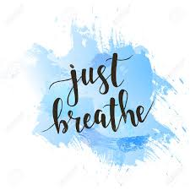
Working in partnership with:
Northumbria Healthcare NHS Foundation Trust
Cumbria, Northumberland, Tyne and Wear NHS Foundation Trust
Notes:
By Breathing!
By Breathing Mindfully!
By Breathing Slowly!
By Breathing Deeper!
By Just Breathing!

Slide 5
What is Mindful Breathing?
Mindful Breathing is a basic, yet powerful technique that helps you:
focus your attention on your breathing
develop a sense of calm and focus
bring awareness to your senses
Working in partnership with:
Northumbria Healthcare NHS Foundation Trust
Cumbria, Northumberland, Tyne and Wear NHS Foundation Trust
Notes:
So, WHAT is Mindful Breathing?
Mindful Breathing is a very basic and simple, yet very powerful and effective technique that helps you:
Focus your attention on your breathing.
Develop a sense of calm and focus in the moment.
Bring awareness to your senses. In particular:
Touch
Sound
Smell

Slide 6
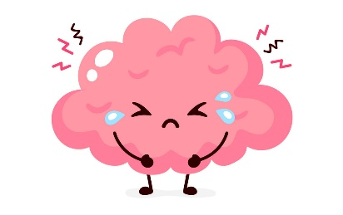
Why should we practice Mindful Breathing?
A way to build resilience to:
Stress
Anxiety
Anger
Studies have shown that the ability to focus attention on your breath can actually help you deal with everyday stress, anxiety and emotional ups and downs
Working in partnership with:
Northumbria Healthcare NHS Foundation Trust
Cumbria, Northumberland, Tyne and Wear NHS Foundation Trust
Notes:
WHY should we practice Mindful Breathing?
Mindful Breathing is used by lots of people as a technique to build resilience against:
Stress
Anxiety
Anger
Remembering that ‘resilience’ is, according to the Oxford Dictionary: “the ability of people or things to feel better, quickly, after something unpleasant, such as shock, injury, etc.”
So with that in mind, Mindful Breathing aims to help people feel better, quicker, during and after experiencing unpleasant feelings or situations.

Slide 7
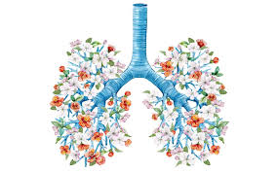
How do we practice Mindful Breathing?
The basic technique is to focus your attention on your breath
** the inhale and the exhale **
with openness and curiosity.
Reminding yourself to take notice of your thoughts, feelings and body sensations.
Working in partnership with:
Northumbria Healthcare NHS Foundation Trust
Cumbria, Northumberland, Tyne and Wear NHS Foundation Trust
Notes:
HOW do we practice Mindful Breathing?
The absolute basics of Mindful Breathing is focussing on inhaling and exhaling. Something that most of us do naturally and without thinking too much about.
But Mindful Breathing encourages us to focus our attention on the breaths that we take.
When doing this, we should be in much more calm and relaxed state to begin recognising our feelings.

Slide 8
https://ee494c7bcaebc61df9a5-e19ab9a66520ad61c29310eafb66e6e6.ssl.cf3.rackcdn.com/content/uploads/2017/06/M_04_Mindful-Breathing.mp3
Working in partnership with:
Northumbria Healthcare NHS Foundation Trust
Cumbria, Northumberland, Tyne and Wear NHS Foundation Trust
Notes:
CNTW – Relaxation techniques - https://www.cntw.nhs.uk/resource-library/relaxation-techniques/
Let’s have another go at a Mindful Breathing exercise together.
This audio clip is voiced by a male. It is important to find a voice that feels relaxing and comforting to listen to. Especially when you are at just learning about and beginning to practice Mindful Breathing.
If you find Mindful Breathing helpful and practice it regularly, you may find that you do not need to use audio/ video guides as much.
Seek feedback on the audio clip from the audience. How did it compare to the first video clip? How do you feel?

Slide 9
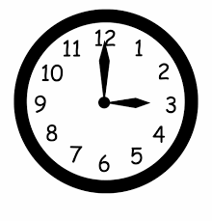
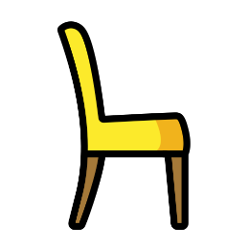
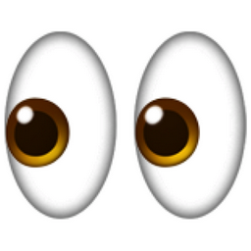
Where and When do we practice Mindful Breathing?
The beauty of mindful breathing is that you can practice it anywhere and anytime.
You can do this while standing, but ideally you’ll be sitting or even lying in a comfortable position.
Your eyes may be open or closed, but you may find it easier to maintain your focus if you close your eyes.
It can help to set aside a designated time for this exercise, but it can also help to practice it when you’re feeling particularly stressed or anxious.
Working in partnership with:
Northumbria Healthcare NHS Foundation Trust
Cumbria, Northumberland, Tyne and Wear NHS Foundation Trust
Notes:
WHERE and WHEN do we practice Mindful Breathing?

Slide 10
Every Mind Matters
Every Mind Matters has been created by Public Health England, with tips and advice developed with experts and approved by the NHS to help you manage and maintain your mental health.
Working in partnership with:
Northumbria Healthcare NHS Foundation Trust
Cumbria, Northumberland, Tyne and Wear NHS Foundation Trust
Notes:
https://www.youtube.com/watch?v=wfDTp2GogaQ&app=desktop

Slide 11
Benefits of Mindful Breathing
Reduces stress and anxiety
Promotes happiness
Ignites peace and calmness
Lowers blood pressure and heart rate
Reduces tension in the body
Improves focus and concentration
Working in partnership with:
Northumbria Healthcare NHS Foundation Trust
Cumbria, Northumberland, Tyne and Wear NHS Foundation Trust
Notes:
What are the BENEFITS of Mindful Breathing?
These are just some benefits that people believe Mindful Breathing has.
It is important to remember, that Mindful Breathing will benefit different people in different ways.
For some, it may be just a really relaxing way to stop and take stock of your feelings and experience a few moments of peace and calm.
For others, it may be a therapeutic tool that becomes part of your daily routine, and something which reduces the physical and emotional symptoms of mental health issues such as anxiety.
However Mindful Breathing benefits us, we must remind ourselves that it should feel natural, and aim to reduce our stress - not add to it.

Slide 12
Still not sure...? That’s OK!
"Mindfulness isn't the answer to everything, and it's important that our enthusiasm doesn't run ahead of the evidence.“
“There's encouraging evidence for its use in health, education, prisons and workplaces, but it's important to realise that research is still going on in all of these fields.”
Professor Mark Williams, former director of the Oxford Mindfulness Centre
Working in partnership with:
Northumbria Healthcare NHS Foundation Trust
Cumbria, Northumberland, Tyne and Wear NHS Foundation Trust
Notes:
https://www.nhs.uk/conditions/stress-anxiety-depression/mindfulness/
It’s OK if you’re sceptical. In fact, it’s more than OK!
Mindful Breathing isn’t for everyone. Some will find it easy, some difficult. Some people will find it enjoyable and some won’t. Some people may find it helpful, others may not.
And that’s OK!
Mark Williams, the former director of the Oxford Mindfulness Centre even stated that Mindfulness isn’t the answer to everything.
We must remember that in terms of therapeutic practices, Mindful Breathing is still a relatively new technique. Although it is becoming more and more popular, there is still a lot of research to be done to provide us with more information and guidance.

Slide 13
Let’s practice some Mindful Breathing techniques together
We want to give you the chance to practice a few Mindful Breathing techniques that you can do anywhere, anytime, without needing an audio or visual guide.
These are techniques that you could use at home, on the bus, at school, before going in to an exam, during an exam even… the point is, you do not need anything resources to complete these techniques.
*If at any time you feel faint or light-headed, stop and return to normal steady breathing*
Working in partnership with:
Northumbria Healthcare NHS Foundation Trust
Cumbria, Northumberland, Tyne and Wear NHS Foundation Trust

Slide 14
One Nostril Breathing
Place your thumb over one nostril, then breathe in deeply through your nose.
Hold for 3 seconds.
Switch your index finger to the other nostril and release your thumb as you breathe out through your nose.
Once you have exhaled slowly, breathe in again.
Hold for 3 seconds.
Switch your thumb to the other nostril and release your index finger as you breathe out through your nose.
Practice this exercise for no more than 2 minutes.
This is an ideal breathing exercise for when you are feeling angry, anxious or tense.
Working in partnership with:
Northumbria Healthcare NHS Foundation Trust
Cumbria, Northumberland, Tyne and Wear NHS Foundation Trust
Notes:
One Nostril Breathing
A simple technique that uses the thumb and index finger to block off one nostril at a time.
Due to only being able to breathe through one nostril, it decreases the amount of oxygen your body can take in at one time, therefore forcing you to take deeper, longer breaths.

Slide 15
Belly Breathing
Place one hand on your belly.
Inhale slowly for 4 seconds through the nose.
Pretend you are blowing up a balloon inside your belly.
You should be able to feel your belly inflate.
Pause for 2 seconds, and then slowly exhale through the mouth.
Pretend that you are emptying the balloon of air.
You should feel your belly deflate.
Pause for 2 seconds, and then repeat.
Working in partnership with:
Northumbria Healthcare NHS Foundation Trust
Cumbria, Northumberland, Tyne and Wear NHS Foundation Trust
Notes:
Belly Breathing
As babies, we used to breath with our bellies, more so than we do as teenagers or adults. If you ever see a baby lying on it’s back, you will notice as it breathes, it’s tummy will inflate and deflate with each breathe in and out.
We forget to do this as we grow up and it’s our chests that tend to inflate and deflate with each breath.
This technique encourages you to practice that deep belly breathing by pretending you’re inflating a balloon inside your belly so that you push out your abdomen.
This technique works great with younger children also. They can lie on the backs and choose a soft toy to place on their belly. As they inhale and exhale, they should be able to watch their soft toy rise and fall with each breath.

Slide 16
Mountain Breathing
Inhale through your nose and raise your arms high above your head.
Bring your palms together above the top of your head.
Imagine you are as tall as a mountain.
Ground your feet into the floor. Imagine your feet like roots, you are strong, sturdy and tall.
Exhale through your mouth and bring your palms together in front of your chest.
Repeat this sequence 5 times.
Working in partnership with:
Northumbria Healthcare NHS Foundation Trust
Cumbria, Northumberland, Tyne and Wear NHS Foundation Trust
Notes:
Mountain Breathing
This exercise can be done sitting or standing but it does have the most impact if done standing up.
Place your feet shoulder width apart on the floor.

Slide 17
Rapid Exhalations
Take a large breath in through your nose.
Breathe out in quick, short outbursts (about six to 10 small quick bursts of air) from your nostrils so you can hear the exhalation.
You'll also feel this in your stomach as it contracts backwards and forwards.
You'll find that you're breathing in as well as out, so you should be able to keep it going for at least six short bursts before you feel the need to breathe normally again.
Repeat three times.
Working in partnership with:
Northumbria Healthcare NHS Foundation Trust
Cumbria, Northumberland, Tyne and Wear NHS Foundation Trust
Notes:
Rapid Exhalations
https://www.nwbh.nhs.uk/healthandwellbeing/Pages/Breathing-Techniques-.aspx
Used a lot within Yoga - you should be able to have some fun with this one.
The whole point is to be able to hear your exhalations so don’t by shy! Although you may want to have a tissue ready for afterwards!
The fast movement of diaphragm gives massage to the digestive organs, lungs and heart increasing their efficiency.
*Fast breathing should not be done by those who have High Blood pressure, heart problems, ulcers, hernia, people who have undergone abdominal surgeries, heart surgeries, brain surgeries. This is not recommended during pregnancy.*

Slide 18
Deep Breathing
Working in partnership with:
Northumbria Healthcare NHS Foundation Trust
Cumbria, Northumberland, Tyne and Wear NHS Foundation Trust
Notes:
Deep Breathing
https://www.therapistaid.com/therapy-video/deep-breathing-exercise
Deep breathing is a simple exercise that can be used to manage stress and anxiety.
Without regular practice, most relaxation skills may not be much in a truly anxiety-producing situation.
You should try to establish a schedule for you to regularly practice deep breathing so that when you do need it, it should work for you!
Seek overall and general feedback from the audience – Which technique did they prefer? Why? How do they feel?

Slide 19
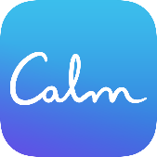
Mindful Breathing Online Support
https://www.nhs.uk/conditions/stress-anxiety-depression/ways-relieve-stress/
https://youngminds.org.uk/find-help/looking-after-yourself/take-time-out/
https://www.calm.com/breathe
https://www.nhs.uk/apps-library/chill-panda/
https://www.headspace.com/meditation/breathing-exercises
Working in partnership with:
Northumbria Healthcare NHS Foundation Trust
Cumbria, Northumberland, Tyne and Wear NHS Foundation Trust
Notes:
Online Support
There is an abundance of online support and guidance in relation to Mindful Breathing.
We only recommend using websites and apps that have been verified and deemed appropriate for children and young people by professionals.
So please explore, investigate and find techniques and practices that work for you – just be careful.
These are some of the NHS recommended apps and websites for Mindful Breathing.

Slide 20
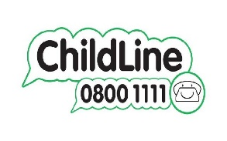
Mental Health Self-Help & Online Support
https://www.nhs.uk/conditions/stress-anxiety-depression/
https://www.mind.org.uk/information-support/for-children-and-young-people/
https://www.childline.org.uk/
https://www.kooth.com/
https://www.nhs.uk/oneyou/every-mind-matters/
Working in partnership with:
Northumbria Healthcare NHS Foundation Trust
Cumbria, Northumberland, Tyne and Wear NHS Foundation Trust
Notes:
Self-Help
We also wanted to point you in the direction of some age appropriate and professional online self-help support.
These websites have been verified by professionals and can provide children and young people with general mental health support in relation to lots of mental health issues.
They are all free and can provide you with advice, support and guidance on a number of issues that you might be facing right now.

Slide 21
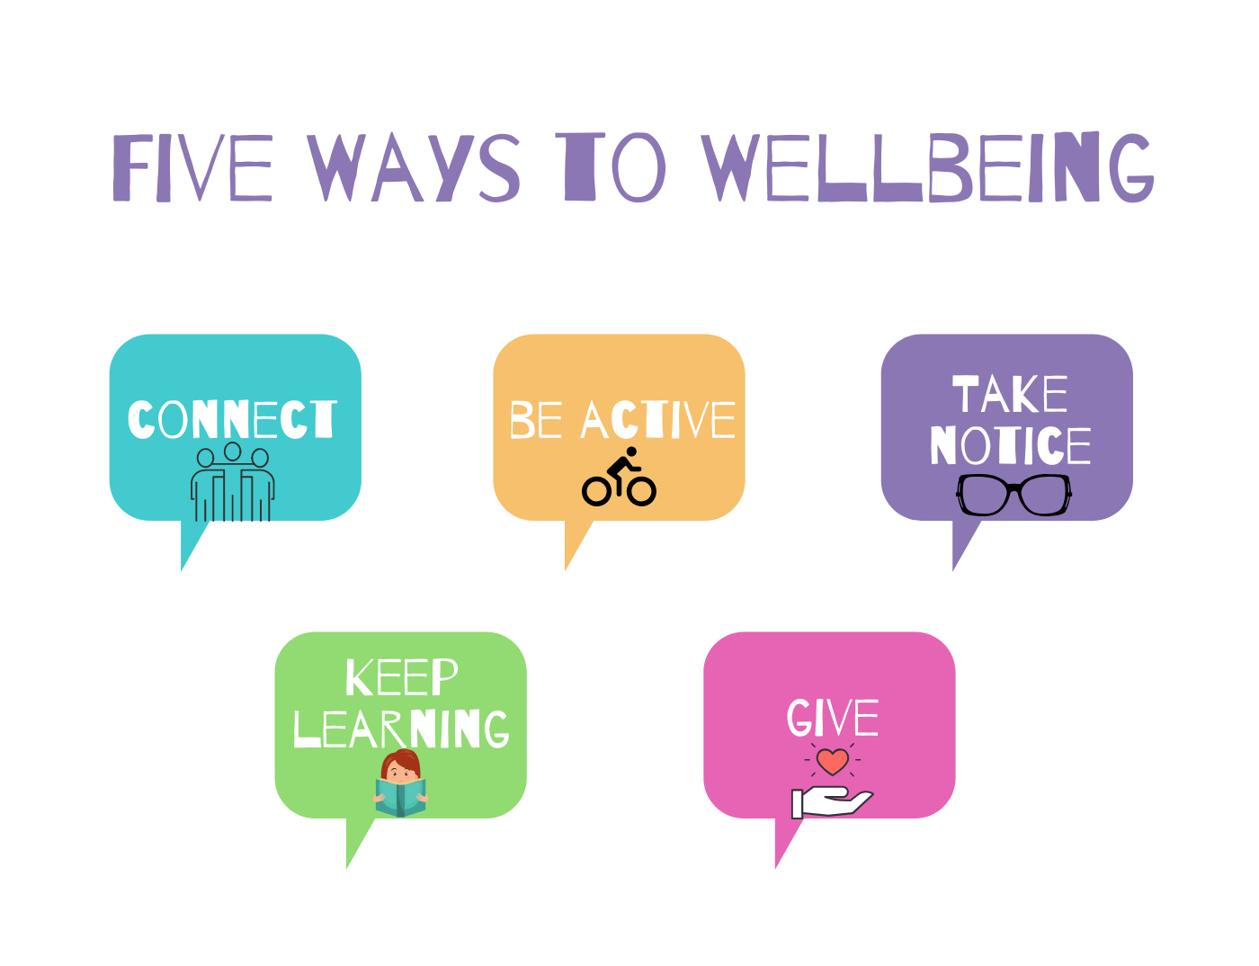
Working in partnership with:
Northumbria Healthcare NHS Foundation Trust
Cumbria, Northumberland, Tyne and Wear NHS Foundation Trust

Slide 22
THANK YOU
for Listening and taking part
Working in partnership with:
Northumbria Healthcare NHS Foundation Trust
Cumbria, Northumberland, Tyne and Wear NHS Foundation Trust

Slide 23
References
Arch, J. J., & Craske, M. G. (2006). Mechanisms of mindfulness: Emotion regulation following a focused breathing induction. Behaviour Research and Therapy, 44(12), 1849-1858.
https://www.cntw.nhs.uk/resource-library/relaxation-techniques/
https://www.headspace.com/meditation/breathing-exercises
https://www.oxfordlearnersdictionaries.com/definition/american_english/resilience
https://www.nhs.uk/conditions/stress-anxiety-depression/mindfulness/
Working in partnership with:
Northumbria Healthcare NHS Foundation Trust
Cumbria, Northumberland, Tyne and Wear NHS Foundation Trust

