Slide 1
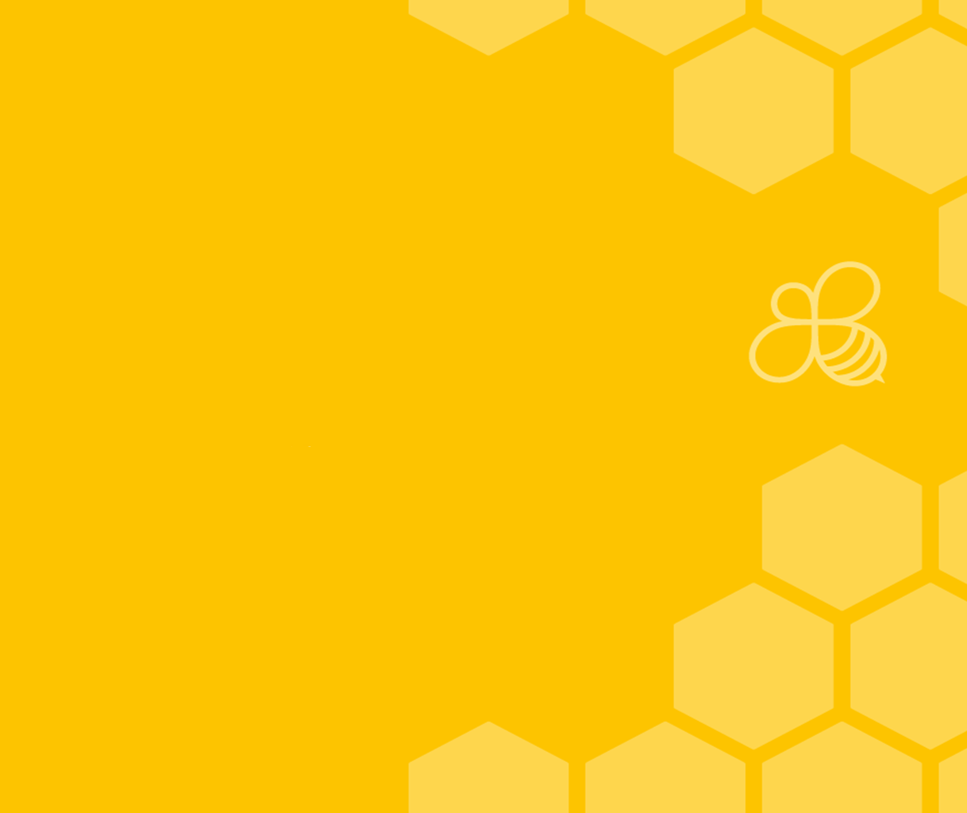
Mindfulness
Working in partnership with:
Northumbria Healthcare NHS Foundation Trust
Cumbria, Northumberland, Tyne and Wear NHS Foundation Trust

Slide 2
Do you ever feel like your mind can be like a snow globe? All shaken up with thoughts falling everywhere?
Working in partnership with:
Northumbria Healthcare NHS Foundation Trust
Cumbria, Northumberland, Tyne and Wear NHS Foundation Trust
Notes:
This PowerPoint is designed to help you start your own mindfulness routine in your classroom.
The activities are designed for young children in a way that make sense to them.
Young children usually need visuals to understand a concept. This PowerPoint gives them visuals to help them practice mindfulness.
The room should be quiet and dark if possible. Ensure that children are sitting comfortably.

Slide 3
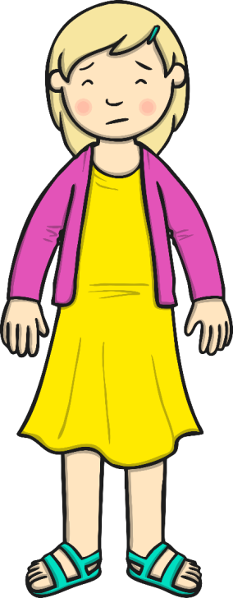
I hope we haven’t got pasta for dinner tonight again!
Have I remembered my PE kit?
I hope Katy is at dancing class tomorrow, I’m lonely when she’s not there.
I hope my baby sister doesn’t keep me awake again tonight.
I can’t believe my brother took my football to school with him without asking...it’s mine!
Working in partnership with:
Northumbria Healthcare NHS Foundation Trust
Cumbria, Northumberland, Tyne and Wear NHS Foundation Trust
Notes:
Here is an example of some worries that young people may have, thinking about things that have happened in the past and also thinking about things that haven't actually happened but we think they might.

Slide 4
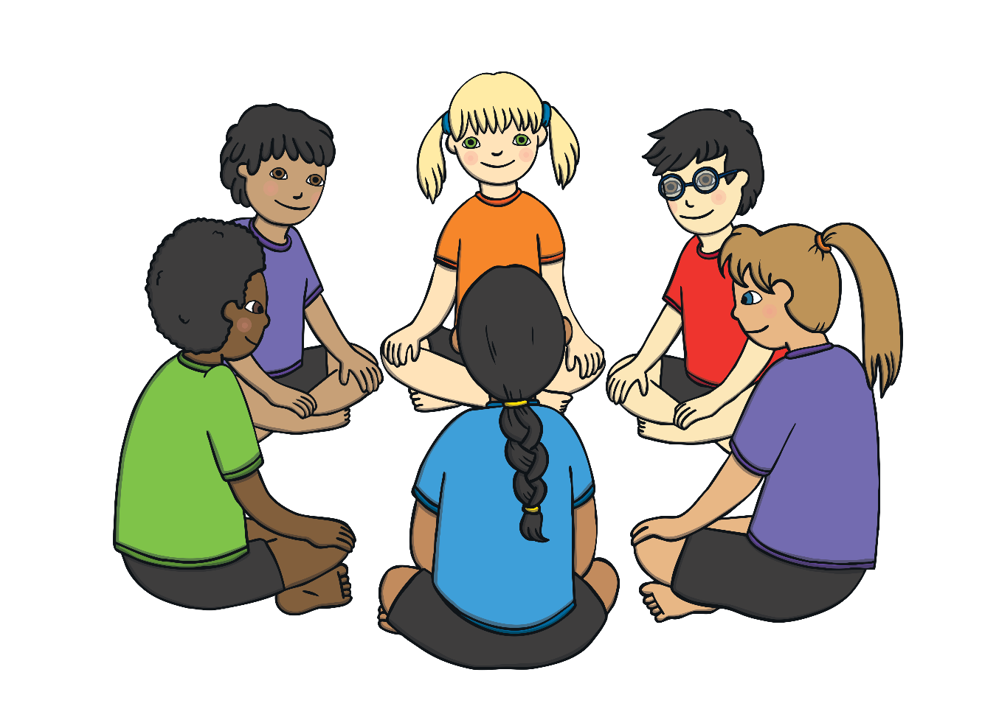
Discussion Time
Think together of a time you were worrying about something that could happen in the future?
Think together about a time you have worried about something that has happened?
Working in partnership with:
Northumbria Healthcare NHS Foundation Trust
Cumbria, Northumberland, Tyne and Wear NHS Foundation Trust
Notes:
Could be small group work, or individuals could put there hand up and volunteer information.
This also could be done with post its, one colour children could write a worry from the future and another colour of something that has happened in the past.
This activity can be conducted in many different ways, depending on the ability of the young people and size of the group

Slide 5
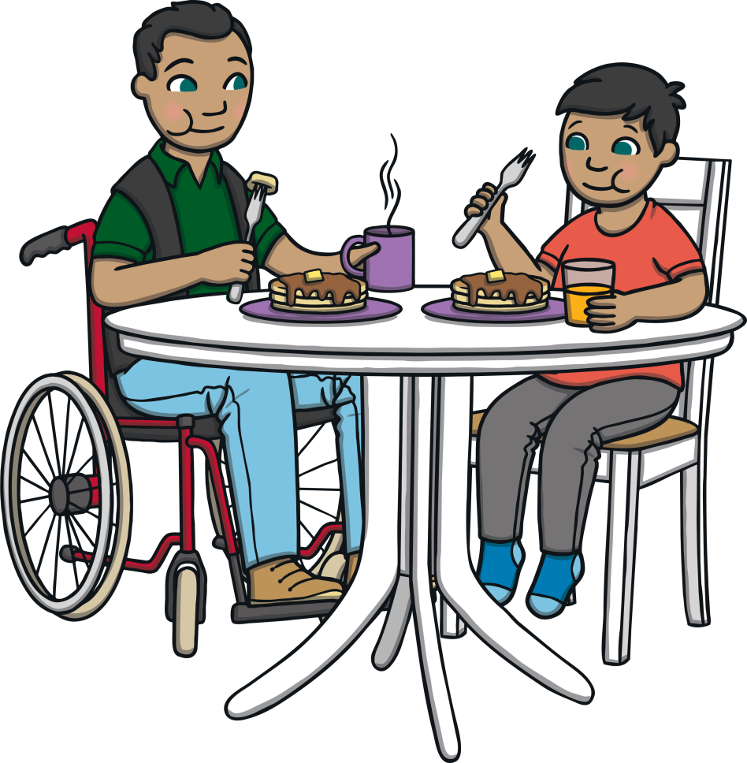
Jacob
Here is a boy called Jacob. We are going to look at Jacob and how he deals with his emotions, feelings and actions in certain situations.
Working in partnership with:
Northumbria Healthcare NHS Foundation Trust
Cumbria, Northumberland, Tyne and Wear NHS Foundation Trust

Slide 6
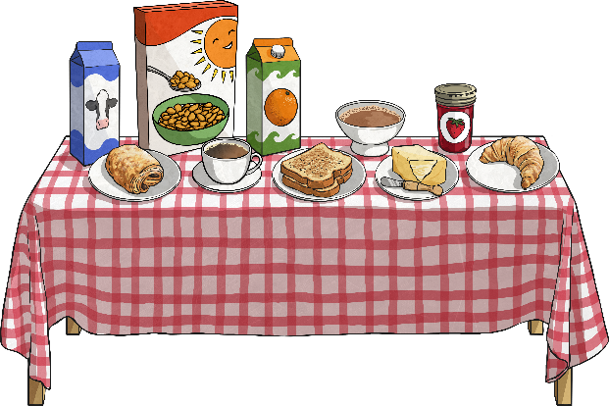
Jacob
Jacob is having his breakfast with his family.
What if Jack isn’t at school today because he felt ill yesterday. I won’t be able to play cards with him…I’ll be all on my own. What will I do? The last time Jack was ill, I was alone all day and I didn’t like it!
Discussion:
In pairs, can you describe how Jacob might be feeling?
Working in partnership with:
Northumbria Healthcare NHS Foundation Trust
Cumbria, Northumberland, Tyne and Wear NHS Foundation Trust
Notes:
This can be done by asking the children's to draw out a body and to label the figure with what Jacob may be thinking, feeling emotionally and physically such as butterflies in tummy, hot sweaty etc.
Please see attachment for supporting resources

Slide 7
Jacob
We can see that Jacob is worrying about the future - a future that might not even happen.
Jacob is also overthinking what has happened in the past and is focusing all the worst parts of his memories, which is making the whole thing worse.
He has forgotten that on that day, Emma and Tai asked if he wanted to play their card game but he said no.
Jacob is not enjoying himself at all with his family or thinking about what he is doing or enjoying now. he is thinking about the past and the future…not the present.
Working in partnership with:
Northumbria Healthcare NHS Foundation Trust
Cumbria, Northumberland, Tyne and Wear NHS Foundation Trust

Slide 8
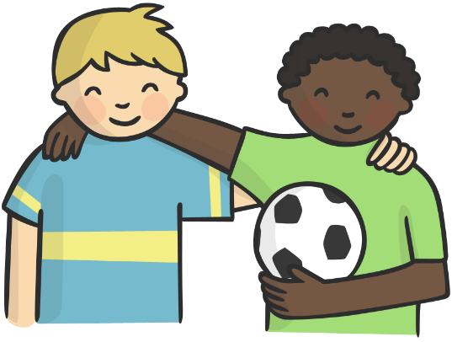
Discussion Time
Let’s see what happens to Jacob when he arrived at school.
So, Jack was at school after all! Jacob was worrying about something in the future that didn’t even happen!
Working in partnership with:
Northumbria Healthcare NHS Foundation Trust
Cumbria, Northumberland, Tyne and Wear NHS Foundation Trust
Notes:
Activity
In pairs, what do you think Jacob could have done that morning instead of worrying about whether his friend would be at school or not?
Jacob could have used mindfulness.

Slide 9
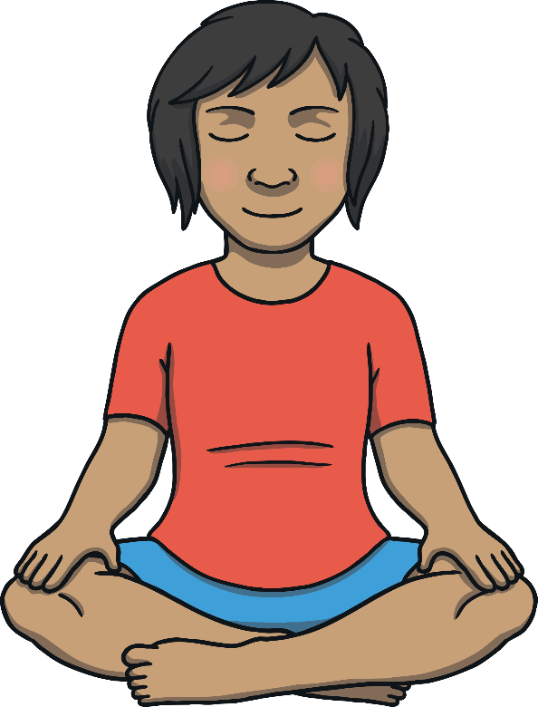
Mindfulness
Mindfulness is when we are thinking about what we are doing right now. Ignoring the past or the future, we just think about
the present.
Of course, sometimes, we want or need to reflect positively about the past or become excited about things in the future. Mindfulness is about living for the here and now and enjoying this very moment of our lives!
Jacob could have focused on his breakfast with his family and enjoyed that special family time instead of worrying about something which was out of his control in the future.
Working in partnership with:
Northumbria Healthcare NHS Foundation Trust
Cumbria, Northumberland, Tyne and Wear NHS Foundation Trust

Slide 10
Mindfulness
Today, we are going to learn how to help ourselves when we feel unhappy, mad, sad or stressed.
We will learn a new way to breathe and some fun exercises that we can use everyday.
Working in partnership with:
Northumbria Healthcare NHS Foundation Trust
Cumbria, Northumberland, Tyne and Wear NHS Foundation Trust

Slide 11
Sitting
Let’s practice sitting first. Find a place on the carpet where you are not touching anyone else.
We will sit on the floor, with our legs crossed and our hands on our knees.
Working in partnership with:
Northumbria Healthcare NHS Foundation Trust
Cumbria, Northumberland, Tyne and Wear NHS Foundation Trust

Slide 12
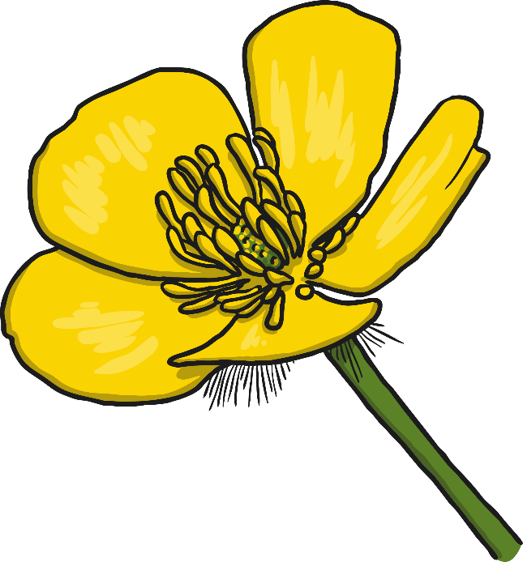
Breathing
Now we will practice breathing.
Sit up straight with your hands on your knees.
Breathe in like you are smelling a flower.
Breathe out like you are blowing a leaf away.
Working in partnership with:
Northumbria Healthcare NHS Foundation Trust
Cumbria, Northumberland, Tyne and Wear NHS Foundation Trust
Notes:
Lets try this a couple of times…
Breath in…..
Breath out……

Slide 13
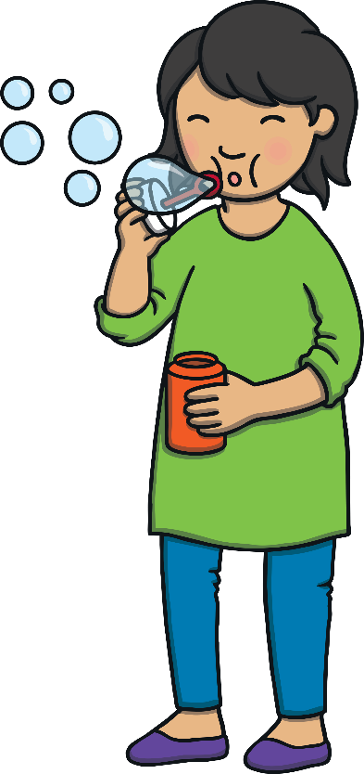
Bubble Breathing
Let’s pretend we are holding a bubble wand in our hand.
We are going to pretend to blow bubbles all around the room.
Breathe in deeply and breathe out slowly. Blow the bubbles around
the room.
Let’s practice this a few times!
Working in partnership with:
Northumbria Healthcare NHS Foundation Trust
Cumbria, Northumberland, Tyne and Wear NHS Foundation Trust
Notes:
This is much more fun when using real bubbles.
Please see attached resources for this activity if wanting to extend further.

Slide 14
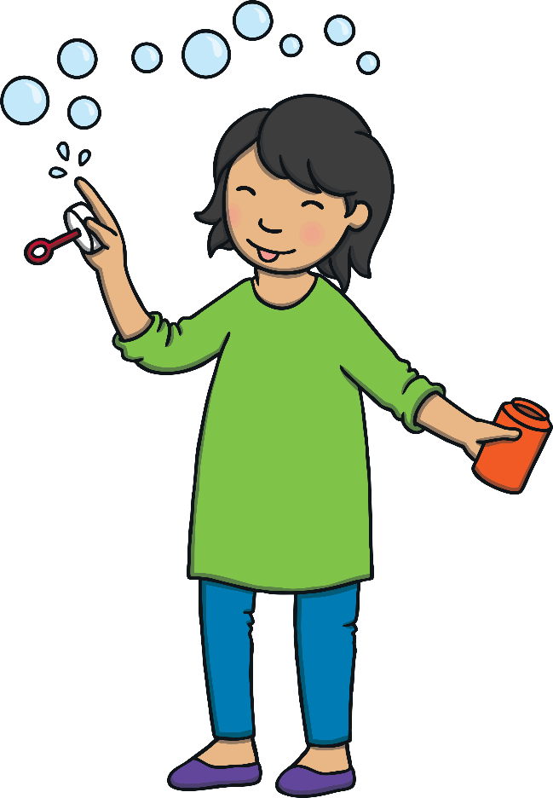
Bubble Breathing
Breathe in and breathe out. Imagine the bubbles have happy faces on them.
Blow happy face bubbles to your friends around the room.
Imagine you are sending them happy thoughts and love.
Feel yourself becoming calm and relaxed with each breath.
Working in partnership with:
Northumbria Healthcare NHS Foundation Trust
Cumbria, Northumberland, Tyne and Wear NHS Foundation Trust

Slide 15
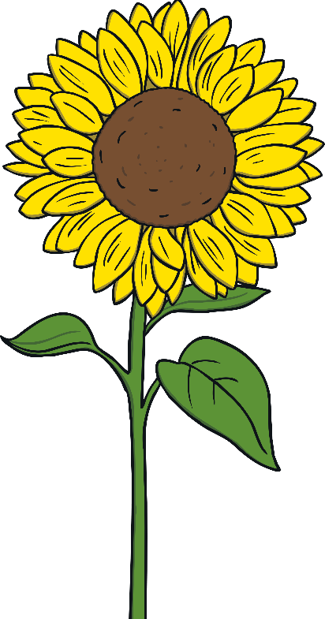
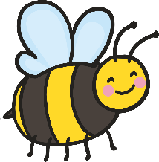
Bumblebee Breathing
Now we are going to pretend to be bees.
Sit comfortably on the floor and open your hands out in front of your face.
Put your fingers over your eyes and your thumbs gently in your ears.
Breathe in through your nose and hum quietly like a bee as you slowly breathe out.
Remember to hum like a bee. As you are humming, think happy and calm thoughts.
Pretend to be a bee buzzing around the flowers happily.
Working in partnership with:
Northumbria Healthcare NHS Foundation Trust
Cumbria, Northumberland, Tyne and Wear NHS Foundation Trust

Slide 16
Rainbow Breathing
Now let’s stand up and make rainbows.
Put your feet shoulder-width apart.
Put your hands out in front of you with your palms facing out.
Reach up high with your hands above your head.
Move them down to your sides making a big arc.
You just made a rainbow!
Working in partnership with:
Northumbria Healthcare NHS Foundation Trust
Cumbria, Northumberland, Tyne and Wear NHS Foundation Trust

Slide 17
Rainbow Breathing
Now we will practice breathing while we make rainbows.
Put your hands in front of you again.
Breathe in as your put your hands over your head.
Breathe out as you move them to your sides.
Each time we do this movement, pretend you are adding another color to your rainbow.
Feel how your body is relaxing and calming down.
Working in partnership with:
Northumbria Healthcare NHS Foundation Trust
Cumbria, Northumberland, Tyne and Wear NHS Foundation Trust

Slide 18
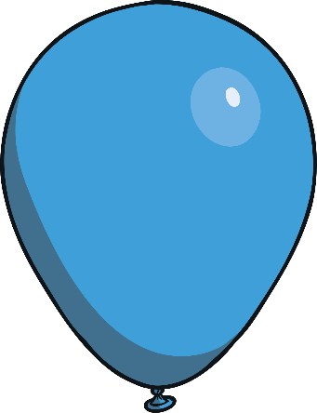
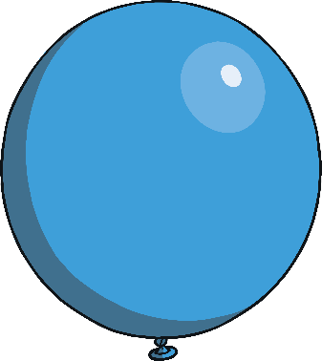
Balloon Breathing
Now let’s sit back down on the floor.
We are going to pretend to blow up balloons.
Take a deep breath in and make your stomach stick out like you have a balloon in it.
Now slowly let the air out of your balloon through your mouth.
As you let the air out, slowly lean forward. Pretend to be a balloon with no air in it.
Let’s see how many balloons we can blow up!
As you blow up each balloon, think, “I am happy.”
Working in partnership with:
Northumbria Healthcare NHS Foundation Trust
Cumbria, Northumberland, Tyne and Wear NHS Foundation Trust
As you let the air out, think, “I am relaxed.”
Notes:
You did such a great job today!
How do you feel?
What was your favorite thing we did today?
Anytime you feel unhappy, stressed, mad or sad, you can do these activities.
Let’s take one last breath in and out.
Breathe in and smell the flowers and breathe out and blow the leaf away!

Slide 19
Thankyou
Working in partnership with:
Northumbria Healthcare NHS Foundation Trust
Cumbria, Northumberland, Tyne and Wear NHS Foundation Trust

