Slide 1


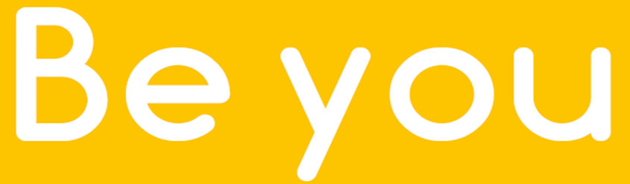


Resilience
Working in partnership with:
Northumbria Healthcare NHS Foundation Trust
Cumbria, Northumberland, Tyne and Wear NHS Foundation Trust
Notes:
Introduce self and role/service
We all know the importance of looking after our bodies, our physical health- making sure we are fit and strong
But we also have mental health, which relates to our thoughts, feelings, mood and behaviour.
It is important to understand how to look after our mental health, in the same way we look after our physical health.
So, today we are going to talk about resilience and how we can support the children and young people in our care, develop their resilience, whilst also considering our own levels.

Slide 2
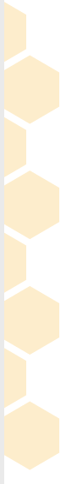

Aims & Objectives
To understand and recognise:
What ‘Resilience’ is
What challenges may test our young peoples resilience levels
How we can promote and support young people to develop their resilience levels by using the 5 ways to wellbeing.
Working in partnership with:
Northumbria Healthcare NHS Foundation Trust
Cumbria, Northumberland, Tyne and Wear NHS Foundation Trust
Notes:
Aims & Objectives
To understand and recognise:
What ‘Resilience’ is
What challenges may test our young peoples resilience levels
How we can promote and support young people to develop their resilience levels by using the 5 ways to wellbeing.
Safe Space Ground Rules
During the session I will be asking you to reflect on your own emotions and experiences.
You will have the opportunity to share your thoughts, if you would like to.
It is important to listen when someone is sharing their thoughts and ideas.
We all have different thoughts and experiences – please respect each others.
Only share what you feel comfortable sharing.

Slide 3
What is Resilience?
Resilience is the ability to cope when things go wrong.
Resilience can also be described as:
Bouncing back after difficult times
Dealing with challenges and still holding your head up
Giving things a go or trying your best
Being strong on the inside
Working in partnership with:
Northumbria Healthcare NHS Foundation Trust
Cumbria, Northumberland, Tyne and Wear NHS Foundation Trust
Notes:
Discussion- Ask parents/ carers what is resilience? Discuss in pairs or table groups before feeding back.
Resilience is defined as an individual's ability to properly adapt to stress and overcome adversity.
It can be described as our ability to ‘bounce back’ when we encounter difficult times.
Bouncing back means that people can carry on, and even flourish, after setbacks
Resilience helps us to maintain our wellbeing in difficult circumstances.
Your level of resilience can change over the course of your life.
Resilience isn’t about stopping bad things from happening; it’s about how we handle difficult situations when they do happen!
There are a whole range of ways that we can improve our wellbeing and resilience.

Slide 4
Everyone experiences challenges
Bullying/friendship issues
Moving to a new school or place
Losing people that they love
Exams and tests
Getting into arguments with people
Illness
Family issues
And many more…
Working in partnership with:
Northumbria Healthcare NHS Foundation Trust
Cumbria, Northumberland, Tyne and Wear NHS Foundation Trust
Notes:
We all experience challenges and difficult times in life. Some of those challenges will push us to our limits and there will be times we question our own ability to get through them.
And not just to overcome them, but to learn from them and be a stronger person as a result
Group task- ‘What are examples of challenges your children and young people face on a regular basis?’
Give a few minutes, encourage discussion and take feedback.
Some of these challenges may include:
Bullying/friendship issues
Moving to a new school or place
Losing people that they love
Exams and tests
Getting into arguments with people
Losing
Illness
Family issues
Sometimes, we have no idea about the challenges our young people are facing on a daily basis.
Ask: How would these type of challenges make our young people feel?
When these challenges occur, it affects the way we think, feel and behave.
Ask: When we experience difficult times/ challenges, how can it make us feel?
Discuss in groups for 2 minutes- move to next slide

Slide 5

How can life challenges make us feel?
Frustrated
Negative
Upset
Sad
Anxious
Angry
Working in partnership with:
Northumbria Healthcare NHS Foundation Trust
Cumbria, Northumberland, Tyne and Wear NHS Foundation Trust
Notes:
You might have said:
Angry
Frustrated
Sad
Upset
Negative
Nervous
Anxious
We all experience these feelings at one point or another, especially during challenging times.
These feelings can build up inside our children and young people, just like a full bottle of pop, it might only take a small knock for these feelings to burst out.
It is important to encourage our young people to talk to someone about their feelings.
Ask: Why do you think it is important to talk to someone? Who could our young people talk to?
We can increase their ability to cope by role modelling having a growth mindset and by viewing challenges as opportunities to learn and develop.

Slide 6
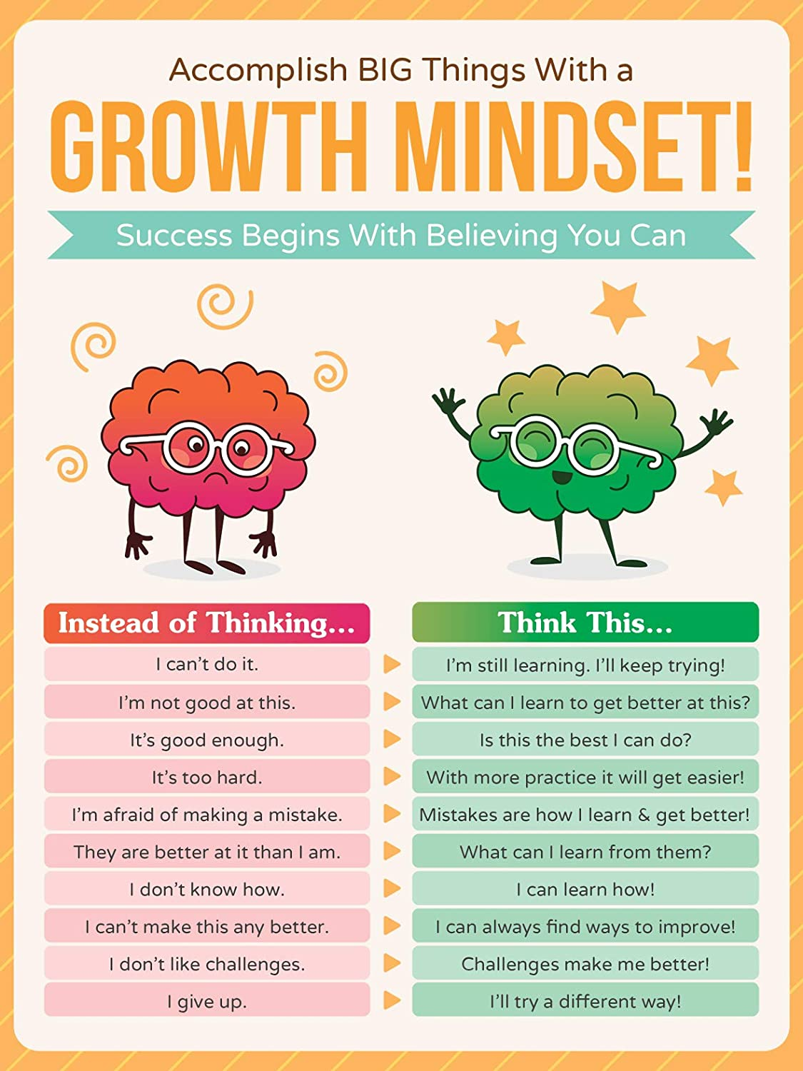
Developing a Growth Mindset
Working in partnership with:
Northumbria Healthcare NHS Foundation Trust
Cumbria, Northumberland, Tyne and Wear NHS Foundation Trust
Notes:
When negative things happen in life, it is easy for children and young people to think negatively about themselves, others and the world around them.
They may think/ say things like:
“I cant do it”
“I’m no good at this”
“I can’t cope”
When we have a fixed mindset like this, we may fear new experiences and avoid things.
These thoughts are unhelpful and can negatively affect our mood and behaviour.
Someone with a growth mindset is more able to bounce back during difficult times. They look for ways to overcome the problem and think more positively.
Developing our mindset can help us become more resilient.
Asking ourselves questions such as:
I can’t control everything, so what is in my control?
Can I change something I’m doing to make things better?
What can I learn from this?
Who can help me?
How can I move forward?

Slide 7

Body clues
Headache
Cant concentrate
Face might go red
Shake
Lump in throat
Feel hot/ Sweating
Restless
Upset stomach
or butterflies
Pounding heart
Tired-cant sleep
Trembling knees
Working in partnership with:
Northumbria Healthcare NHS Foundation Trust
Cumbria, Northumberland, Tyne and Wear NHS Foundation Trust
Shallow breathing
Notes:
When we feel stressed or worried, our bodies will physically react.
You may notice your child have some of the following symptoms if they are stressed:
feel a lump in their throat
go red
have an upset stomach or butterflies
Have Trembling knees
Begin to sweat
Find it hard to breathe
Pounding heart
Find it difficult to concentrate
Tired or restless
These ‘body clues’ are not dangerous- they are just the natural way our bodies responds when we are feeling worried or stressed.
When we notice these, it is a sign for us to take some time to gather our thoughts, recognise our feelings and decide how we want to respond.
Activity- What are your young persons body clues? Complete body sheet

Slide 8
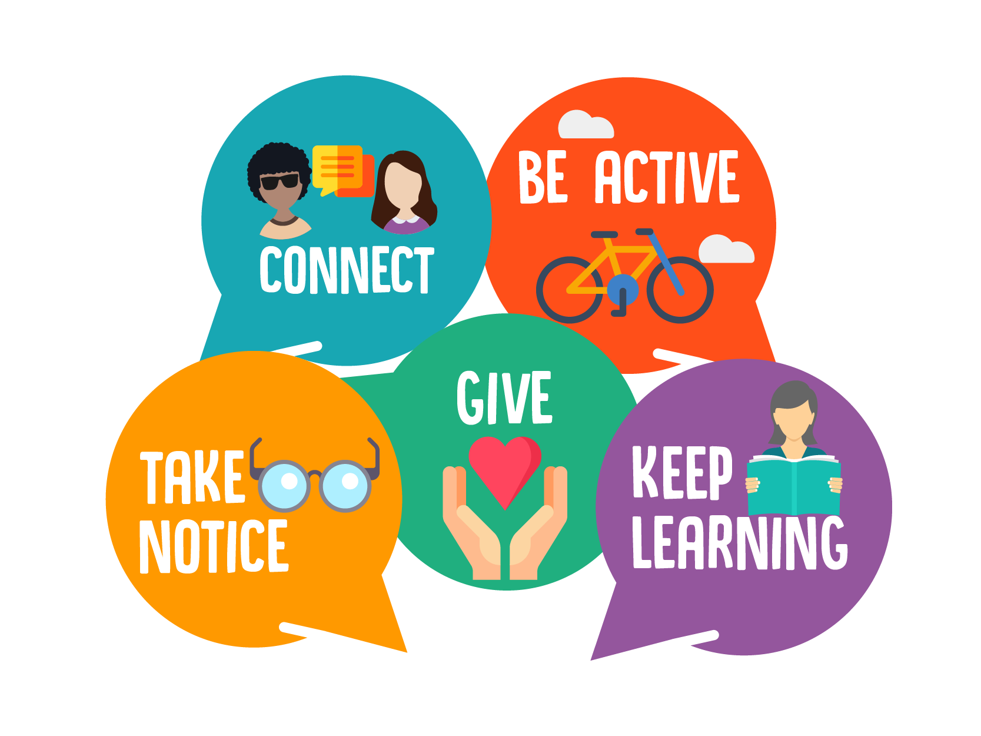
Developing Resilience?
Working in partnership with:
Northumbria Healthcare NHS Foundation Trust
Cumbria, Northumberland, Tyne and Wear NHS Foundation Trust
Notes:
So how do we help our children and young people develop their resilience skills?
Resilience is about giving ourselves the right tools to handle anything that life throws at us.
We can help our young people improve their resilience using the: 5 Ways to Wellbeing.
Everyone is individual and we all have different things that make us feel good, but researchers have recently come up with 5 ways to improve our mood and boost our emotional wellbeing that have been shown to work.
Connect
Be active
Take notice
Give
Keep learning
These 5 Ways to Wellbeing are just as applicable to adults, as they are to children and young people, so we can also practice them and become every day role models.

Slide 9
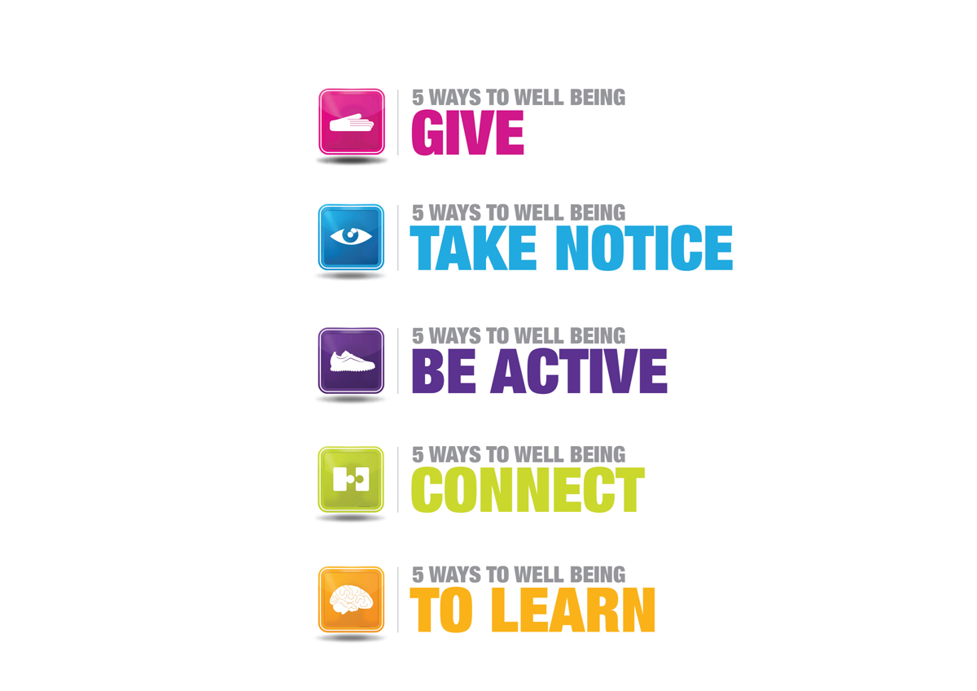
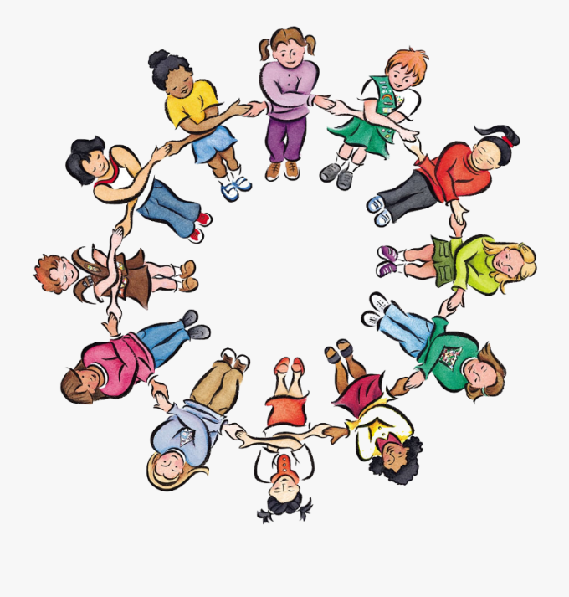
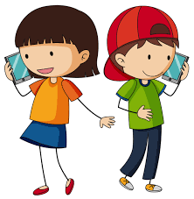

5 ways to wellbeing
Connect: Strengthening relationships with others and feeling close to and valued by others is critical to boosting wellbeing.
Working in partnership with:
Northumbria Healthcare NHS Foundation Trust
Cumbria, Northumberland, Tyne and Wear NHS Foundation Trust
Notes:
1. Connect
Good relationships are important for young peoples mental wellbeing. Healthy relationships can:
help them to build a sense of belonging and self-worth
give them an opportunities to share positive experiences
provide emotional support and allow them to support others in turn
Discussion- How does your young person connect with others? (give examples below if necessary)
There are lots of things that we could suggest to help them build stronger and closer relationships:
if possible, take time each day to be with your family
Talk to someone new
arrange a day out with friends
Join a club at school
have lunch with a friend
visit a friend or family member who needs support or company
Talk to someone on the phone/facetime
Connect with pets
Play with brothers/sisters
Write a letter to someone
Activity- On 5 ways to wellbeing sheet, write down 5 ways you could suggest that your person do to connect with others this week.
If you want, you could also think about: Who could you connect with? What could you do?

Slide 10
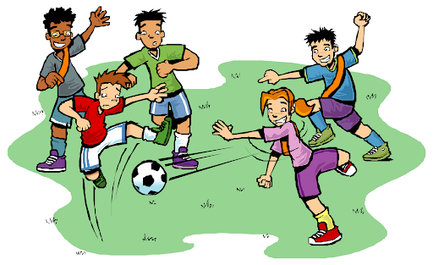

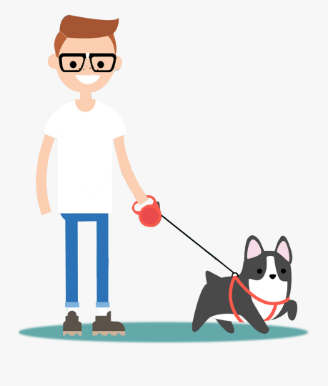
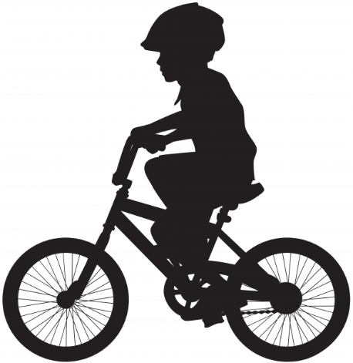
5 ways to wellbeing
Be Active: Being physically active, improves our physical health and can improve our mood and wellbeing.
Working in partnership with:
Northumbria Healthcare NHS Foundation Trust
Cumbria, Northumberland, Tyne and Wear NHS Foundation Trust
Notes:
2. Be Active
Increasing our activity and exercise levels can boost our mood significantly:
Being active:
Makes us feel better about ourselves
Makes us feel more positive
Improves our ability to think more clearly
Provides us with greater energy and motivation levels
Helps us to think about something other than focussing on our unhelpful thoughts
Gives us a sense of achievement
Gives us a sense Enjoyment
Allows us to socialise with others
Activity: Think of 5 activities that you enjoy and makes you feel good!
Dance to your favourite song
Listen to music
Walk the dog
Cycle
Play a sport with friends
Join a club
Run in the playground
gardening
Activity- On 5 ways to wellbeing sheet, write down 5 ways you could suggest that your person do to be active this week.

Slide 11

5 ways to wellbeing
Take Notice: Paying more attention to the present moment, to thoughts and feelings and to the world around, boosts our wellbeing.
Working in partnership with:
Northumbria Healthcare NHS Foundation Trust
Cumbria, Northumberland, Tyne and Wear NHS Foundation Trust
Notes:
3. Take notice
Ours and our childrens lives can be very busy… school, home, friends, homework, clubs etc… We often forget to notice our surroundings and reflect on the day and experiences.
This is about being mindful – appreciating what is around us and enjoying the moment.
In order to take notice of the positive things around us, we could:
Reﬂect on how you feel and what went well that day.
notice how your friends or family are feeling today
Relax and look around you- maybe clouds moving across the sky
listen to music or the sound outside.
take a few deep breaths.
paint or draw a picture of what you've seen today
Reading a book in the sunshine
Grounding exercise- We can encourage our young people to stay in the moment by using out 5 senses. A simple way to do this is by asking your child to:
5: Acknowledge FIVE things they see
4: Acknowledge FOUR things they can touch
3: Acknowledge THREE things they can hear
2: Acknowledge TWO things they can smell
1: Acknowledge ONE thing they can taste
Alternative Activity- Guided imagery (time dependent)
Close your eyes and bring yourself to a calm, quiet place in your mind. Just stay here and relax for a few moments. Breathe deeply and comfortably. Notice how your chest and belly move as you take calming, deep breaths.
Just listen as the air moves in and out…. in…. and out. It is a quiet and beautiful sound.
(Pause)
Now imagine transporting yourself magically to your favourite spot on a beach.
You can choose your favourite beach. Or if you’ve never been to a beach, just imagine what you think it would be like.
Picture yourself there now.
The sun shines brightly and gently warms your skin. It’s as if the sun is reaching down and pouring its love on you…. so warm and so nice.
Now you’ll slowly walk down toward the surf until you feel the lapping of the warm waves against your toes. Dig your toes deeply into the wet sand.
Feel the rhythm of the calm waves flow over the sand – it relaxes you. Notice how your breathing remains very calm and even- inhaling and exhaling slowly and calmly. Paying attention now, you slow down your breathing even further and allow your muscles to relax.
Feel the warmth of the sun melting your muscles into complete relaxation. Slowly and easily your body relaxes more and more …. releasing tension or frustration, releasing any worries or doubts you have. Inhaling deeply again – breathe in calm and peacefulness.
Look out at the vast, blue ocean. It’s so big, you can’t even see to the other side! Anytime your mind brings up worries, you can think of how small our problems seem when we’re standing next to the huge, beautiful sea. You can also take comfort in how the waves always keep going. Whether the seas are calm and easy or stormy and choppy, the waves never fail to wash up and make the shore look brand new – like it has a fresh start!
Your body is now relaxed; your mind is relaxed now too. You can empty your mind of all worries or thoughts that have been bothering you. Just enjoy this moment you have now.
Right now, only this matters, just relaxing and enjoying this moment. Breathe in deeply and allow the relaxation to flow to any part of your body that needs it.
Imagine the beautiful golden warm sun waking up each and every cell and muscle, making you feel so wonderful and alive! I’m sure you can feel the peace that surrounds you now, letting you know that everything is all right.
Take in a nice, deep breath again and bring your attention back to where you are….. along with all the calm, peaceful feelings of relaxation and rest
Activity- On 5 ways to wellbeing sheet, write down 5 ways you could suggest that your person do to take notice this week.

Slide 12

5 ways to wellbeing
Give: Any acts of kindness, whether small or large can make you feel happier and more satisfied about life.
Working in partnership with:
Northumbria Healthcare NHS Foundation Trust
Cumbria, Northumberland, Tyne and Wear NHS Foundation Trust
Notes:
4. Giving
Any acts of kindness, whether small or large can make us feel happier and more satisfied about life. Encouraging you’re your person to ‘give’, can have a huge positive impact on how they see and value themselves, and how they continue to contribute to society as the grow and develop.
Discussion- What type of things could we do to give or be kind to others?
Say thank you to someone who has helped you.
Give unwanted items to a local charity shop
Give someone a compliment
• Donate your time to do something for someone else
• Offer to help your parents
• Bake a cake and give it to someone
• Do some volunteering
• Nominate someone for an award
• Give someone a hug
• Be a mentor for someone
• Raise money for charity
• Help an elderly neighbour
• Be a good role model
Activity- On 5 ways to wellbeing sheet, write down 5 ways you could suggest that your person do to give to others this week.

Slide 13

5 ways to wellbeing
Keep Learning: Being curious and seeking out new experiences in life, positively stimulates the brain. Don’t worry if things go wrong- try again
Working in partnership with:
Northumbria Healthcare NHS Foundation Trust
Cumbria, Northumberland, Tyne and Wear NHS Foundation Trust
Notes:
5. Keep learning
Research shows that learning new skills can also improve children's mental health and emotional wellbeing by:
boosting self-confidence and self-esteem
Helping to build a sense of purpose
helping to connect with others
Even if your child or young person feels like you do not have enough time, or may not need to learn new things, there are lots of different ways to bring learning into their lives.
Discussion- What simple things could young people do to increase their learning in a variety or areas?
Try something new
Learn a new skill/hobby
Be creative- start a project
Read something new
Complete a puzzle
Make a cake
Learn how to play a musical instrument
Join a club
Learn a new word
Learn how to draw
Research something they are interested in.
Learn something new about the people around you
Write a story
Visit a new place
Activity- On 5 ways to wellbeing sheet, write down 5 ways you could suggest that your person do to learn something new this week.

Slide 14
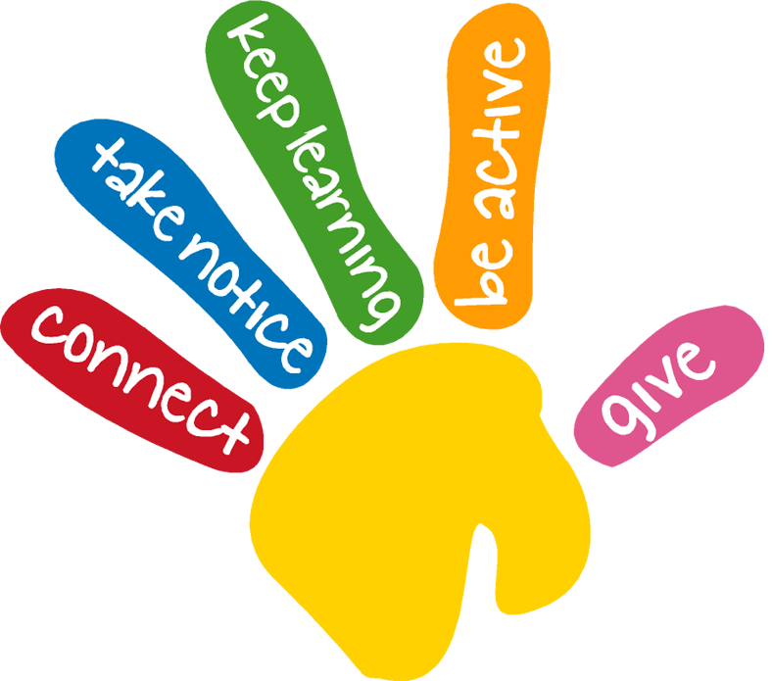
Key Points
Resilience is our ability to cope and overcome difficult situations
Everyone experiences difficult times
Think of challenges as opportunities to help your child learn and develop a growth mindset.
Pay attention to their body clues
It is alright to ask for help
Resilience can be developed in us all by using the 5 ways to wellbeing
Working in partnership with:
Northumbria Healthcare NHS Foundation Trust
Cumbria, Northumberland, Tyne and Wear NHS Foundation Trust

Slide 15





Mental Health Self-Help &Online Support
https://www.nhs.uk/conditions/stress-anxiety-depression/ways-relieve-stress/
https://youngminds.org.uk/find-help/looking-after-yourself/take-time-out/
https://www.childline.org.uk/
https://www.mind.org.uk/information-support/for-children-and-young-people/
https://www.kooth.com/
Working in partnership with:
Northumbria Healthcare NHS Foundation Trust
Cumbria, Northumberland, Tyne and Wear NHS Foundation Trust
Notes:
Online Support
There is an abundance of online support and guidance in relation to developing resilience, as well as general mental health support for both you and your young person.
We only recommend using websites and apps that have been verified and deemed appropriate for children and young people by professionals.
So please explore, investigate and find techniques and practices that work for you and your family.
They are all free and can provide you and your child with advice, support and guidance on a number of issues that they might be facing right now.

Slide 16
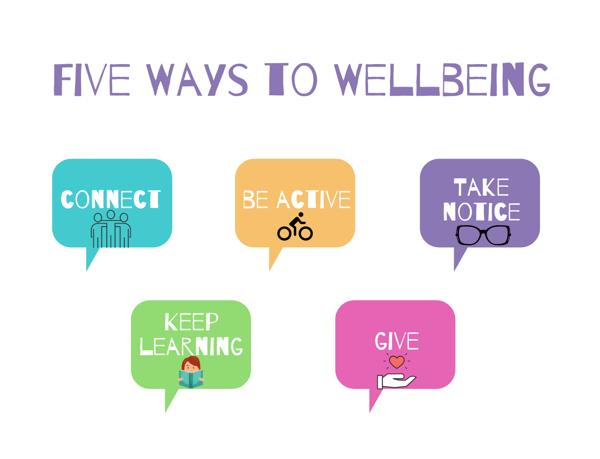
Thank You for Listening
Working in partnership with:
Northumbria Healthcare NHS Foundation Trust
Cumbria, Northumberland, Tyne and Wear NHS Foundation Trust

