Slide 1
Resilience
Melanie Slater
Phillip Dixon
Working in partnership with:
Northumbria Healthcare NHS Foundation Trust
Cumbria, Northumberland, Tyne and Wear NHS Foundation Trust
Michelle Kell
Notes:
Introduce self and role/service
We all know the importance of looking after our bodies, our physical health- making sure we are fit and strong
But we also have mental health, which relates to our thoughts, feelings, mood and behaviour. It is important to understand how to look after our mental health, in the same way we look after our physical health.
Today we are going to talk about resilience.

Slide 2
Safe Space Ground Rules
Aims/objectives
To understand and recognise:
What resilience is
Challenges which test our resilience
How we can increase our resilience by using the 5 ways to wellbeing.
Working in partnership with:
Northumbria Healthcare NHS Foundation Trust
Cumbria, Northumberland, Tyne and Wear NHS Foundation Trust
Notes:
Aims/objectives
To understand and recognise:
what resilience is
Challenges which test our resilience
How we can increase/boost our resilience by using different techniques and strategies.
Safe space ground rules
During the session I will be asking you to reflect on your own emotions and experiences.
You will have the opportunity to share your thoughts, if you would like to.
Go through the ‘Safe Space Ground Rules’
It is important to listen when someone is sharing their thoughts and ideas.
We all have different thoughts and experiences- respect
Only share what you feel comfortable sharing
Ask class if they can think of any appropriate rules

Slide 3
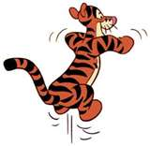
What is Resilience?
Resilience is the ability to cope when things go wrong.
Resilience can also be described as:
Bouncing back after difficult times.
Dealing with challenges and still holding your head up.
Giving things a go or trying your best.
Being strong on the inside.
Working in partnership with:
Northumbria Healthcare NHS Foundation Trust
Cumbria, Northumberland, Tyne and Wear NHS Foundation Trust
Notes:
Discussion- Ask children what is resilience? Have you heard of it?
Discuss in pairs or table groups before feeding back
Resilience is defined as an individual's ability to properly adapt to stress and overcome adversity.
It can be described as our ability to ‘bounce back’ when we encounter difficult times.
Bouncing back means that people can carry on, and even flourish, after setbacks
Resilience helps us to maintain our wellbeing in difficult circumstances.
Your level of resilience can change over the course of your life.
Resilience isn’t about stopping bad things from happening; it’s about how we handle difficult situations when they do happen!
There are a whole range of ways that we can improve our wellbeing and resilience.

Slide 4
Everybody experiences challenges.
Bullying/friendship issues
Moving to a new school or place
Losing people that we love
Exams and tests
Getting into arguments with people
Losing
Illness
Family issues
Working in partnership with:
Northumbria Healthcare NHS Foundation Trust
Cumbria, Northumberland, Tyne and Wear NHS Foundation Trust
And many more…
Notes:
We all experience challenges and difficult times in life. Some of those challenges will push us to our limits and there will be times we question our own ability to get through them.
However, every single person in this room has what it takes to overcome every single challenge that is put in front of them. And not just to overcome them, but to learn from them and be a stronger person as a result
Group task- ‘What are examples of challenges people of your age face?’ Give a few minutes, encourage discussion and take feedback.
Some of these challenges may include:
Bullying/friendship issues
Moving to a new school or place
Losing people that we love
Exams and tests
Getting into arguments with people
Losing
Illness
Family issues
Ask-children to raise their hand if they have experienced challenges- helping to normalise challenge.
We often have no idea about the challenges our friends are facing, and it’s easy to start believing that we have more problems than the people around us, but this often isn’t the case
When these challenges occur, it affects the way we think, feel and behave.
Ask- When we experience difficult times/ challenges, how can it make us feel?
Discuss in groups for 2 minutes- move to next slide

Slide 5
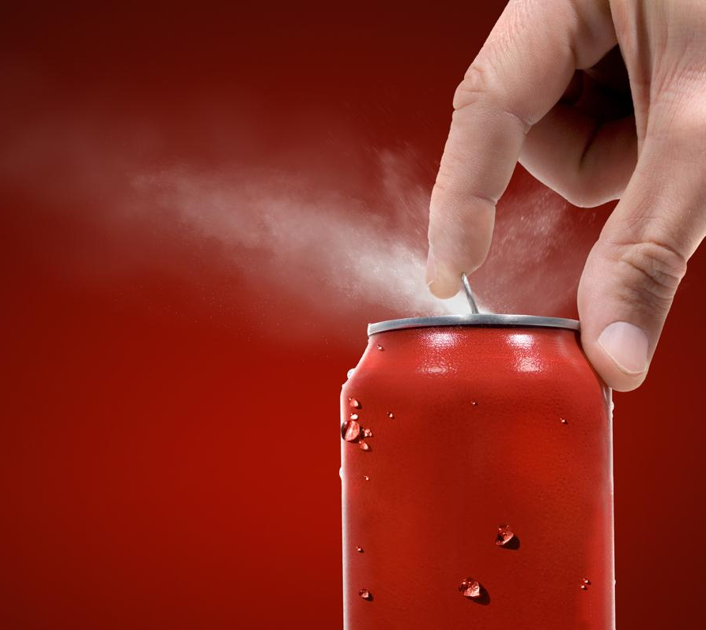
Frustrated
How challenges can make us feel
Upset
Nervous
Negative
Angry
Sad
Anxious
Working in partnership with:
Northumbria Healthcare NHS Foundation Trust
Cumbria, Northumberland, Tyne and Wear NHS Foundation Trust
Notes:
You might have said:
Angry
Frustrated
Sad
Upset
Negative
Nervous
Anxious
We all experience these feelings at one point or another, especially during challenging times. These feelings can build up inside us. Like a full bottle of pop, it might only take a small knock for these feelings to burst out.
It is important to talk to someone about our feelings.
Ask- why do you think it is important to talk to someone?
Think/write down- Who would you talk to? perhaps a friend, parent or teacher.
We can increase our ability to cope by having a growth mindset, viewing these challenges as opportunities to learn and develop.

Slide 6
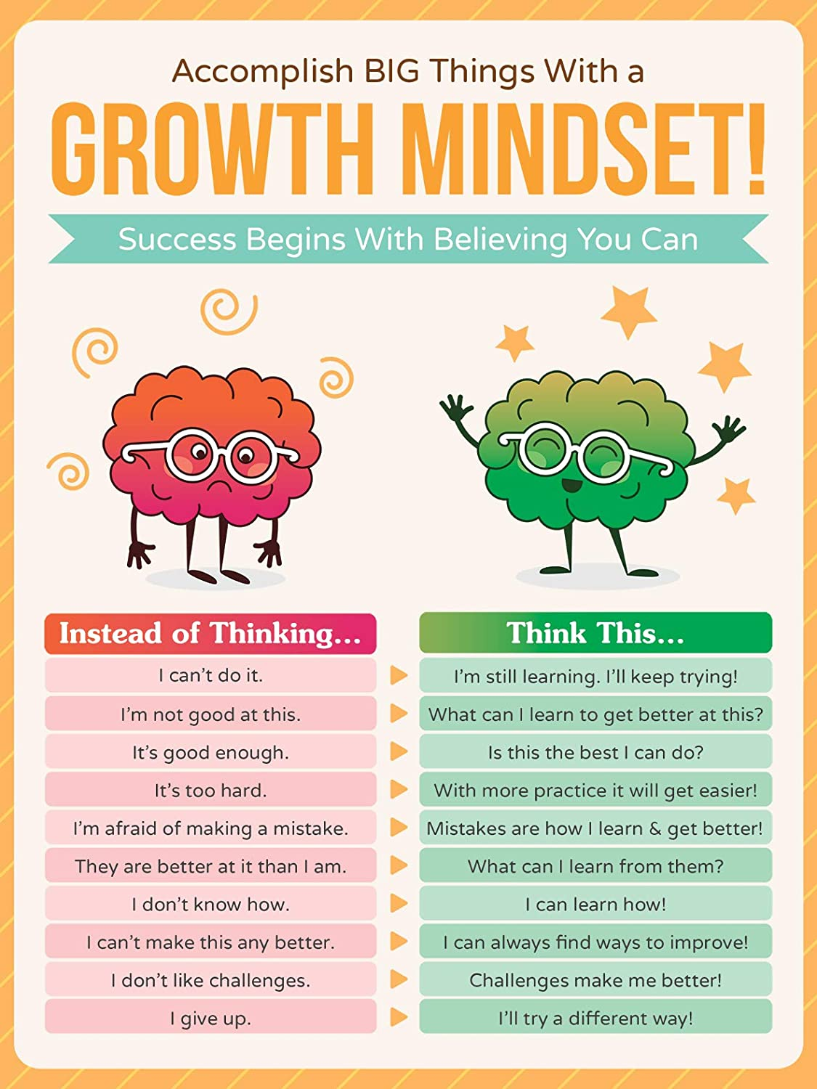
Developing a growth mindset
Working in partnership with:
Northumbria Healthcare NHS Foundation Trust
Cumbria, Northumberland, Tyne and Wear NHS Foundation Trust
Notes:
When bad things happen it is easy for us to think negatively about ourselves, others and the world around us.
“I cant do it”
“Im not good at this”
“I cant cope”
When we have a fixed mindset we may fear new experiences and avoid things.
These thoughts are unhelpful and can affect our mood and behaviour.
Someone with a growth mindset is more able to bounce back during difficult times. They look for ways to overcome the problem and think more positively.
Developing our mindset can help us become more resilient.
Asking ourselves questions such as:
I can’t control everything, so what is in my control?
Can I change something I’m doing to make things better?
What can I learn from this?
Who can help?
How can I move forward?
Give an example. “I can’t do this Maths test”
How might someone with a growth mindset approach this challenge?
Or
Pairs activity- Ask children to pair up the unhelpful thought with a more balance/positive thought.

Slide 7
Recognising our ‘Body clues’
Headache
Cant concentrate
Face might go red
Shallow breathing
lump in our throat
Feel hot/ Sweating
Pounding heart
upset stomach
or butterflies
Trembling knees
Tired-cant sleep
Restless
Working in partnership with:
Northumbria Healthcare NHS Foundation Trust
Cumbria, Northumberland, Tyne and Wear NHS Foundation Trust
Shake
Notes:
When we feel stressed or worried, our bodies react.
We may:
feel a lump in our throat
go red
have an upset stomach or butterflies
Have Trembling knees
Begin to sweat
Find it hard to breathe
Pounding heart
Find it difficult to concentrate
Tired or restless
These ‘body clues’ are not dangerous- they are just the natural way your body responds when you are feeling worried or stressed.
When we notice these, it is a sign for us to take some time to gather our thoughts and reflect.
Activity- What are your body clues?
Complete body sheet

Slide 8
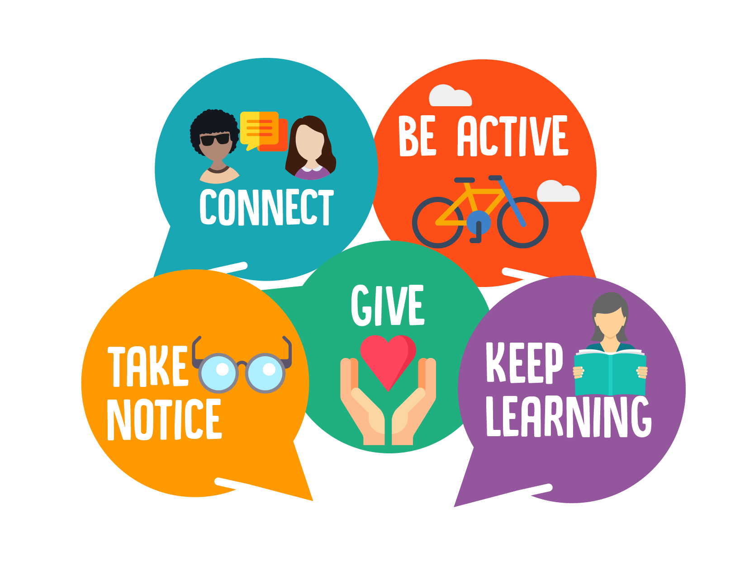
What can we do to develop our resilience?
5 ways to wellbeing
Working in partnership with:
Northumbria Healthcare NHS Foundation Trust
Cumbria, Northumberland, Tyne and Wear NHS Foundation Trust
Notes:
Resilience is about giving ourselves the right tools to handle anything that life throws at us.
We can improve our resilience using the 5 ways to wellbeing.
Everyone is individual and we all have different things that make us feel good, but researchers have recently come up with 5 ways to improve our mood and boost our emotional wellbeing that have been shown to work.
Connect
Be active
Take notice
Give
Keep learning.

Slide 9
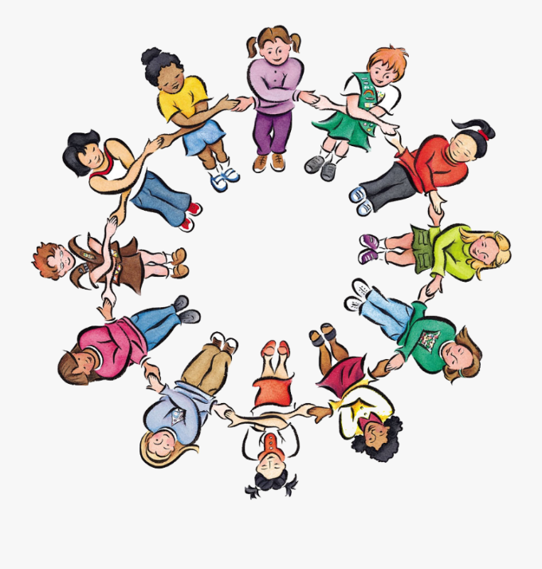
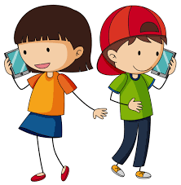
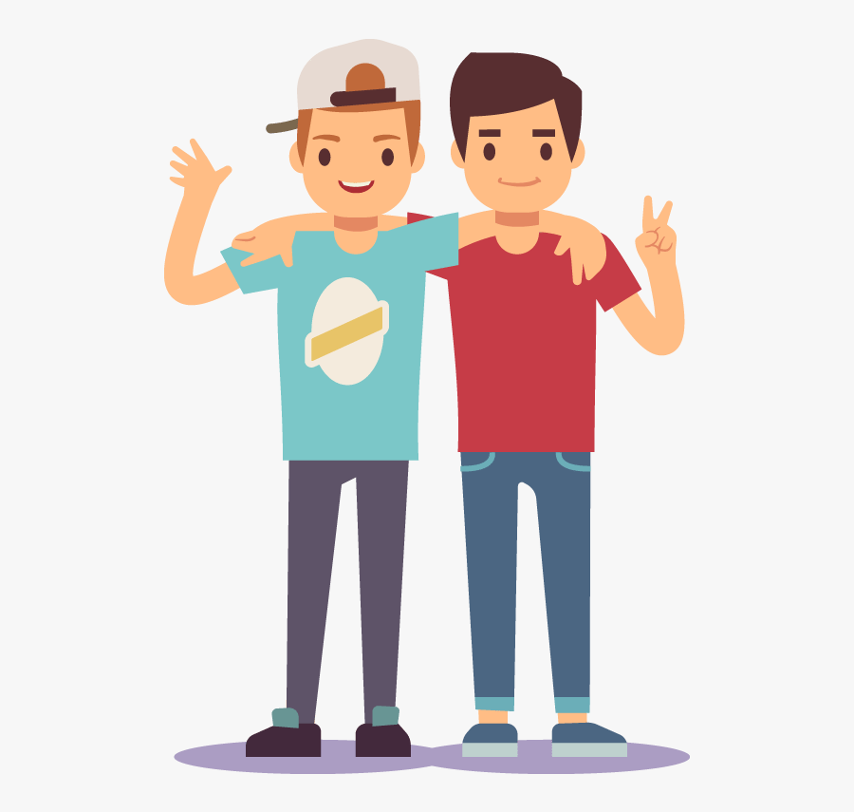
5 ways to wellbeing
Connect: Strengthening relationships with others and feeling close to and valued by others is critical to boosting wellbeing.
Working in partnership with:
Northumbria Healthcare NHS Foundation Trust
Cumbria, Northumberland, Tyne and Wear NHS Foundation Trust
Notes:
Connect
Good relationships are important for your mental wellbeing. They can:
help you to build a sense of belonging and self-worth
give you an opportunity to share positive experiences
provide emotional support and allow you to support others
Discussion- How could you connect with others? (give examples below if necessary)
There are lots of things you could try to help build stronger and closer relationships:
if possible, take time each day to be with your family
Talk to someone new
arrange a day out with friends
Join a club at school
have lunch with a friend
visit a friend or family member who needs support or company
Talk to someone on the phone/facetime
Connect with pets
Play with brothers/sisters
Write a letter to someone
Activity- On 5 ways to wellbeing sheet, write 5 ways you would/could connect with others this week.
Who would you connect with? What would you do?

Slide 10
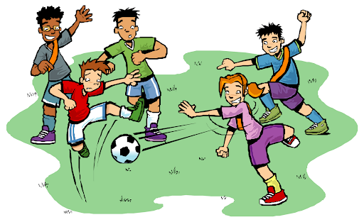
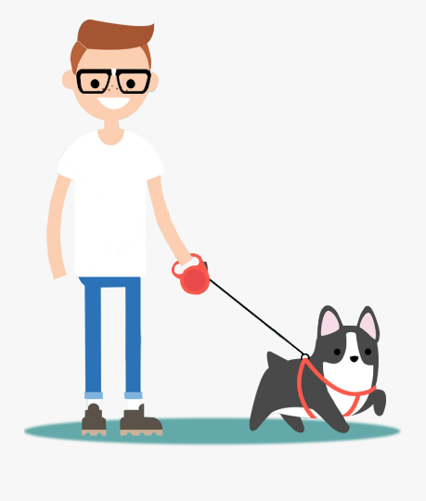
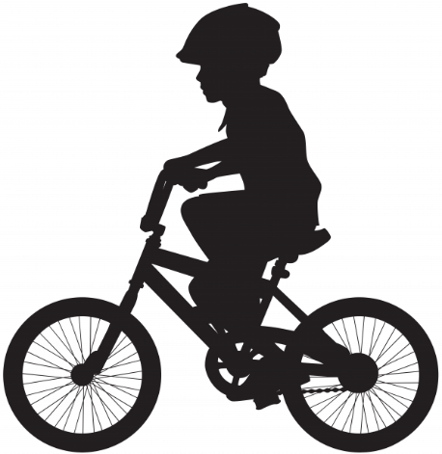
5 ways to wellbeing
Be Active: Being physically active, improves our physical health and can improve our mood and wellbeing.
Working in partnership with:
Northumbria Healthcare NHS Foundation Trust
Cumbria, Northumberland, Tyne and Wear NHS Foundation Trust
Notes:
Be Active
Increasing our activity and exercise levels can boost our mood:
Makes us feel better about ourselves/ more hopeful/positive
Take on new tasks
improves our ability to think more clearly
Greater energy and motivation
Helping us think about something other than focussing on our unhelpful thoughts
Giving us a sense of achievement
Enjoyment
Socialise with others
Activity
Make a list of 5 activities that you enjoy or make you feel good!
Dance to your favourite song
Listen to music
Walk the dog
Cycle
Play a sport with friends
Join a club
Run in the playground
gardening
Activity- On 5 ways to wellbeing sheet, write 5 ways you could be active this week.

Slide 11
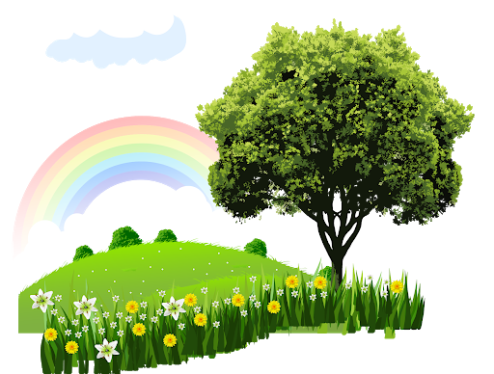
5 ways to wellbeing
Take Notice: Paying more attention to the present moment, to thoughts and feelings and to the world around, boosts our wellbeing.
Working in partnership with:
Northumbria Healthcare NHS Foundation Trust
Cumbria, Northumberland, Tyne and Wear NHS Foundation Trust
Notes:
Take notice
Our lives can be very busy… school, home, friends, homework, clubs etc. .we often forget to notice our surroundings and reflect on the day and experiences. This is about being mindful – appreciating what is around us and enjoying the moment.
In order to take notice you could:
Reﬂect on how you feel and what went well that day.
notice how your friends or family are feeling today
Relax and look around you- maybe clouds moving across the sky
listen to music or the sound outside.
take a few deep breaths.
paint or draw a picture of what you've seen today
Reading a book in the sunshine
Grounding exercise- We can stay in the moment by using out 5 senses
Children can work in pairs or individually.
Encourage them to control their breathing, slowly and deeply
Then ask them to:
5: Acknowledge FIVE things you see around you.
4: Acknowledge FOUR things you can touch around you
3: Acknowledge THREE things you hear.
2: Acknowledge TWO things you can smell.
1: Acknowledge ONE thing you can taste.
How did that feel/feedback
Alternative activity- Guided imagery
Close your eyes and bring yourself to a calm, quiet place in your mind. Just stay here and relax for a few moments. Breathe deeply and comfortably. Notice how your chest and belly move as you take calming, deep breaths.
Just listen as the air moves in and out…. in…. and out. It is a quiet and beautiful sound.
(Pause)
Now imagine transporting yourself magically to your favourite spot on a beach.
You can choose your favourite beach. Or if you’ve never been to a beach, just imagine what you think it would be like.
Picture yourself there now.
The sun shines brightly and gently warms your skin. It’s as if the sun is reaching down and pouring its love on you…. so warm and so nice.
Now you’ll slowly walk down toward the surf until you feel the lapping of the warm waves against your toes. Dig your toes deeply into the wet sand.
Feel the rhythm of the calm waves flow over the sand – it relaxes you. Notice how your breathing remains very calm and even- inhaling and exhaling slowly and calmly. Paying attention now, you slow down your breathing even further and allow your muscles to relax.
Feel the warmth of the sun melting your muscles into complete relaxation. Slowly and easily your body relaxes more and more …. releasing tension or frustration, releasing any worries or doubts you have. Inhaling deeply again – breathe in calm and peacefulness.
Look out at the vast, blue ocean. It’s so big, you can’t even see to the other side! Anytime your mind brings up worries, you can think of how small our problems seem when we’re standing next to the huge, beautiful sea. You can also take comfort in how the waves always keep going. Whether the seas are calm and easy or stormy and choppy, the waves never fail to wash up and make the shore look brand new – like it has a fresh start!
Your body is now relaxed; your mind is relaxed now too. You can empty your mind of all worries or thoughts that have been bothering you. Just enjoy this moment you have now.
Right now, only this matters, just relaxing and enjoying this moment. Breathe in deeply and allow the relaxation to flow to any part of your body that needs it.
Imagine the beautiful golden warm sun waking up each and every cell and muscle, making you feel so wonderful and alive! I’m sure you can feel the peace that surrounds you now, letting you know that everything is all right.
Take in a nice, deep breath again and bring your attention back to where you are….. along with all the calm, peaceful feelings of relaxation and rest

Slide 12
5 ways to wellbeing
Give: Any acts of kindness, whether small or large can make you feel happier and more satisfied about life.
Working in partnership with:
Northumbria Healthcare NHS Foundation Trust
Cumbria, Northumberland, Tyne and Wear NHS Foundation Trust
Notes:
Giving
Any acts of kindness, whether small or large can make you feel happier and more satisfied about life.
Discussion- What type of things could someone do to give/be kind to others?
Say thank you to someone who has helped you.
• Give unwanted items to a local charity shop
Give someone a compliment
• Donate your time to do something for someone else
• Offer to help your parents
• Bake a cake and give it to someone
• Do some volunteering
• Nominate someone for an award
• Give someone a hug
• Be a mentor for someone
• Raise money for charity
• Help an elderly neighbour
• Be a good role model
Fill in 5 ways to wellbeing sheet
Write down 5 things you could do to help others this week

Slide 13
5 ways to wellbeing
Keep Learning: Being curious and seeking out new experiences in life, positively stimulates the brain. Don’t worry if things go wrong- try again
Working in partnership with:
Northumbria Healthcare NHS Foundation Trust
Cumbria, Northumberland, Tyne and Wear NHS Foundation Trust
Notes:
Keep learning
Research shows that learning new skills can also improve your mental wellbeing by:
boosting self-confidence and self-esteem
helping you to build a sense of purpose
helping you to connect with others
Even if you feel like you do not have enough time, or you may not need to learn new things, there are lots of different ways to bring learning into your life.
Discussion- ask the class, what they/someone could do to increase their learning- provide examples
Try something new
Learn a new skill/hobby
Be creative- start a project
Read something new
Complete a puzzle
Make a cake
Learn how to play a musical instrument
Join a club
Learn a new word
Learn how to draw
Research something they are interested in.
Learn something new about the people around you
Write a story
Visit a new place
Talk about their interests with a partner.
Complete Learn section on 5 ways to Wellbeing sheet- what 5 activities could they could do this week to boost their learning

Slide 14
Key points to remember:
Resilience is our ability to cope and overcome difficult situations/events
Everyone experiences difficult times.
Think of challenges as opportunities to learn- growth mindset.
Pay attention to our body clues
It is alright to ask for help
Resilience can be developed using the 5 ways to wellbeing
Working in partnership with:
Northumbria Healthcare NHS Foundation Trust
Cumbria, Northumberland, Tyne and Wear NHS Foundation Trust
Notes:
We all experience low mood from time to time.
Low mood can affect the way we think, feel and what we do.
Live positively by using the 5 ways of wellbeing.
Possible extension activity- Children could draw their own 5 ways to wellbeing poster/ draw around their hand and include their planned activities
If you feel low it is important to talk to someone, who will be able to support you. At school…

Slide 15
Write down three things in your life you are grateful for. It can be anything at all.
Working in partnership with:
Northumbria Healthcare NHS Foundation Trust
Cumbria, Northumberland, Tyne and Wear NHS Foundation Trust
Notes:
To end
ask the children to reflect on their lives and write down three things they are grateful for. Give the children a few minutes to complete the exercise. After a few minutes bring the group back together and ask if anybody would like to share something they are grateful for.

