Slide 1





Self Esteem
Working in partnership with:
Northumbria Healthcare NHS Foundation Trust
Cumbria, Northumberland, Tyne and Wear NHS Foundation Trust

Slide 2
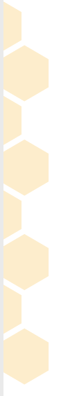


What is Self Esteem?
Working in partnership with:
Northumbria Healthcare NHS Foundation Trust
Cumbria, Northumberland, Tyne and Wear NHS Foundation Trust
Notes:
What is Self Esteem?
Ask the audience first!
There are no wrong answers because Self-Esteem means different things to different people.

Slide 3
Healthy Self Esteem
When we have healthy self esteem, we tend to feel positive about ourselves and about life in general. It makes us better able to deal with life's ups and downs.
Low Self Esteem
When our self esteem is low, we tend to see ourselves and our life in a more negative and critical light. We also feel less able to take on the challenges that life throws at us.
Working in partnership with:
Northumbria Healthcare NHS Foundation Trust
Cumbria, Northumberland, Tyne and Wear NHS Foundation Trust
Notes:
What’s the difference between healthy self esteem and low self esteem?
Having healthy self esteem helps us deal with the ups and downs of life. When our self esteem is at a healthy level, usually we feel more positive about ourselves.
When our self esteem is low, we tend to see ourselves more negatively and are more critical of ourselves. Having low self esteem can often make us feel unable to deal with the challenges of life.
Of course, it’s normal to have days when our self esteem is healthy and it is normal to have days when our self esteem is low.

Slide 4
Which of the following might be said (or thought) by someone with low self esteem?
2. I think I am a good person.
1. I say sorry even when I have done nothing wrong.
3. I’ll go along with what they want to do so that they like me.
4. If only I had hair like hers….
5. I can’t do that.
7. I won’t go to that after school club because I’ll be no good at it.
6. The teacher said my work was good. He gave me some tips on how to make it even better, which is really helpful
8. I didn’t do so well in the test, but I know what to do in order to do better next time.
9. The teacher only said my homework was good to be kind. She didn’t really think it was any good.
Working in partnership with:
Northumbria Healthcare NHS Foundation Trust
Cumbria, Northumberland, Tyne and Wear NHS Foundation Trust
Notes:
Have a think about which of these might be said (or thought) by someone who has low self esteem.
*** If this is delivered F2F, could use sets of real cards to share in pairs ***
Probably these:
1, 3, 4, 5, 7,9
Might be useful discussion to compare nos. 6 and 9 – someone with healthy self esteem is more likely to see the tips to make their work better as helpful/positive. Someone with low self esteem may have difficulty taking the praise that something they did was good, not believing it to be genuine.
No.5 – obviously this might be perfectly true – I can’t ride a horse, for example. But if it’s repeated and starts to be an automatic response to any kind of challenge in life it can be a difficulty. (The power of ‘yet’ could be explored here.)
Are there any of these that feel familiar for the children in your lives?

Slide 5
What causes low self esteem?
Low self-esteem often begins in childhood.
It can be caused by a number of things:
Comparing ourselves to others.
Problems with family
Problems at school
Health
Sometimes it passes on its own. If not, there are steps children can learn to help themselves feel better.
Working in partnership with:
Northumbria Healthcare NHS Foundation Trust
Cumbria, Northumberland, Tyne and Wear NHS Foundation Trust
Notes:
What causes low self esteem?
Low self-esteem often begins in childhood so it’s important to teach our children tips and techniques now.
We give positive and negative messages about our children even when we don’t realise we are, or don’t intend to. Our children’s teachers, friends, siblings, , and even social media does the same.
For some reason, the message that you are not good enough is the one that stays with you rather than the message that you are enough!!!
It can be caused by a number of things – our children comparing themselves to their friends, problems with family or at school or having health issues.
Sometimes it passes on its own or you can take steps to teach children to help them feel better.

Slide 6
Ways to improve low self esteem
Here are some simple techniques that may help a child feel better about themselves.
Build positive relationships
Learn to be assertive
Give themselves a challenge
Be kind to themselves
Recognise what they’re good at
Start saying “No”
Working in partnership with:
Northumbria Healthcare NHS Foundation Trust
Cumbria, Northumberland, Tyne and Wear NHS Foundation Trust
Notes:
Build positive relationships
If you find certain people tend to bring your child down, try to find ways for them to spend less time with them, or encourage your child to tell them how they feel about that person’s words/actions
Try to build relationships with people who are positive and who appreciate your child.
Give themselves a challenge
We all feel nervous or afraid to do things at times. But people with healthy self-esteem do not let these feelings stop them trying new things or taking on challenges.
Work with your child to set themselves a goal, such as joining an after school club or going to a social occasion. Achieving goals will help to increase their self-esteem.
Teach them to be assertive
Being assertive is about respecting other people's opinions and needs, and expecting the same from them.
One trick is to look at other people who act assertively and copy what they do. Encourage your child to do this.
Let them know it's not about pretending you're someone you're not. It’s about picking up hints and tips from people you admire. For example they might notice how someone uses a calm but firm voice when being assertive. Draw their attention to the way assertive people start statements with ‘I ‘ eg. I don’t like it when you say I can’t join in. I would like you to let me play. ‘I statements’ work because they are non-judgemental and they don’t blame or criticise.
Be kind to yourself
Being kind to yourself means being gentle to yourself at times when you feel like being self-critical.
Encourage your child to think what they'd say to a friend in a similar situation. We often give far better advice to others than we do to ourselves.
Start saying "no"
People with low self-esteem often feel they have to say yes to other people, even when they do not really want to.
The risk is that you become overburdened, resentful, angry and depressed.
For the most part, saying no does not upset relationships. It can be helpful to keep saying no, but in different ways, until they get the message.
Recognise what they’re good at
We're all good at something, whether it's cooking, singing, doing puzzles or being a friend. We also tend to enjoy doing the things we're good at, which can help boost your mood.

Slide 7

Mirror Mirror On The Wall
Looking in the mirror once a day and saying something that you like about yourself
can really help.
It may be difficult to start
with but this will
slowly start to help you feel happy in your own skin.
Working in partnership with:
Northumbria Healthcare NHS Foundation Trust
Cumbria, Northumberland, Tyne and Wear NHS Foundation Trust
Notes:
Mirror Mirror On The Wall – an activity to encourage your children to try – you could do it with them
***you will need some mirrors for this activity***
Let’s have a go….
Everybody take a mirror and look at yourself for a few moments.
Think about things you like about yourself. It can be things you like about the way that you look, or things you like about your personality, or things that you are good at or enjoy doing.
For Example, you might say to yourself:
I like my brown hair
I like my glasses
I like my sense of humour
I like that I play football
I like that I enjoy drawing and painting
I like that I take my dog for a walk
I like my family
I like my friends
I like that I have friends to play on the X-Box with
I like my long legs
I like my laugh
Try saying what you like about yourself to yourself in the mirror.
If you find this difficult to do, you could whisper them to begin with, or even write them down and then work towards saying them out loud.
The more children practice telling themselves that they like themselves, the easier it will become and the more they will begin to believe it. ***HOW WOULD YOU ADAPT THIS ACTIVITY TO USE WITH YOUR CHILD? ***

Slide 8
Building Confidence after Bullying
Bullying or cyberbullying can really affect your child’s confidence
and self esteem.
Feeling better can take time, but here are some tips to help.
Talk to someone
Try something new
Let go of any guilt
Be proud of what makes you different
Take your time
Working in partnership with:
Northumbria Healthcare NHS Foundation Trust
Cumbria, Northumberland, Tyne and Wear NHS Foundation Trust
Notes:
Talk to someone
Having someone listen to can help your child to feel less alone. They could talk to a friend, family member or another adult that they trust.
Try something new
You could support your child to start a new hobby, make something creative or challenge themselves in some way.
Let go of any guilt
Lots of people blame themselves for being bullied or end up thinking they deserved it. But let your child know that bullying is done by the bully, and it's never their fault. Ask them to try imagining what they'd say to a friend if they'd been bullied and felt guilty.
Be proud of what makes you different
Let your child know that difference is amazing. And the world would be boring if everyone was the same. If someone's made your child feel bad for being or looking different, or bullied them about their race, gender, or because they have a disability, it can be really upsetting.
Ask them to make a list of all the things that they like about being different or that they're proud of. They can always ask a Childline counsellor for help.
Take your time
Building confidence isn't easy and it can take time to feel better. Encourage your child to take small steps every day. They could try using the mood journal on the Childline website to track what they've tried and how it made them feel ( or just make your own)

Slide 9
Extra Tips to Boost your child’s Self Esteem
Building confidence can take time.
But there are lots of things they can try to help them feel more confident in any situation.
Act as if you already have confidence
Watch your words
Try something new
Listen to music
Eat better, feel better
Be kind
Change the way you think
Set yourself goals
Working in partnership with:
Northumbria Healthcare NHS Foundation Trust
Cumbria, Northumberland, Tyne and Wear NHS Foundation Trust
Notes:
Act as if you already have confidence – talk with your child about what traits a person with confidence might display eg. Walking with head held high. Get them to practice doing this/behaving in this way.
Watch your words –sometimes the way we say something an make a big difference to how we feel – for example taking a moment before we answer a question can help us feel more confident about what we are saying, swapping ‘sort of’ and ‘not really’ for decisive ‘yes’ or ‘no’ can make us sound clearer and more confident.
Try something new- talk with your child about them trying something new every day – small things like wearing their hair differently, or bolder things like speaking up in class – each time they’ll be stepping out of their comfort zone and boosting their confidence. You could do it along with them, so they can see how new things, no matter how small, can help.
Listen to music – music can be very powerful – choose songs which are positive messages/uplifting
Eat better , feel better –looking after yourself physically really can make you feel more confident – you will naturally feel better and have more energy.
Be kind- helping others can help us feel appreciated and valued – talk with your child about little things they could do to help someone else- a neighbour, a family member?
Change the way you think- Taking the time to notice when things go well and realising when you're being too hard on yourself can improve your self-esteem and make you feel better. Whenever something happens and your child has a have a negative thought about themselves, encourage them to ask themselves if that though is helpful? Could they change the thought to a more balanced one? This will take practice and support.
Set yourself goals – ask your child to write down 3 things they would like to improve or learn – help them to pick one for starters and make a plan for the first steps to making it happen.

Slide 10
What about giving praise?
Of course praise is good – it’s a way to show you are proud.
BUT use it wisely
Don’t over praise
Be specific
Praise effort
Working in partnership with:
Northumbria Healthcare NHS Foundation Trust
Cumbria, Northumberland, Tyne and Wear NHS Foundation Trust
Notes:
Don’t over praise - Praise that doesn't feel earned doesn't ring true. For example, telling a child he did great at something when he knows he didn't feels a bit hollow . It's better to say, "I know that was tricky for you- I'm proud of you for not giving up."
Be specific- this way your child knows exactly what you have noticed and starts to see progress in themselves as a result. For example, ‘Well done’ compared to ‘You did so well this morning when you got ready for school without getting upset. I know Monday’s can be hard for you, so well done you.
Praise effort: Avoid focusing praise only on results (such as getting an A) or fixed qualities (such as being clever or athletic). Let them know that you value effort rather than perfection. Offer most of your praise for effort, progress, and attitude. For example: "You're working hard on that project," "You're getting better and better at these spelling tests,“. “ I’m so proud of you for practising X – well done for sticking with it” This kind of praise encourages children to put effort into things and work toward goals, which can help with their self-esteem.

Slide 11





Self Esteem Online Support
https://www.nhs.uk/conditions/stress-anxiety-depression/ways-relieve-stress/
https://youngminds.org.uk/find-help/looking-after-yourself/take-time-out/
https://www.childline.org.uk/
https://www.mind.org.uk/information-support/for-children-and-young-people/
https://www.kooth.com/
Working in partnership with:
Northumbria Healthcare NHS Foundation Trust
Cumbria, Northumberland, Tyne and Wear NHS Foundation Trust
Notes:
Online Support
There is an abundance of online support and guidance in relation to Self Esteem.
We only recommend using websites and apps that have been verified and deemed appropriate for children and young people by professionals.
So please explore, investigate and find techniques and practices that work for you and your family.
They are all free and can provide you with advice, support and guidance on a number of issues that your child might be facing right now.

Slide 12
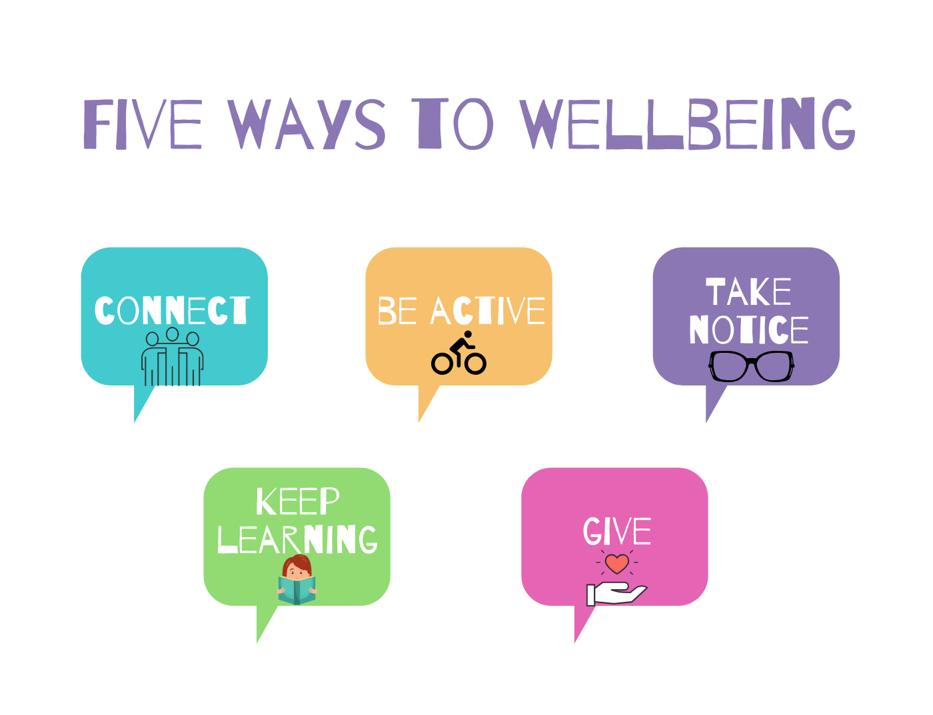
Working in partnership with:
Northumbria Healthcare NHS Foundation Trust
Cumbria, Northumberland, Tyne and Wear NHS Foundation Trust
Notes:
Keep these 5 ways to well being in mind as you support a child who is struggling with their self esteem.

Slide 13
THANK YOU
for listening and taking part
Working in partnership with:
Northumbria Healthcare NHS Foundation Trust
Cumbria, Northumberland, Tyne and Wear NHS Foundation Trust

Slide 14
References
https://www.nhs.uk/conditions/stress-anxiety-depression/raising-low-self-esteem/
https://healthtalk.org/depression-and-low-mood/depression-self-and-self-esteem
https://youngminds.org.uk/find-help/looking-after-yourself/believe-in-yourself/
https://www.childline.org.uk/info-advice/your-feelings/feelings-emotions/building-confidence-self-esteem/
Working in partnership with:
Northumbria Healthcare NHS Foundation Trust
Cumbria, Northumberland, Tyne and Wear NHS Foundation Trust

