Slide 1
Self Esteem
Working in partnership with:
Northumbria Healthcare NHS Foundation Trust
Cumbria, Northumberland, Tyne and Wear NHS Foundation Trust

Slide 2
What is Self Esteem?
Self-esteem is the opinion we have of ourselves.
Working in partnership with:
Northumbria Healthcare NHS Foundation Trust
Cumbria, Northumberland, Tyne and Wear NHS Foundation Trust
Notes:
What is Self Esteem?
Ask the audience first!
There are no wrong answers because Self-Esteem means different things to different people.
Seek feedback from a variety of children and young people, boys and girls, to allow for a variety of responses.

Slide 3
Healthy Self Esteem
When we have healthy self esteem, we tend to feel positive about ourselves and about life in general. It makes us better able to deal with life's ups and downs.
Low Self Esteem
When our self esteem is low, we tend to see ourselves and our life in a more negative and critical light. We also feel less able to take on the challenges that life throws at us.
Working in partnership with:
Northumbria Healthcare NHS Foundation Trust
Cumbria, Northumberland, Tyne and Wear NHS Foundation Trust
Notes:
What’s the difference between healthy self esteem and low self esteem?
Having healthy self esteem helps us deal with the ups and downs of life. When our self esteem is at a healthy level, usually we feel more positive about ourselves.
When our self esteem is low, we tend to see ourselves more negatively and are more critical of ourselves. Having low self esteem can often make us feel unable to deal with the challenges of life.
It is normal to have days when our self esteem is healthy and it is normal to have days when our self esteem is low.

Slide 4
We all have times when we lack confidence and don’t feel good about ourselves.
Write down 3 things that make you, you!
Write down 3 things that
you would like to learn
or improve!
Working in partnership with:
Northumbria Healthcare NHS Foundation Trust
Cumbria, Northumberland, Tyne and Wear NHS Foundation Trust
Notes:
We all have times when we lack confidence and don’t feel good about ourselves.
It’s how we view ourselves that counts!
On one side of your piece of paper, write down three things that make you, you! It could be things like:
Subjects you enjoy
Sports you play
Musical instruments you play
The colour of your hair
If you have freckles or wear glasses
Interests you have
Books you’ve read and enjoyed
Now, turn your piece of paper over and write down three things that you would like to learn or improve at: So things like:
Read more often
Join a sports club
Help out more at home
Say Hello to younger students
Not talk during assembly
Now keep these pieces of paper safe for later!

Slide 5
What causes low self esteem?
Low self-esteem often begins in childhood.
It can be caused by a number of things:
Comparing yourself to your friends
Problems with family
Problems at school
Your health
Sometimes it passes on its own or you can take steps to help yourself feel better.
Working in partnership with:
Northumbria Healthcare NHS Foundation Trust
Cumbria, Northumberland, Tyne and Wear NHS Foundation Trust
Notes:
What causes low self esteem?
Low self-esteem often begins in childhood so it’s important to learn tips and techniques now.
Our teachers, friends, siblings, parents, and even social media send us positive and negative messages about ourselves daily, most of the time without meaning to.
For some reason, the message that you are not good enough is the one that stays with you rather than the message that you are enough!!!
It can be caused by a number of things – comparing yourself to your friends, problems with family or at school or having health issues.
Sometimes it passes on its own or you can take steps to help yourself feel better. And that’s what we’re here to help you with.

Slide 6
Ways to improve low self esteem
Here are some simple techniques that may help you feel better about yourself.
Build positive relationships
Learn to be assertive
Give yourself a challenge
Be kind to yourself
Recognise what you’re good at
Start saying “No”
Working in partnership with:
Northumbria Healthcare NHS Foundation Trust
Cumbria, Northumberland, Tyne and Wear NHS Foundation Trust
Notes:
Recognise what you're good at
We're all good at something, whether it's cooking, singing, doing puzzles or being a friend. We also tend to enjoy doing the things we're good at, which can help boost your mood.
Build positive relationships
If you find certain people tend to bring you down, try to spend less time with them, or tell them how you feel about their words or actions.
Try to build relationships with people who are positive and who appreciate you.
Be kind to yourself
Being kind to yourself means being gentle to yourself at times when you feel like being self-critical.
Think what you'd say to a friend in a similar situation. We often give far better advice to others than we do to ourselves.
Learn to be assertive
Being assertive is about respecting other people's opinions and needs, and expecting the same from them.
One trick is to look at other people who act assertively and copy what they do.
It's not about pretending you're someone you're not. It's picking up hints and tips from people you admire and letting the real you come out.
Start saying "no"
People with low self-esteem often feel they have to say yes to other people, even when they do not really want to.
The risk is that you become overburdened, resentful, angry and depressed.
For the most part, saying no does not upset relationships. It can be helpful to keep saying no, but in different ways, until they get the message.
Give yourself a challenge
We all feel nervous or afraid to do things at times. But people with healthy self-esteem do not let these feelings stop them trying new things or taking on challenges.
Set yourself a goal, such as joining an exercise class or going to a social occasion. Achieving your goals will help to increase your self-esteem.

Slide 7
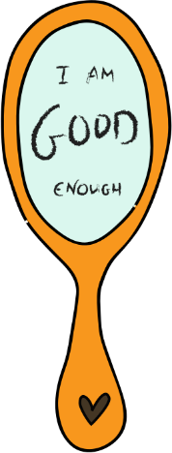
Mirror Mirror On The Wall
Looking in the mirror once a day and saying something that you like about yourself
can really help.
It may be difficult to start
with but this will
slowly start to help you feel happy in your own skin.
Working in partnership with:
Northumbria Healthcare NHS Foundation Trust
Cumbria, Northumberland, Tyne and Wear NHS Foundation Trust
Notes:
Mirror Mirror On The Wall
***you will need some mirrors for this activity***
Let’s have a go….
Everybody take a mirror and look at yourself for a few moments.
Think about things you like about yourself. It can be things you like about the way that you look, or things you like about your personality, or things that you are good at or enjoy doing.
For Example, you might say to yourself:
I like my brown hair
I like my glasses
I like my sense of humour
I like that I play football
I like that I enjoy drawing and painting
I like that I take my dog for a walk
I like my family
I like my friends
I like that I have friends to play on the X-Box with
I like my long legs
I like my laugh
Try saying what you like about yourself to yourself in the mirror.
If you find this difficult to do, you could whisper them to begin with, or even write them down and then work towards saying them out loud.
The more we practice telling ourselves that we like ourselves, the easier it will become and the more we will begin to believe it.
Keep practising at home!

Slide 8
Building Confidence after Bullying
Bullying or cyberbullying can really affect your confidence
and self esteem.
Feeling better about yourself can take time, but our tips can
help if you're struggling.
Talk to someone
Try something new
Let go of any guilt
Be proud of what makes you different
Take your time
Working in partnership with:
Northumbria Healthcare NHS Foundation Trust
Cumbria, Northumberland, Tyne and Wear NHS Foundation Trust
Notes:
Talk to someone
Having someone listen to you can help you to feel less alone. You could talk to a friend, family member or another adult you trust.
Try something new
You could start a new hobby, make something creative or challenge yourself to say hello to someone new every day. It could be anything.
Let go of your guilt
Lots of people blame themselves for being bullied or end up thinking they deserved it. But bullying is done by the bully, and it's never your fault. Try imagining what you'd say to a friend if they'd been bullied and felt guilty.
Be proud of what makes you different
Difference is amazing. And the world would be boring if everyone was the same. If someone's made you feel bad for being or looking different, or bullied you about your race, gender, or because you have a disability, it can be really upsetting. Try making a list of all the things that you like about being different or that you're proud of. You can always ask a Childline counsellor to help you.
Take your time
Building confidence isn't easy and it can take time to feel better. Taking small steps every day can make a big difference. Try using the mood journal to write down what you've tried and how it made you feel.

Slide 9
Extra Tips to Boost your Self Esteem
Building your confidence can take time.
But there are lots of things you can try to help you feel more confident in any situation.
Act as if you already have confidence
Watch your words
Try something new
Listen to music
Eat better, feel better
Be kind
Change the way you think
Set yourself goals
Working in partnership with:
Northumbria Healthcare NHS Foundation Trust
Cumbria, Northumberland, Tyne and Wear NHS Foundation Trust
Notes:
Set yourself goals…
Remember the piece of paper from the first activity – you should have at least two things that you would like to learn or improve at.
Well there you go! There’s you first goals to work towards!
Now it’s up to you to make a plan about how to achieve your goals.
Why not start now and begin working towards achieving just one of your goals today.

Slide 10
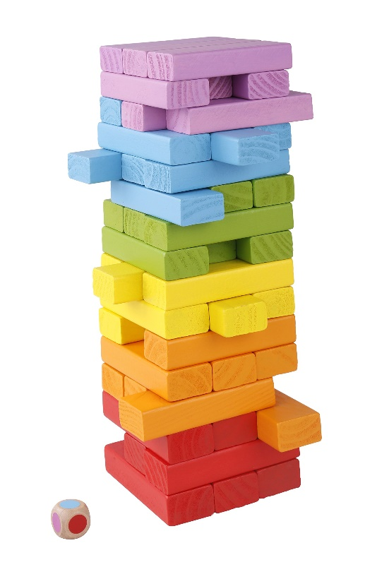
The Tower of Self Esteem
The Tower of Self Esteem is all about:
Recognising what you like about yourself
Working together as a team
Learning to accept everyone for who they
are
Learning how to re-build your self esteem
if it has been damaged
Learning how to help re-build someone
else’s self esteem if it has been damaged
Working in partnership with:
Northumbria Healthcare NHS Foundation Trust
Cumbria, Northumberland, Tyne and Wear NHS Foundation Trust
Notes:
The Tower of Self Esteem
On the table, there are lots of Jenga bricks.
On each Jenga brick, there is a positive message in relation to how we feel about ourselves.
Everybody here is going to get the chance to choose a Jenga piece that represents something they like about themselves.
Then, as a team, were going to build a Tower of Self Esteem.
**BUILD TOWER OF SELF ESTEEM**
I wonder, what would happen if a piece of the tower was either taken or fell out of the tower?
What might make someone not believe their own message of positivity? (being bullied, not having the same hair colour as someone else etc…)
Does this mean that this message isn’t true anymore?
**READ THE MESSAGE OUT**
What could we do to help re-build this persons Tower of Self Esteem?
Could we say anything to them to make them feel better?
Could we do anything to make them feel better?
Should we leave the Jenga brick out of the tower or should we use it to build the Tower of Self Esteem even higher?
If we place this brick on top, whilst thinking about all of the positive messgaes you have given this person, do you think this will help re-build there confidence?
Yes, Great!!

Slide 11
Self Esteem Online Support
https://www.nhs.uk/conditions/stress-anxiety-depression/ways-relieve-stress/
https://youngminds.org.uk/find-help/looking-after-yourself/take-time-out/
https://www.childline.org.uk/
https://www.mind.org.uk/information-support/for-children-and-young-people/
https://www.kooth.com/
Working in partnership with:
Northumbria Healthcare NHS Foundation Trust
Cumbria, Northumberland, Tyne and Wear NHS Foundation Trust
Notes:
Online Support
There is an abundance of online support and guidance in relation to Self Esteem.
We only recommend using websites and apps that have been verified and deemed appropriate for children and young people by professionals.
So please explore, investigate and find techniques and practices that work for you – just be careful.
They are all free and can provide you with advice, support and guidance on a number of issues that you might be facing right now.

Slide 12
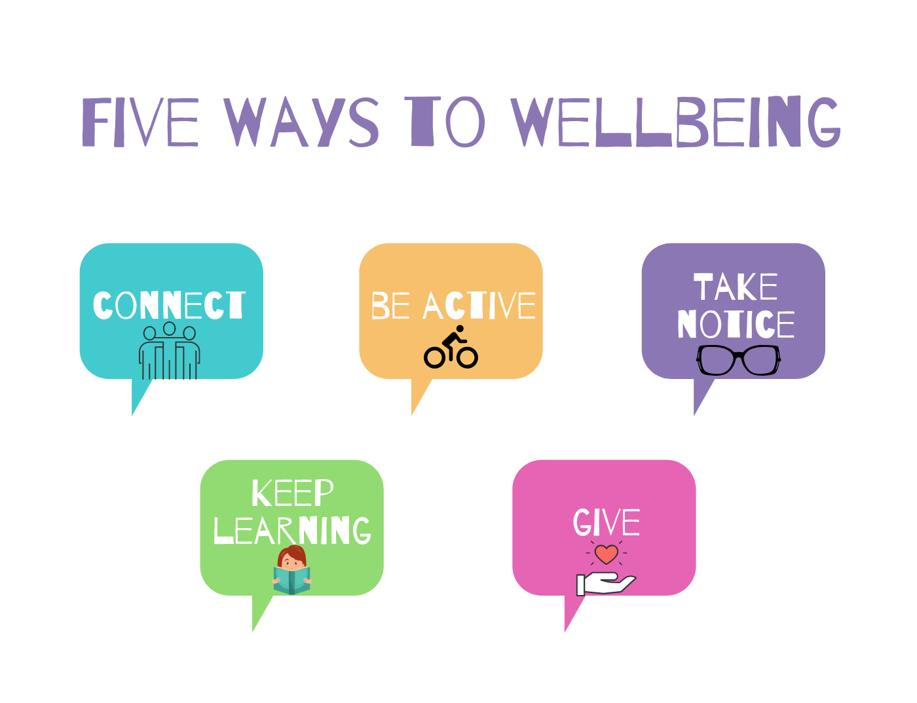
Working in partnership with:
Northumbria Healthcare NHS Foundation Trust
Cumbria, Northumberland, Tyne and Wear NHS Foundation Trust

Slide 13
THANK YOU
for listening and taking part
Working in partnership with:
Northumbria Healthcare NHS Foundation Trust
Cumbria, Northumberland, Tyne and Wear NHS Foundation Trust

Slide 14
References
https://www.nhs.uk/conditions/stress-anxiety-depression/raising-low-self-esteem/
https://healthtalk.org/depression-and-low-mood/depression-self-and-self-esteem
https://youngminds.org.uk/find-help/looking-after-yourself/believe-in-yourself/
https://www.childline.org.uk/info-advice/your-feelings/feelings-emotions/building-confidence-self-esteem/
Working in partnership with:
Northumbria Healthcare NHS Foundation Trust
Cumbria, Northumberland, Tyne and Wear NHS Foundation Trust

