Slide 1




Self-harm
Working in partnership with:
Northumbria Healthcare NHS Foundation Trust
Cumbria, Northumberland, Tyne and Wear NHS Foundation Trust
Notes:
Introduce self and role/service
Today we are going to discuss Self Harm, which we acknowledge for some you will trigger some difficult feelings. We hope to provide you with some further understanding of self-harm and why our young people do it. We want you to take away some strategies of support and guidance of who to go to if you need to seek help for you child. Please ask questions as we progress, there are no silly questions. We appreciate that you may need some time out, please feel free to step out of the room if needed. We will be available for further discussion at the end if required. This is a safe confidential space, please be considerate of others in the room.
Aims/objectives
what self-harm is
Methods of self-harm
potential causes
Warning signs
Ground Rules
Confidentiality
Look after yourself- I understand that some people may find this topic a little uncomfortable, so if you need to leave the room you can.
Look after each other
Ask any questions you have

Slide 2
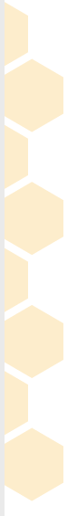
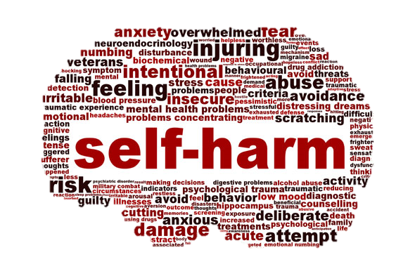

What is Self-harm?
What comes to mind when you think of ‘self-harm’?
Self-harm is any behaviour where someone intentionally damages or injures their body, usually as a way to help cope with difficult or distressing thoughts and feelings. Mental Health Foundation
Working in partnership with:
Northumbria Healthcare NHS Foundation Trust
Cumbria, Northumberland, Tyne and Wear NHS Foundation Trust
Notes:
What is self-harm?
Discussion (if appropriate)- What words do you think of, when you hear the words ‘self-harm’?
How would you define self-harm, talk to the person next to you.
Feedback
The Mental Health Foundation- describes self-harm as any behaviour where someone intentionally damages or injures their body, usually as a way to help cope with difficult or distressing thoughts and feelings.
More official quote of what self-harm is. Demonstrates it is a maladaptive coping strategy – self destructive. Most people adopt some self destructive behaviours at times even if they don’t realise it, to avoid being alone with their thoughts and feelings. They may smoke, eat or drink too much or work extra hard at work or school. What is worth remembering is that it is a temporary relief – it doesn’t change or resolve the issues leading to self-harm.
Self-harm is a behaviour- not an illness

Slide 3
Methods of self-harm?
Cutting
Burning/scalding
Overdose/self poisoning
Hair pulling
Restrictive eating
Picking/pinching skin
Self-hitting/ biting self
Excessive risk taking behaviours
Breaking bones
Bruising
Restricting airway
Working in partnership with:
Northumbria Healthcare NHS Foundation Trust
Cumbria, Northumberland, Tyne and Wear NHS Foundation Trust
Notes:
Discussion- ask audience to name/or discuss, if appropriate
It most frequently takes the form of cutting, burning or non-lethal overdoses. However, it can also be any behaviour that causes injury – no matter how minor, or high-risk behaviours.
Basically, any behaviour that that causes harm or injury to someone as a way to deal with difficult emotions can be seen as self-harm. (Hair pulling, scratching, bruising, poisoning, biting etc.)
Research shows that girls are more likely to use cutting as their method of harm, while boys tend to self-hit.

Slide 4
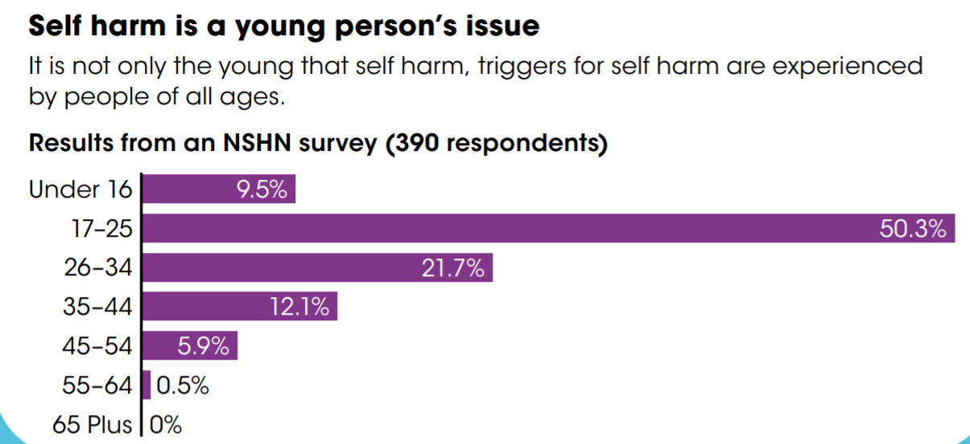
Who does this affect?
“Self-harm does not discriminate on the basis of gender, race, age, religion, disability or sexual orientation.”
most prevalent in adolescents and young adults aged between 11-25.
Working in partnership with:
Northumbria Healthcare NHS Foundation Trust
Cumbria, Northumberland, Tyne and Wear NHS Foundation Trust
Notes:
There is no such thing as a typical young person who self-harms. Self-harm is something that can affect anyone.
“Self-harm does not discriminate on the basis of gender, race, age, religion, disability or sexual orientation.”
most prevalent in adolescents and young adults aged between 11-25. Usually starting with the onset of puberty. This age represents a time of great physical, social and mental change and development.

Slide 5
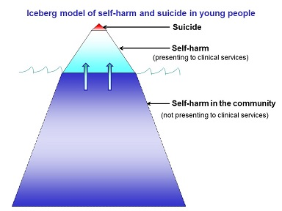
Who does this affect?
1 in 10 young people self-harm, but it could be as high as 20%.
Some research indicates four times as many females as males self-harm.
The level of reported incidents has risen by 68 % in the last 10 years.
Working in partnership with:
Northumbria Healthcare NHS Foundation Trust
Cumbria, Northumberland, Tyne and Wear NHS Foundation Trust
Notes:
It’s believed that around 10% of young people self-harm, (that is on average 3 per class), but the figure could be as high as 20%.
This is due to self-harm often being a hidden and secretive behaviour- stigma still attached. Therefore many cases will go unreported, and will not reflect the true prevalence- use diagram
Some research indicates four times as many females as males self-harm- Males are less likely to come forward and talk about their difficulties
The level of reported incidents has risen by 68 % in the last 10 years.

Slide 6
Dispelling the Myths
Self-harm is an attention seeking and manipulative behaviour
Self-harm is a ‘Goth’ thing
Only girls self-harm
Self-harm is a form of suicidal behaviour
They must enjoy it or they would stop
Working in partnership with:
Northumbria Healthcare NHS Foundation Trust
Cumbria, Northumberland, Tyne and Wear NHS Foundation Trust
Notes:
Discussion-Look at these statements- what do you think when you read these? Have you heard these before? Discuss with a partner
There are lots of myths attached to self-harm. This isn’t surprising – myths and misunderstandings often arise when a problem like self-harm is poorly understood. Negative stereotypes can be powerful.
MYTH: ‘Self-harm is attention-seeking’ One of the most common stereotypes is that self-harm is about ‘attention seeking’. This is not the case. Many people who self-harm don’t talk to anyone about what they are going through for a long time and it can be very hard for them to find enough courage to ask for help.
MYTH: ‘Self-harm is a goth thing’ Self-harm has been stereotyped to be seen as part of youth subcultures such as “goth” or “emo”. While there is some research suggesting a link, there is no conclusive evidence of this with little or no evidence supporting the belief that self-harm is part of any particular young person subculture.
MYTH: ‘Only girls self-harm’ It is often assumed that girls are more likely than boys to self-harm, however it isn’t clear if this is true. Boys and girls may engage with different self-harming behaviours or have different reasons for hurting themselves, but this doesn’t make it any less serious.
MYTH: ‘People who self-harm must enjoy it’ Some people believe that people who self-harm take pleasure in the pain or risk associated in the behaviour. There is no evidence that people who self-harm feel pain differently than anyone else. The harming behaviour often causes people great pain. For some, being depressed has left them numb and they want to feel anything to remind them they are alive, even if it hurts. Others have described this pain as punishment.
MYTH: ‘People who self-harm are suicidal’ People often associate self harm with attempted suicide however this is rarely the case. People suffering emotional distress may feel suicidal but as self harm is a coping mechanism its function is predominantly to prevent suicide rather than being a suicide However, some people who self-harm can feel suicidal and might attempt to take their own life, which is why it must always be taken seriously.

Slide 7
Common problems preceding
self-harm
Traumatic events, e.g. abuse, bereavement
Difficulty at home- not getting on with parents/ family breakdown.
Difficulty at school- workload, pressure and stress Bullying
Relationship/friendship difficulties- Bullying, relationship breakdown
Difficulties associated with sexuality, race, culture or religion
Mental Health conditions, such as anxiety and depression
Low self-esteem
Feeling rejected – friends or family
Difficulty expressing themselves/feelings
Physical ill health, alcohol and drug use
(NSPCC 2020)
Working in partnership with:
Northumbria Healthcare NHS Foundation Trust
Cumbria, Northumberland, Tyne and Wear NHS Foundation Trust
And many many more…
Notes:
There is not just one factor that contributes to self-harm. Instead, there are a variety of biological and environmental issues.
Someone’s reason to self-harm can be very different from other people who self-harm. Some of the reasons that young people report as triggers or reasons that lead them to self-harm include:
Traumatic events, e.g. abuse, bereavement
Difficulty at home- not getting on with parents/ family breakdown.
Difficulty at school- workload, pressure and stress Bullying
Relationship/friendship difficulties- Bullying, relationship breakdown
Difficulties associated with sexuality, race, culture or religion
Mental Health difficulties, such as anxiety and depression
Low self-esteem
Feeling rejected – friends or family
Difficulty expressing themselves/feelings
Physical ill health, alcohol and drug use
It is important to remember that although these are risk factors that can make someone more likely to self-harm, having any of these does not mean someone will self-harm. Similarly, someone who self-harms might not experience any of these. Anyone can be affected.

Slide 8
“It’s a way of coping”
Children and young people often use self-harm as a coping mechanism.
They may engage in self-harm in an attempt to:
reduce tension
manage extreme emotional upset
distract from emotional pain
express emotions such as hurt, anger or frustration
regain a sense of control
punish themselves or others
feel something
Working in partnership with:
Northumbria Healthcare NHS Foundation Trust
Cumbria, Northumberland, Tyne and Wear NHS Foundation Trust
Notes:
Reasons why
Children and young people engage in self-harm for a number of different reasons
reduce tension
manage extreme emotional upset
To distract from emotional pain
express emotions such as hurt, anger or frustration
regain control over feelings or problems
punish themselves or others
To feel something- rather than numb- The act of cutting releases endorphins for immediate relief from emotional stress. It is likely that the body grows to expect a higher level of these chemicals.

Slide 9
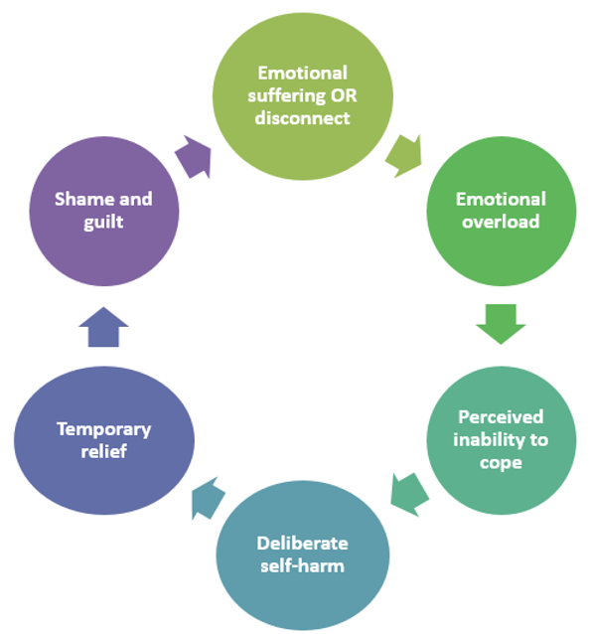
The self-harm cycle
The self-harm
cycle
Working in partnership with:
Northumbria Healthcare NHS Foundation Trust
Cumbria, Northumberland, Tyne and Wear NHS Foundation Trust
Notes:
The self-harm cycle
Talk through cycle using diagram
Self-harm usually starts as a way to relieve the build-up of pressure from distressing thoughts and feelings. This might give temporary relief from the emotional pain the person is feeling. It’s important to know that this relief is only temporary because the underlying reasons still remain. Soon after, feelings of guilt and shame might follow, which can continue the cycle.
Because there may be some temporary relief at the start, self-harm can become someone’s normal way of dealing with life’s difficulties. This means that it is important to talk to someone as early as possible to get the right support and help. Learning new coping strategies to deal with these difficulties can make it easier to break the cycle of self-harm in the long term.

Slide 10
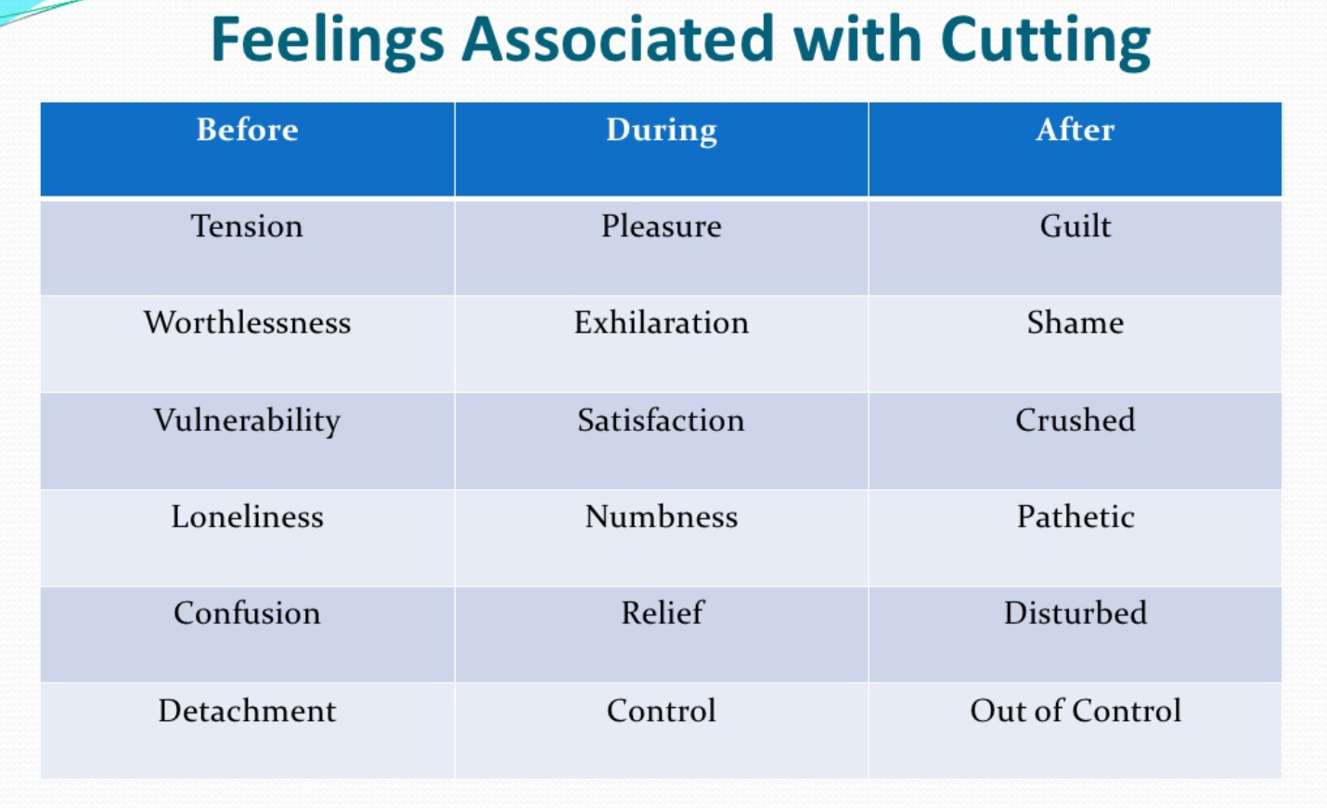
The self-harm cycle
Working in partnership with:
Northumbria Healthcare NHS Foundation Trust
Cumbria, Northumberland, Tyne and Wear NHS Foundation Trust
Notes:
Adds to previous slide- How emotions feed in

Slide 11
Warning signs
Unexplained wounds or scars from cuts, bruises or burns. Usually wrists, arms, thighs or chest
Blood stains on clothing, towels, bedding or tissues
Sharp objects i.e. razors, knives, needles, blades in person’s belongings
Frequent ‘accidents’
Covering up, even in hot weather
Avoiding activities/situations that may require exposure of scars/marks
Needing to be alone for long periods of time, especially in the bedroom or bathroom
Isolation or irritability
Withdrawal
Anger/frustration
Signs of low mood/depression
Working in partnership with:
Northumbria Healthcare NHS Foundation Trust
Cumbria, Northumberland, Tyne and Wear NHS Foundation Trust
Notes:
How to recognise self-harm
It can be hard to recognise when someone has started to self-harm as they may not want anyone else to know.
There are also many different ways that someone might self-harm.
Warning signs
Unexplained wounds or scars from cuts, bruises or burns. Usually wrists, arms, thighs or chest
Blood stains on clothing, towels, bedding or tissues
Sharp objects i.e. razors, knives, needles, blades in person’s belongings
Frequent ‘accidents’
Covering up, even in hot weather
Avoiding activities/situations that may require exposure of scars/marks
Needing to be alone for long periods of time, especially in the bedroom or bathroom
Isolation or irritability
Withdrawal
Anger/frustration
Signs of low mood/depression

Slide 12
Advice for parents
Look after yourself
Offer them emotional support:
Communication is key
Be supportive
Keep an open mind
Listen, trying not to ask too many questions about why they’ve been self-harming,
Try to understand their emotions and experiences, without judgment.
Collaborative approach
Ask if they would like to talk to someone else
Working in partnership with:
Northumbria Healthcare NHS Foundation Trust
Cumbria, Northumberland, Tyne and Wear NHS Foundation Trust
Notes:
What can help
1. Remember to take extra care of yourself- If you know or suspect your child is engaging in self-harm, it's natural to feel a whole range of emotions. You might feel shocked, angry, sad, disappointed, confused, or scared. You might feel hurt that your teen didn't come to you for help or feel guilty that you didn't know about it. All of these emotions are completely understandable. But it's not your fault, and it's not your teen's fault.
Helping your child recover from self-harm will take energy and patience. It is important to get support for yourself, if required. It may be difficult to support your child if you are also stressed, tired and upset.
Be aware that you can influence how your child responds to stress and pressure by setting a good example.
2. Offer them emotional support:
Keep open communication between you and your child and remember they may feel ashamed of their self-harm and find it very difficult to talk about
Let them know you are there to support them and ready to listen.
If they do feel ready to talk, try to just listen and not ask too many questions about why they’ve been self-harming, so it doesn’t seem like you’re judging them.
Try to understand their emotions and experiences, without judging them.
Collaborative
Consider body language, facial expressions and tone.

Slide 13
Advice for parents
Focus on what's causing the self-harm
Remember the self-harm is a coping mechanism. It is a symptom of an underlying problem. Therefore, It can be more helpful to focus on helping them with what’s causing their feelings rather than on the self-harm itself.
Seek professional help. Your child may need a risk assessment from a qualified mental health professional. Talk to your GP and explore whether your child can be referred to your local Child and Adolescent Mental Health Services (CAMHS).
Sometimes hiding or taking away something a child is using to self-harm can lead to them finding other ways to hurt themselves.
It’s important to make sure any injuries or cuts are cleaned and properly taken care of. Any serious injuries should be treated right away in a hospital.
Working in partnership with:
Northumbria Healthcare NHS Foundation Trust
Cumbria, Northumberland, Tyne and Wear NHS Foundation Trust
Notes:
3. Focus on what's causing the self-harm
Remember the self-harm is a coping mechanism. It is a symptom of an underlying problem.
It can be more helpful to focus on helping them with what’s causing their feelings rather than on the self-harm itself.
Seek professional help. Your child may need a risk assessment from a qualified mental health professional. Talk to your GP and explore whether your child can be referred to your local Child and Adolescent Mental Health Services (CAMHS).
Sometimes hiding or taking away something a child is using to self-harm can lead to them finding other ways to hurt themselves. You could try asking your child what would be most helpful for them and ask them to tell you when they feel they want to hurt themselves.
Sometimes, it might be possible to come to an agreement where your child tells you when they’ve hurt themselves. It’s important to make sure any injuries or cuts are cleaned and properly taken care of. Any serious injuries should be treated right away in a hospital.
Keep firm boundaries and don’t be afraid of disciplining your child. It is helpful to keep a sense of normality and this will help your child feel secure and emotionally stable.

Slide 14
Advice for parents
Encourage them to find healthy ways to cope
Instead of simply asking a child to stop self-harming, it can be helpful to suggest something they could do instead to cope with difficult feelings.
Some things young people who’ve spoken to us have found helpful are:
  Paint, draw or scribble in red ink
  Hold an ice cube in your hand until it melts
  Write down your negative feelings then rip the paper up
  Wear an elastic band on your wrist and snap it every time you feel the urge to self-harm
  Listen to music
  Punching or screaming into a pillow
  Talk to friends or family
  Take a bath or shower
  Exercise
  Watch your favourite funny film
  Breathing techniques.
  Help them to build their confidence
Working in partnership with:
Northumbria Healthcare NHS Foundation Trust
Cumbria, Northumberland, Tyne and Wear NHS Foundation Trust
Notes:
Encourage them to find healthy ways to cope
Instead of simply asking a child to stop self-harming, it can be helpful to suggest something they could do instead to cope with difficult feelings.
Talk through activities (more suggestions attached)-Some things young people who’ve spoken to us have found helpful are: soothing/stress relief/distraction techniques
paint, draw or scribble in red ink
hold an ice cube in your hand until it melts
write down your negative feelings then rip the paper up
wear an elastic band on your wrist and snap it every time you feel the urge to self-harm
listen to music
punching or screaming into a pillow
talk to friends or family
take a bath or shower
exercise
watch your favourite funny film.
Keep firm boundaries and don’t be afraid of disciplining your child. It is helpful to keep a sense of normality and this will help your child feel secure and emotionally stable.
let them be in control of their decisions, but get them medical attention if needed
Set a good example. Be aware that you can influence how your child responds to stress and pressure by setting a good example.

Slide 15
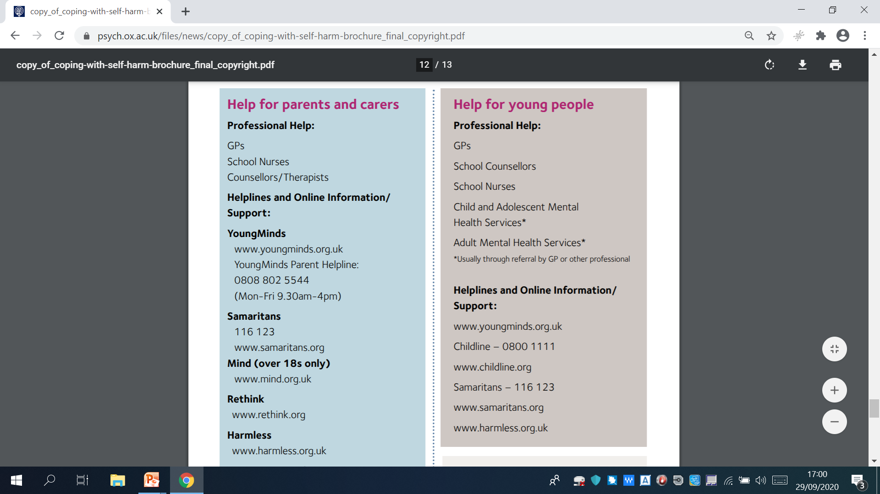
Support for child/young person
YoungMinds Crisis Messenger Provides free, 24/7 text support for young people experiencing a mental health crisis. Text YM to 85258
Youth Wellbeing Directory www.annafreud.org/on-my-mind/youth-wellbeing Lists local services for young people’s mental health and wellbeing.
Calm Harm app www.calmharm.co.uk A free app providing support and strategies to help you resist or manage the urge to self-harm.
Text "SHOUT" to 85258 to contact the Shout Crisis Text Line, or text "YM" if you're under 19
Working in partnership with:
Northumbria Healthcare NHS Foundation Trust
Cumbria, Northumberland, Tyne and Wear NHS Foundation Trust
Notes:
Talk through slide

Slide 16
Support for parents
If you're supporting someone who self-harms you should also make sure you take care of yourself.
These organisations offer information and advice for friends and family:
Mind – for friends and family of someone who self-harms
Staying Safe – advice for supporting someone else
YoungMinds – parents' guide to self-harm support
British Medical Association – coping with self-harm: a guide for parents and carers (PDF, 3MB)
University of Nottingham – It's Okay to Talk about Self-harm leaflet
Working in partnership with:
Northumbria Healthcare NHS Foundation Trust
Cumbria, Northumberland, Tyne and Wear NHS Foundation Trust
Notes:
Talk through slide

Slide 17
THANK YOU
for listening and taking part
Working in partnership with:
Northumbria Healthcare NHS Foundation Trust
Cumbria, Northumberland, Tyne and Wear NHS Foundation Trust

