Slide 1





Sleep Hygiene
Working in partnership with:
Northumbria Healthcare NHS Foundation Trust
Cumbria, Northumberland, Tyne and Wear NHS Foundation Trust

Slide 2
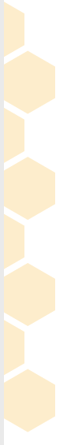


What is Sleep Hygiene?
Good sleep hygiene is all about putting yourself in the best position to sleep well each and every night.
A good night’s sleep is about getting to sleep, staying asleep and getting enough good-quality, deep sleep.
Working in partnership with:
Northumbria Healthcare NHS Foundation Trust
Cumbria, Northumberland, Tyne and Wear NHS Foundation Trust
Notes:
https://www.mentallyhealthyschools.org.uk/risks-and-protective-factors/lifestyle-factors/sleeping-problems/
https://www.sleepfoundation.org/articles/sleep-hygiene
What is Sleep Hygiene?
Good sleep hygiene is all about putting yourself in the best position to sleep well each and every night.
A good night’s sleep is about getting to sleep, staying asleep and getting enough good-quality, deep sleep.

Slide 3
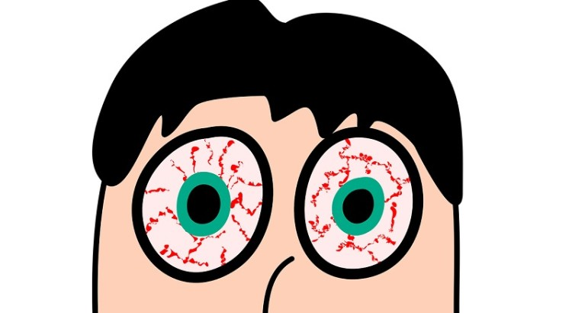
Why is Sleep so important?
It helps us to feel well, focused and happy.
Most people experience a bad night’s sleep now and again, but if you regularly don’t get enough sleep it can really affect how you feel and what you can get done during the day.
Working in partnership with:
Northumbria Healthcare NHS Foundation Trust
Cumbria, Northumberland, Tyne and Wear NHS Foundation Trust
Notes:
https://headspace.org.au/assets/Factsheets/HSP225-Sleep-Fact-Sheet-DP3.pdf
Why is Sleep so important?
It helps us to feel well, focused and happy.
Most people experience a bad night’s sleep now and again, but if you regularly don’t get enough sleep it can really affect how you feel and what you can get done during the day.

Slide 4

NHS Recommended
Sleep Times for Night Time
10 years old - 9 hours 45 minutes
11 years old - 9 hours 30 minutes
12 years old - 9 hours 15 minutes
13 years old - 9 hours 15 minutes
14 years old - 9 hours
15 years old - 9 hours
16 years old - 9 hours
Working in partnership with:
Northumbria Healthcare NHS Foundation Trust
Cumbria, Northumberland, Tyne and Wear NHS Foundation Trust
Notes:
https://www.nhs.uk/live-well/sleep-and-tiredness/how-much-sleep-do-kids-need/
How much sleep to our children need, Nhs have recommended sleep times from the ages of 10-16, this will differ from child to child. As you see its around 9 hours per night.

Slide 5

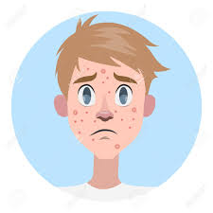
What gets in the way of a good night’s sleep?
For young people, not getting enough sleep might be caused by:
Environmental factors: such as social pressure, school workload, use of electronic devices, or using alcohol or other drugs.
Biological factors:
such as puberty, changes in your body clock and the delayed release of melatonin.
Working in partnership with:
Northumbria Healthcare NHS Foundation Trust
Cumbria, Northumberland, Tyne and Wear NHS Foundation Trust
Notes:
https://headspace.org.au/assets/Factsheets/HSP225-Sleep-Fact-Sheet-DP3.pdf
https://www.bbc.co.uk/science/humanbody/body/articles/lifecycle/teenagers/sleep.shtml#:~:text=Most%20adults%20start%20to%20produce,by%20the%20b
What gets in the way of a good night’s sleep?
For young people, not getting enough sleep might be caused by:
Environmental factors: such as social pressure, school workload, use of electronic devices, or using alcohol or other drugs.
Biological factors: such as puberty, changes in your body clock and the delayed release of melatonin.
Melatonin is the sleep hormone, which helps us to fall asleep. Most adults start to produce melatonin at about 10pm.
There can be a delay in melatonin production when you stay up late, you often play computer games, play on your mobile phone or watch television. This stimulates the brain and exposes teenagers to bright lights which could cause a much later release of melatonin.

Slide 6
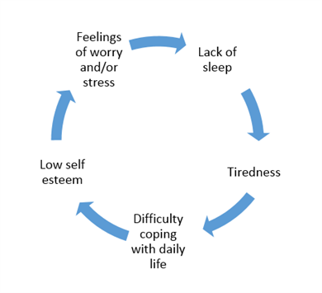
How does sleep affect our Mental Health?
Working in partnership with:
Northumbria Healthcare NHS Foundation Trust
Cumbria, Northumberland, Tyne and Wear NHS Foundation Trust
Notes:
https://www.mind.org.uk/information-support/types-of-mental-health-problems/sleep-problems/about-sleep-and-mental-health/
How does sleep affect our Mental Health?
There's a close relationship between sleep and mental health. Living with a mental health problem can affect how well you sleep, and poor sleep can have a negative impact on your mental health.

Slide 7
What is affected by not getting enough sleep?
Mood
Academic Performance
Thinking
Behaviour
Athletic Performance
Working in partnership with:
Northumbria Healthcare NHS Foundation Trust
Cumbria, Northumberland, Tyne and Wear NHS Foundation Trust
Notes:
https://www.choc.org/wp/wp-content/uploads/2016/04/Sleep-Hygiene-Teen-Handout.pdf
• Mood. Not getting enough sleep can cause teens to be irritable and moody. Controlling their moods can be an issue, and you may find your teen frustrated or upset more easily.
• Behaviour. Teens who are not getting enough sleep are more prone to risk-taking behaviours such as drinking or drugs.
• Thinking. Sleep deprivation can result in attention problems, memory problems, lead to bad decision-making, slow down reaction time and stunt creativity. These are all important for academic success.
• Academic performance. Teens who are sleep deprived are more likely to do poorly in school, fall asleep during class, have multiple school absences or struggle to concentrate and feel motivated
• Athletic performance. Sleep deprived teens are more likely to perform poorly in after-school sports due to slower reaction times.

Slide 8
Benefits of Good Sleep Hygiene
Improve mood
Maintain a healthy weight
Energy levels
Memory and recall
Concentration
Cope better with general stress
Working in partnership with:
Northumbria Healthcare NHS Foundation Trust
Cumbria, Northumberland, Tyne and Wear NHS Foundation Trust
Notes:
https://sleepcouncil.org.uk/advice-support/sleep-hub/family-matters/teenagers-sleep/
SLEEP MATTERS!
Sleep may be the last thing on your mind but here are some reasons why you should give it a little more thought:
We all know when we have had a good night sleep that it helps improve our mood if we have had a had a bad night sleep your child may come across grumpy, short tempered, not wanting to interact and possibly emotional and the smallest things.
Sleep helps produce the grown hormone so even whilst your child is sleeping their body is still working overtime.
If they haven't had a good night sleep they may come across as sluggish, not wanting to move, they might not want breakfast which is common in teenagers. This could be seen in school where they cant concentrate, struggle to recall what has been said and memorise work. When your child has come home they have had to keep together all day at school so they may act irritable, emotional and tired at home

Slide 9
Here are some helpful tips to create a good routine:
• Take some time to plan your routine and write it down. Work out what time it will start, this should be an hour before your child goes to sleep.
• Do the same thing at the same time each day, including having a set wake up time each morning.
• Turn off all screens at the start of the routine.
• Consider having a light supper time or snack.
• Dim the lights in the hour before bed to encourage the production of melatonin, this will help to promote that sleepy feeling.
• Younger children may enjoy a bedtime box.
• A bath 30 minutes before bed can help to promote sleep, the decrease in body temperature after a bath can help us to nod off more easily.
• Once in bed sharing a story is a great way to end the day or older children may prefer to read independently.
Working in partnership with:
Northumbria Healthcare NHS Foundation Trust
Cumbria, Northumberland, Tyne and Wear NHS Foundation Trust
Notes:
Point 1…..Display the new routine somewhere where everybody in the home can
follow it.
Point 2……We know this is difficult at the weekend, but it is
important to have these set times to support your child’s body clock.
Point 3…… the blue light on the screen may supress the body’s
production of melatonin, the sleep hormone, and make it more difficult to
nod off.
Point 3….. Bananas are an excellent source of magnesium and potassium. They also contain
tryptophan an amino acid that helps us to sleep but don’t forget fruit contains
sugar too. Blend one banana with one cup of milk or soya milk to make an ideal
bedtime drink.
• Dairy, yogurt, milk and cheese contain tryptophan helping us to nod off more
easily. Calcium is effective in stress reduction and it’s not true... cheese doesn’t
give you nightmares!
Cereal not only is it a healthy snack, but it may also help you snooze.
• Point 4….this could be filled with a selection of
activities to carry out during the routine. Hand eye co-ordination activities
such as jigsaws, colouring and threading are great for promoting relaxation. Older children may prefer to read, play a board game or take part in a
craft activity.

Slide 10




Sleep Hygiene Self-Help & Online Support
https://pzizz.com/
https://www.sleepio.com/
https://www.sleepstation.org.uk/
https://youngminds.org.uk/find-help/feelings-and-symptoms/sleep-problems/
Working in partnership with:
Northumbria Healthcare NHS Foundation Trust
Cumbria, Northumberland, Tyne and Wear NHS Foundation Trust
Notes:
Sleep Hygiene Self-Help
We wanted to show you some age appropriate and professional online self-help support.
These websites and apps have been verified by professionals and can provide children and young people with sleep support.
They are all free (with some in-app purchases) and can provide you with advice, support and guidance on how to improve your sleep quality.

Slide 11





Mental Health Self-Help & Online Support
https://www.nhs.uk/conditions/stress-anxiety-depression/
https://www.mind.org.uk/information-support/for-children-and-young-people/
https://www.childline.org.uk/
https://www.kooth.com/
https://www.nhs.uk/oneyou/every-mind-matters/
Working in partnership with:
Northumbria Healthcare NHS Foundation Trust
Cumbria, Northumberland, Tyne and Wear NHS Foundation Trust
Notes:
Self-Help
We also wanted to point you in the direction of some age appropriate and professional online self-help support.
These websites have been verified by professionals and can provide children and young people with general mental health support in relation to lots of mental health issues.
They are all free and can provide you with advice, support and guidance on a number of issues that you might be facing right now.

Slide 12
THANK YOU
Working in partnership with:
Northumbria Healthcare NHS Foundation Trust
Cumbria, Northumberland, Tyne and Wear NHS Foundation Trust

