Slide 1
Sleep Hygiene
Working in partnership with:
Northumbria Healthcare NHS Foundation Trust
Cumbria, Northumberland, Tyne and Wear NHS Foundation Trust

Slide 2
What is Sleep Hygiene?
Good sleep hygiene is all about putting yourself in the best position to sleep well each and every night.
A good night’s sleep is about getting to sleep, staying asleep and getting enough good-quality, deep sleep.
Working in partnership with:
Northumbria Healthcare NHS Foundation Trust
Cumbria, Northumberland, Tyne and Wear NHS Foundation Trust
Notes:
https://www.mentallyhealthyschools.org.uk/risks-and-protective-factors/lifestyle-factors/sleeping-problems/
https://www.sleepfoundation.org/articles/sleep-hygiene
What is Sleep Hygiene?
Good sleep hygiene is all about putting yourself in the best position to sleep well each and every night.
A good night’s sleep is about getting to sleep, staying asleep and getting enough good-quality, deep sleep.

Slide 3
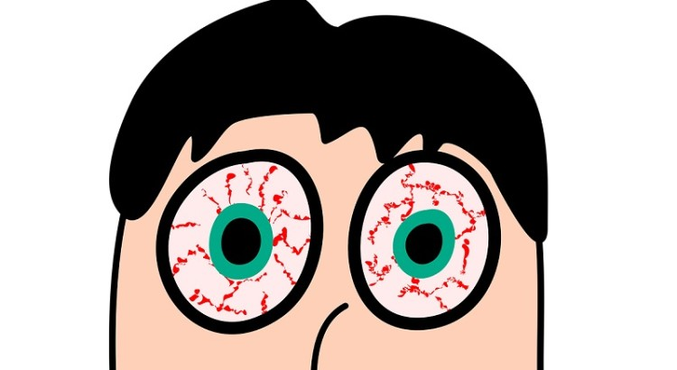
Why is Sleep so important?
It helps us to feel well, focused and happy.
Most people experience a bad night’s sleep now and again, but if you regularly don’t get enough sleep it can really affect how you feel and what you can get done during the day.
Working in partnership with:
Northumbria Healthcare NHS Foundation Trust
Cumbria, Northumberland, Tyne and Wear NHS Foundation Trust
Notes:
https://headspace.org.au/assets/Factsheets/HSP225-Sleep-Fact-Sheet-DP3.pdf
Why is Sleep so important?
It helps us to feel well, focused and happy.
Most people experience a bad night’s sleep now and again, but if you regularly don’t get enough sleep it can really affect how you feel and what you can get done during the day.

Slide 4
NHS Recommended
Sleep Times for Night Time
10 years old - 9 hours 45 minutes
11 years old - 9 hours 30 minutes
12 years old - 9 hours 15 minutes
13 years old - 9 hours 15 minutes
14 years old - 9 hours
15 years old - 9 hours
16 years old - 9 hours
Working in partnership with:
Northumbria Healthcare NHS Foundation Trust
Cumbria, Northumberland, Tyne and Wear NHS Foundation Trust
Notes:
https://www.nhs.uk/live-well/sleep-and-tiredness/how-much-sleep-do-kids-need/
NHS Recommended Sleep Times for Night Time
10 years old - 9 hours 45 minutes
11 years old - 9 hours 30 minutes
12 years old - 9 hours 15 minutes
13 years old - 9 hours 15 minutes
14 years old - 9 hours
15 years old - 9 hours
16 years old - 9 hours

Slide 5
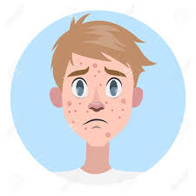
What gets in the way of a good night’s sleep?
For young people, not getting enough sleep might be caused by:
Environmental factors: such as social pressure, school workload, use of electronic devices, or using alcohol or other drugs.
Biological factors:
such as puberty, changes in your body clock and the delayed release of melatonin.
Working in partnership with:
Northumbria Healthcare NHS Foundation Trust
Cumbria, Northumberland, Tyne and Wear NHS Foundation Trust
Notes:
https://headspace.org.au/assets/Factsheets/HSP225-Sleep-Fact-Sheet-DP3.pdf
https://www.bbc.co.uk/science/humanbody/body/articles/lifecycle/teenagers/sleep.shtml#:~:text=Most%20adults%20start%20to%20produce,by%20the%20b
What gets in the way of a good night’s sleep?
For young people, not getting enough sleep might be caused by:
Environmental factors: such as social pressure, school workload, use of electronic devices, or using alcohol or other drugs.
Biological factors: such as puberty, changes in your body clock and the delayed release of melatonin.
One important change that occurs at night time is increased levels of the ‘sleep hormone’ – sometimes known as the ‘darkness hormone’ melatonin, which helps us to fall asleep. Most adults start to produce melatonin at about 10pm.
A delay in melatonin production might be caused by the behaviour of teenagers. When you stay up late, you often play computer games, play on your mobile phone or watch television. This stimulates the brain and exposes teenagers to bright lights which could cause a much later release of melatonin.

Slide 6
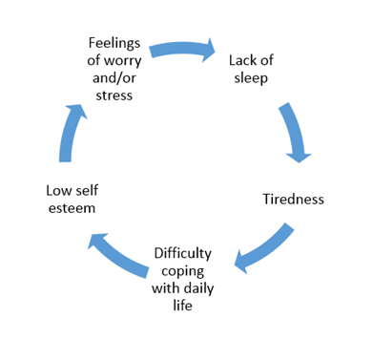
How does sleep affect our Mental Health?
Working in partnership with:
Northumbria Healthcare NHS Foundation Trust
Cumbria, Northumberland, Tyne and Wear NHS Foundation Trust
Notes:
https://www.mind.org.uk/information-support/types-of-mental-health-problems/sleep-problems/about-sleep-and-mental-health/
How does sleep affect our Mental Health?
There's a close relationship between sleep and mental health. Living with a mental health problem can affect how well you sleep, and poor sleep can have a negative impact on your mental health.
"Poor sleep leads to worrying.
Worrying leads to poor sleep.
Worrying about sleep is like your mind trying to fight itself.
That's a horrible place to be."

Slide 7
What is affected by not getting enough sleep?
Mood
Academic Performance
Thinking
Behaviour
Athletic Performance
Working in partnership with:
Northumbria Healthcare NHS Foundation Trust
Cumbria, Northumberland, Tyne and Wear NHS Foundation Trust
Notes:
https://www.choc.org/wp/wp-content/uploads/2016/04/Sleep-Hygiene-Teen-Handout.pdf
• Mood. Not getting enough sleep can cause teens to be irritable and moody all day. Controlling your moods can be an issue, and you can find themselves frustrated or upset more easily.
• Behaviour. Teens who are not getting enough sleep are more prone to risk-taking behaviours such as drinking alcohol and driving recklessly.
• Thinking. Sleep deprivation can result in attention problems, memory problems, lead to bad decision-making, slow down reaction time and stunt creativity. These are all important for academic success.
• Academic performance. Teens who are sleep deprived are more likely to do poorly in school, fall asleep during class, have multiple school absences or be consistently tardy.
• Athletic performance. Sleep deprived teens are more likely to perform poorly in after-school sports due to slower reaction times.

Slide 8
Benefits of Good Sleep Hygiene
Have spot-free skin
Maintain a healthy weight
Grow
Have more energy
Remember information for exams
Concentrate at school
Cope better with general stress
Working in partnership with:
Northumbria Healthcare NHS Foundation Trust
Cumbria, Northumberland, Tyne and Wear NHS Foundation Trust
Notes:
https://sleepcouncil.org.uk/advice-support/sleep-hub/family-matters/teenagers-sleep/
SLEEP MATTERS!
Sleep may be the last thing on your mind but here are some reasons why you should give it a little more thought:
Lack of sleep can cause havoc with your skin and result in spots and pimples.
The right amount of sleep will make it easier to maintain a healthy weight.
Growth hormones are released when you are asleep.
Sleep deprivation can make it hard to concentrate and remember things – the last thing you need when you are in an exam situation!
Getting a good night’s sleep can help you to cope better with the stress of life such as exams, parents and relationships.

Slide 9
Working in partnership with:
Northumbria Healthcare NHS Foundation Trust
Cumbria, Northumberland, Tyne and Wear NHS Foundation Trust
Notes:
https://www.childline.org.uk/info-advice/your-feelings/feelings-emotions/problems-sleeping/

Slide 10
Top 10 Tips
Simple lifestyle changes can make a world of difference to your quality of sleep.
Follow these 10 tips for a more restful night:
Keep regular sleep hours
Create a restful sleeping environment
Make sure your bed is comfortable
Exercise regularly
Cut down on caffeine
Do not over-indulge
Do not smoke
Write away your worries
If you cannot sleep, get up
Try to wind down before going to bed
Working in partnership with:
Northumbria Healthcare NHS Foundation Trust
Cumbria, Northumberland, Tyne and Wear NHS Foundation Trust
Notes:
Top 10 Tips for Better Sleep
Simple lifestyle changes can make a world of difference to your quality of sleep.
Follow these 10 tips for a more restful night.
Keep regular sleep hours
Going to bed and getting up at roughly the same time every day will programme your body to sleep better. Choose a time when you're likely to feel tired and sleepy.
Create a restful sleeping environment
Your bedroom should be a peaceful place for rest and sleep. Temperature, lighting and noise should be controlled so that your bedroom environment helps you to fall (and stay) asleep.
If you have a pet that sleeps in the room with you, consider moving it somewhere else if it often disturbs you in the night.
Make sure your bed is comfortable
It's difficult to get restful sleep on a mattress that's too soft or too hard, or a bed that's too small or old.
Exercise regularly
Moderate exercise on a regular basis, such as swimming or walking, can help relieve some of the tension built up over the day. But make sure you do not do vigorous exercise, such as running or the gym, too close to bedtime, as it may keep you awake.
Cut down on caffeine
Cut down on caffeine in tea, coffee, energy drinks or colas, especially in the evening. Caffeine interferes with the process of falling asleep, and also prevents deep sleep. Instead, have a warm, milky drink or herbal tea.
Do not over-indulge
Too much food or alcohol, especially late at night, can interrupt your sleep patterns. Alcohol may help you to fall asleep initially, but it will disrupt your sleep later on in the night.
Do not smoke
Nicotine is a stimulant. People who smoke take longer to fall asleep, wake up more frequently, and often have more disrupted sleep.
Write away your worries
If you tend to lie in bed thinking about everything you have to do tomorrow, set aside time before bedtime to make plans for the next day. The aim is to avoid doing these things when you're in bed, trying to sleep.
If you cannot sleep, get up
If you cannot sleep, do not lie there worrying about it. Get up and do something you find relaxing until you feel sleepy again, then go back to bed.
Try to relax before going to bed
Have a warm bath, listen to quiet music or do some gentle yoga to relax your mind and body. Your GP may be able to recommend a helpful relaxation CD.
Make an appointment to see your GP if lack of sleep is persistent and it's affecting your daily life.

Slide 11
Winding Down
Winding down is a critical stage in preparing for bed. There are lots of ways to relax:
A warm bath
Writing "to do" lists
Reading a book
Avoid using electronic devices
Relaxation Exercises
Yoga
Scripts
Music
Sound Effects
Working in partnership with:
Northumbria Healthcare NHS Foundation Trust
Cumbria, Northumberland, Tyne and Wear NHS Foundation Trust
Notes:
Winding Down
Winding down is a critical stage in preparing for bed. There are lots of ways to relax before you go to bed:
A warm bath (not hot) will help your body reach a temperature that's ideal for rest.
Writing "to do" lists for the next day can organise your thoughts and clear your mind of any distractions.
Reading a book or listening to the radio relaxes the mind by distracting it.
Avoid using smartphones, tablets or other electronic devices for an hour or so before you go to bed as the light from the screen on these devices may have a negative effect on sleep.
Relaxation exercises, such as yoga, helps to relax the muscles.
Relaxation works by using scripts, music and sound effects to relax you.
Seek feedback from audience RE: if they have any other suggestions on ways to relax before bed time.

Slide 12
Working in partnership with:
Northumbria Healthcare NHS Foundation Trust
Cumbria, Northumberland, Tyne and Wear NHS Foundation Trust
Notes:
https://www.headspace.com/?utm_source=google&utm_medium=cpc&utm_campaign=917256451&utm_content=51529952052&utm_term=217943262924&headpsace&gclid=EAIaIQobChMIiIHBt9Lg6wIVyOFRCh1J_AjkEAAYASAAEgJ74vD_BwE
On the theme of ‘winding down’ – were now going to watch and listen to a video created by Headpsace.
This is simple and introductory video to help soothe the mind and relax the body, creating the ideal conditions for healthy, restful sleep.
Please feel free to close your eyes and notice how you feel throughout the video.
Notice how you body feels at the beginning and at the end.
Seek feedback from audience.

Slide 13
Sleep Hygiene Self-Help & Online Support
https://pzizz.com/
https://www.sleepio.com/
https://www.sleepstation.org.uk/
https://youngminds.org.uk/find-help/feelings-and-symptoms/sleep-problems/
Working in partnership with:
Northumbria Healthcare NHS Foundation Trust
Cumbria, Northumberland, Tyne and Wear NHS Foundation Trust
Notes:
Sleep Hygiene Self-Help
We wanted to show you some age appropriate and professional online self-help support.
These websites and apps have been verified by professionals and can provide children and young people with sleep support.
They are all free (with some in-app purchases) and can provide you with advice, support and guidance on how to improve your sleep quality.

Slide 14
Mental Health Self-Help & Online Support
https://www.nhs.uk/conditions/stress-anxiety-depression/
https://www.mind.org.uk/information-support/for-children-and-young-people/
https://www.childline.org.uk/
https://www.kooth.com/
https://www.nhs.uk/oneyou/every-mind-matters/
Working in partnership with:
Northumbria Healthcare NHS Foundation Trust
Cumbria, Northumberland, Tyne and Wear NHS Foundation Trust
Notes:
Self-Help
We also wanted to point you in the direction of some age appropriate and professional online self-help support.
These websites have been verified by professionals and can provide children and young people with general mental health support in relation to lots of mental health issues.
They are all free and can provide you with advice, support and guidance on a number of issues that you might be facing right now.

Slide 15
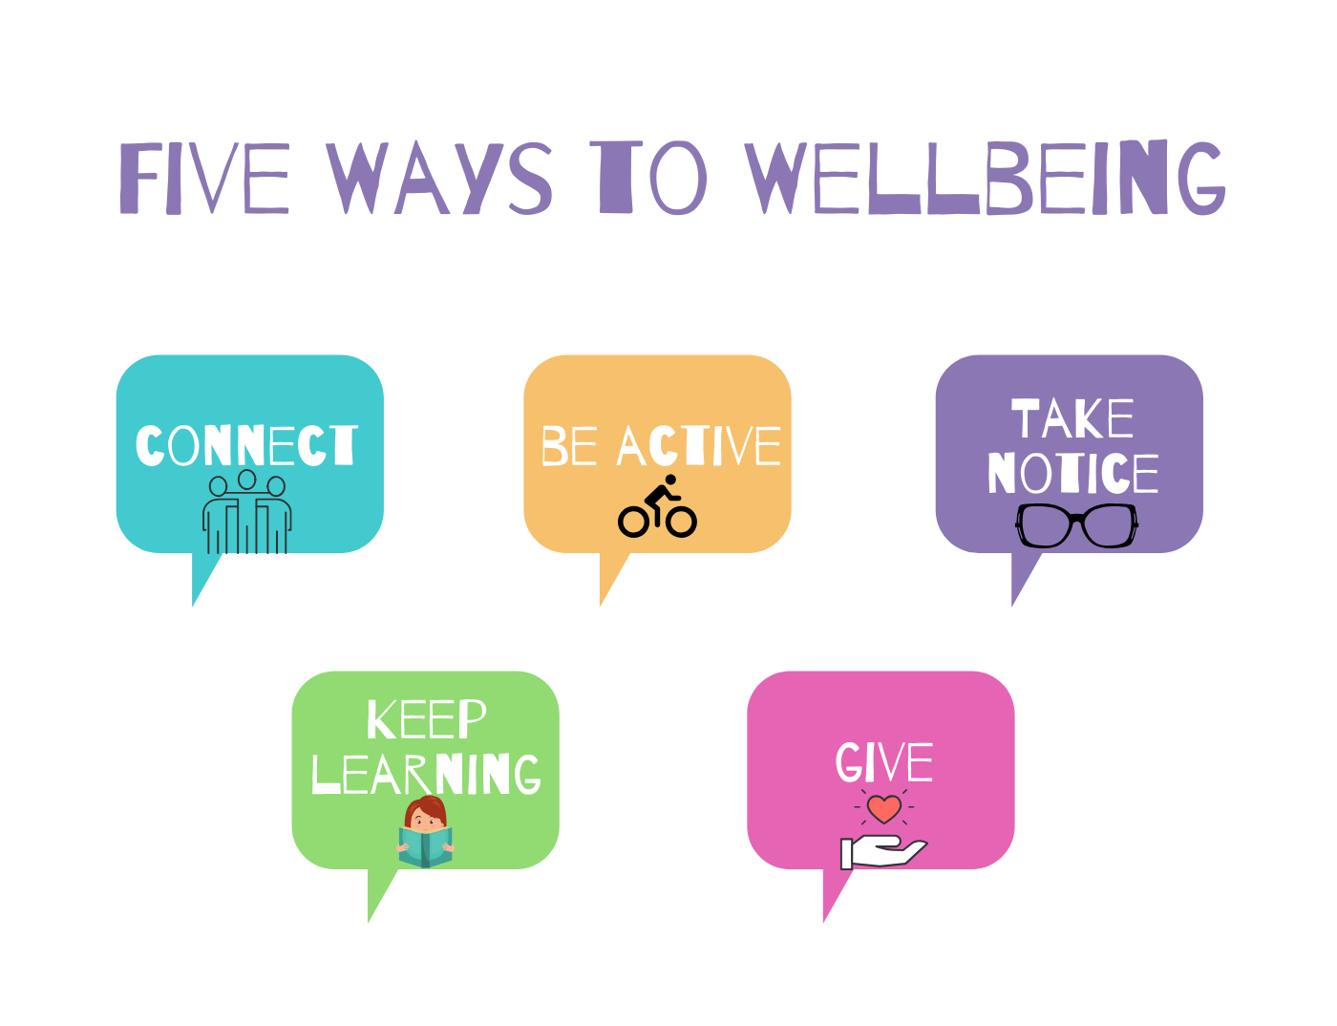
Working in partnership with:
Northumbria Healthcare NHS Foundation Trust
Cumbria, Northumberland, Tyne and Wear NHS Foundation Trust

Slide 16
THANK YOU
for Listening and taking part
Working in partnership with:
Northumbria Healthcare NHS Foundation Trust
Cumbria, Northumberland, Tyne and Wear NHS Foundation Trust

Slide 17
References
https://www.nhs.uk/live-well/sleep-and-tiredness/how-to-get-to-sleep/
https://www.choc.org/wp/wp-content/uploads/2016/04/Sleep-Hygiene-Teen-Handout.pdf
https://headspace.org.au/assets/Factsheets/HSP225-Sleep-Fact-Sheet-DP3.pdf
https://www.mentallyhealthyschools.org.uk/risks-and-protective-factors/lifestyle-factors/sleeping-problems/
file:///C:/Users/MTRUB001/Downloads/how_to_sleep_better_-_mental_health_foundation.pdf
https://www.sleepfoundation.org/articles/sleep-hygiene
https://www.childline.org.uk/info-advice/your-feelings/feelings-emotions/problems-sleeping/
https://sleepcouncil.org.uk/advice-support/sleep-hub/family-matters/teenagers-sleep/
Working in partnership with:
Northumbria Healthcare NHS Foundation Trust
Cumbria, Northumberland, Tyne and Wear NHS Foundation Trust

