Slide 1
I Am Feeling Worried
Working in partnership with:
Northumbria Healthcare NHS Foundation Trust
Cumbria, Northumberland, Tyne and Wear NHS Foundation Trust

Slide 2
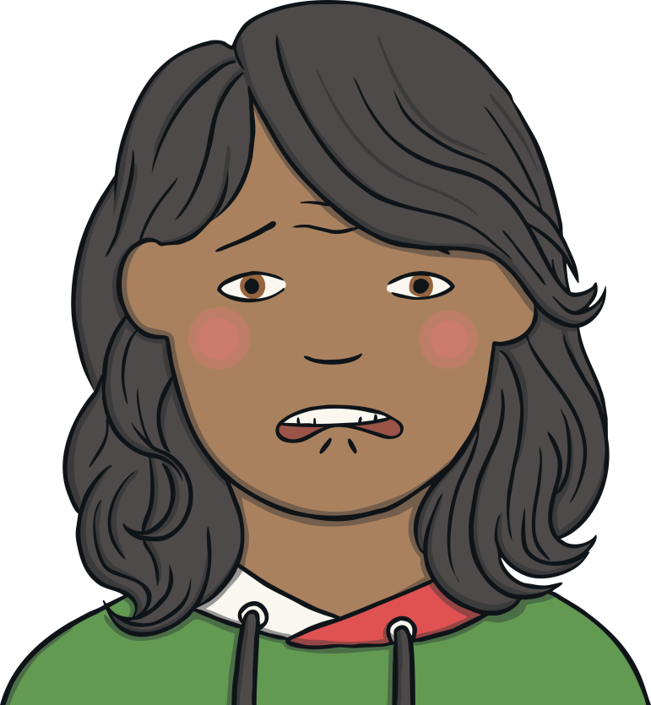
I Am Feeling Worried
Working in partnership with:
Northumbria Healthcare NHS Foundation Trust
Cumbria, Northumberland, Tyne and Wear NHS Foundation Trust
Notes:
Today we are going to talk about worries, can anyone tell me what a worry is?
Class discussion.

Slide 3
How Are You Feeling?
We have lots of different feelings every day. Sometimes the feelings feel good and sometimes they feel bad.
When you get a feeling, try to name it and then decide what you can do with that feeling.
Working in partnership with:
Northumbria Healthcare NHS Foundation Trust
Cumbria, Northumberland, Tyne and Wear NHS Foundation Trust
Notes:
Can we name theses feelings? Hand up?
Lets play heads down thumbs up, but it will be a little different today… I would like everyone to put the heads down gently on the table resting on their arms and I will call out a feeling and what I want you to try is to show that feeling face to your table/partner/ teacher.

Slide 4
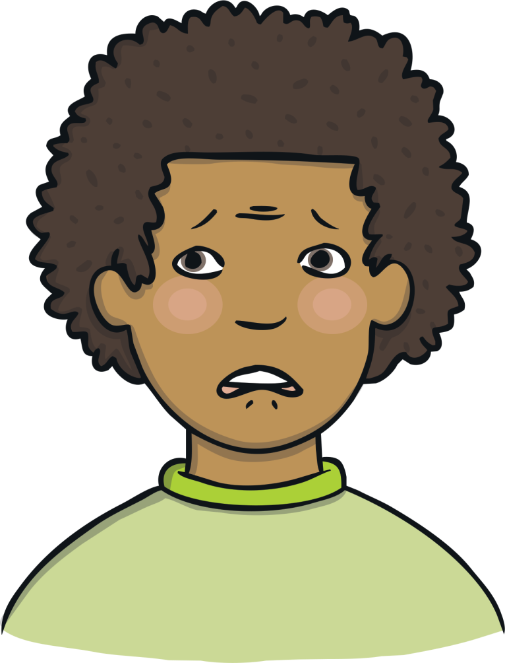
Feeling Worried
When you are feeling worried, you are often thinking unhelpful thoughts about something that might happen.
Feeling worried is not a nice feeling, but we all feel worried sometimes.
It’s a feeling that might make you feel like you have a knot in your tummy.
Working in partnership with:
Northumbria Healthcare NHS Foundation Trust
Cumbria, Northumberland, Tyne and Wear NHS Foundation Trust

Slide 5
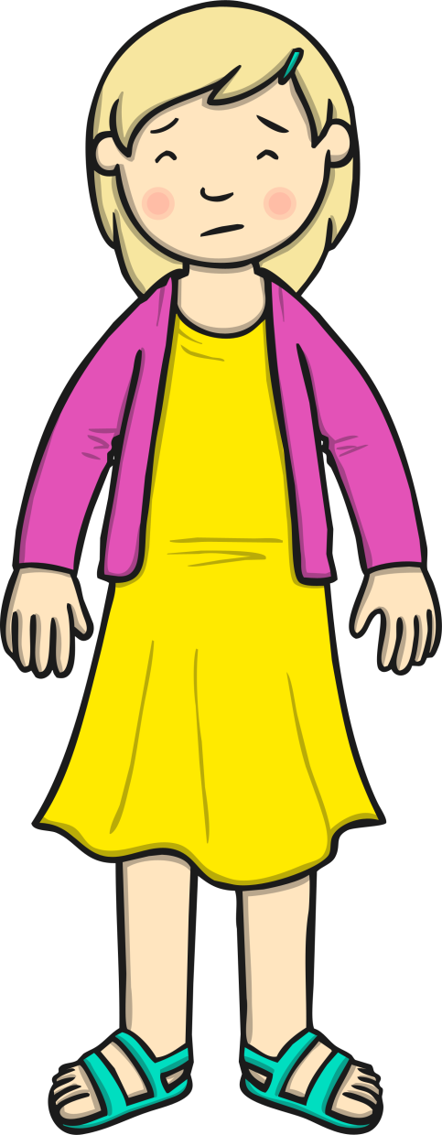
Feeling Worried
You might feel worried when…
lots of people are watching you (e.g. Sports Day)
you are going to do something new
you need to do something on your own
You have fallen out with a friend
Working in partnership with:
Northumbria Healthcare NHS Foundation Trust
Cumbria, Northumberland, Tyne and Wear NHS Foundation Trust
Notes:
This is CeCe, she has lots of worries as we can see, can anyone show their hands if they have ever had the same worrying thoughts as CeCe?
On your post its can you write down a worry that you might have had or are having now…… here is my worry box and what we will start in class is this worry box where you can post a worry if you have one and your name and we will make time throughout the day to have a chat about it and to see what positive solutions we can come up with. (optional)
Now lets have a look what worry might look like?.....

Slide 6
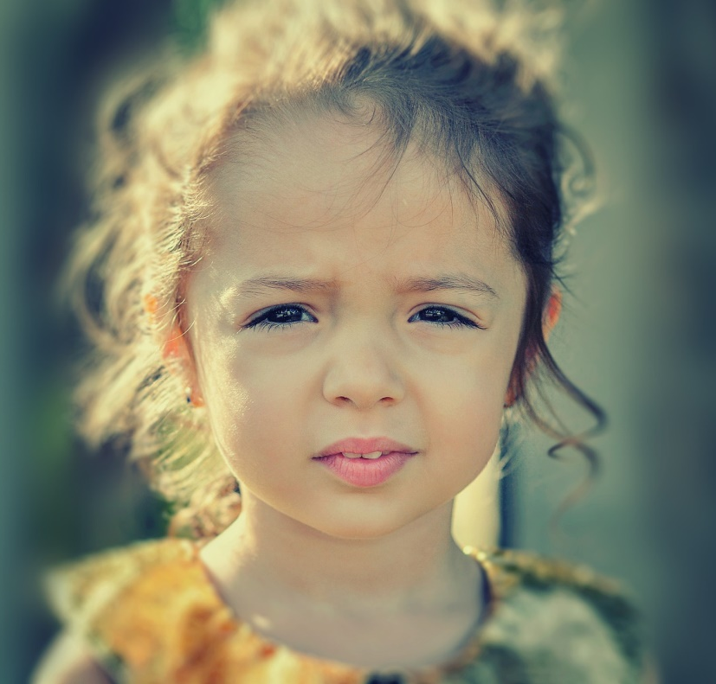
Feeling Worried
This child is feeling worried.
What do you notice about her face?
Working in partnership with:
Northumbria Healthcare NHS Foundation Trust
Cumbria, Northumberland, Tyne and Wear NHS Foundation Trust
Notes:
Have image printed out and placed on group tables, ask children to write on post its, what they can see and why do they think she might be worried?

Slide 7
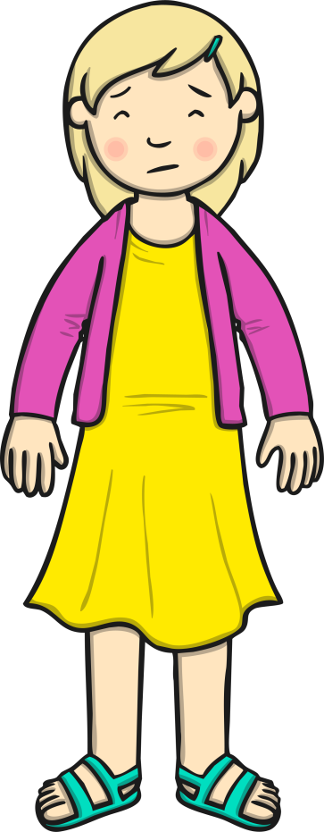
Feeling Worried
What happens to our bodies when we are worried?
When we are worried we may show it on our face but also our body can show signs that we are worried.
I have to stand up in front of my class and show my work
Headache
Red cheeks
Heart beating fast
Need to go to the toilet more often
Butterflies in my tummy
Working in partnership with:
Northumbria Healthcare NHS Foundation Trust
Cumbria, Northumberland, Tyne and Wear NHS Foundation Trust
Wobbly knees
Notes:
This Is CeCe again…. One of her worries was that she had to stand up in front of her class and show her work. Even though the teacher asked CeCe to show everyone because she was impressed with her work, this didn’t make CeCe feel great she was very worried and her body started to show signs of worry such as …. (read powerpoint)
Now we are going to create our own characters to see what other physical feeling we may have when we are worried.
Each group has a large piece of wallpaper, big enough to fit a child from the group.
Ask the child to lay on the paper and the group draw around them, you give each group an envelope with a character and a possible worry inside.
can they design their young person and label the drawing with post its of possible feelings.
Second option to have individual pieces of paper with an outline of a body and the table is given the envelope again and they all individually label the character and design what the character might look like.
This is great for communication,
do they say the same things?
Did one person write a feeling but others have not?
Display them in classroom if possible
Staff member to hold up character and read through with class/ if group are confident would they like to show it to the class?
Spend time on this as a lot of conversation will come from it.

Slide 8
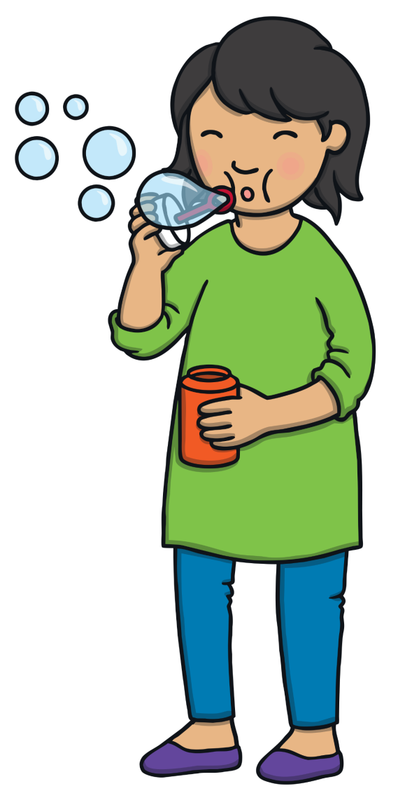
What Can You Do?
There are lots of things you can do if you are feeling worried.
Use your words and say why you are worried.
Take three deep breaths.
Picture your worry in a bubble and blow it away.
Tell yourself nice things.
Have some quiet time.
Working in partnership with:
Northumbria Healthcare NHS Foundation Trust
Cumbria, Northumberland, Tyne and Wear NHS Foundation Trust
Notes:
So how can we possibly help CeCe
There are many things we can to do to help with the worries, we can … (read powerpoint)
Now with our worry characters that we made before … and looking at the worry they had can we come with ideas to help them with that worry?
What would you suggest? …. Write on a different colour post its.
Go through them as a class, teacher taking lead unless again the children feel confident to do so.

Slide 9
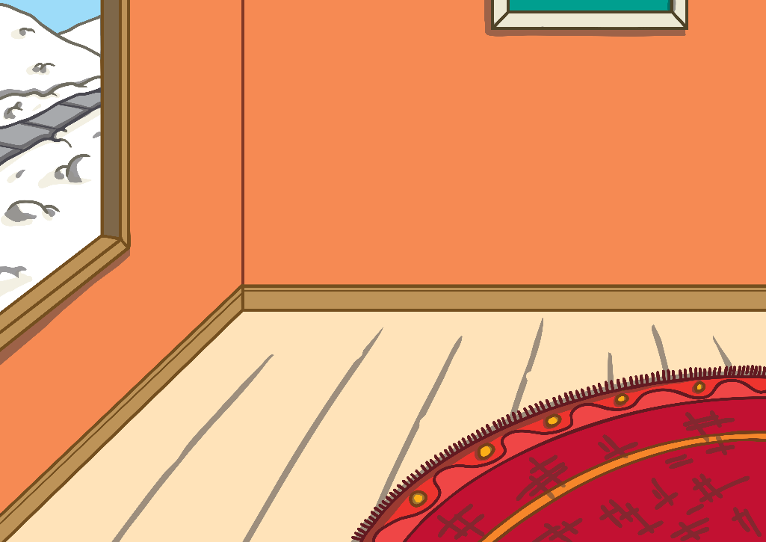
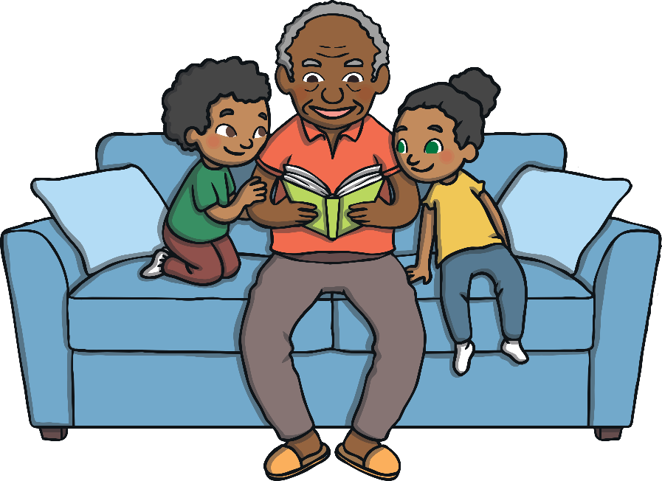
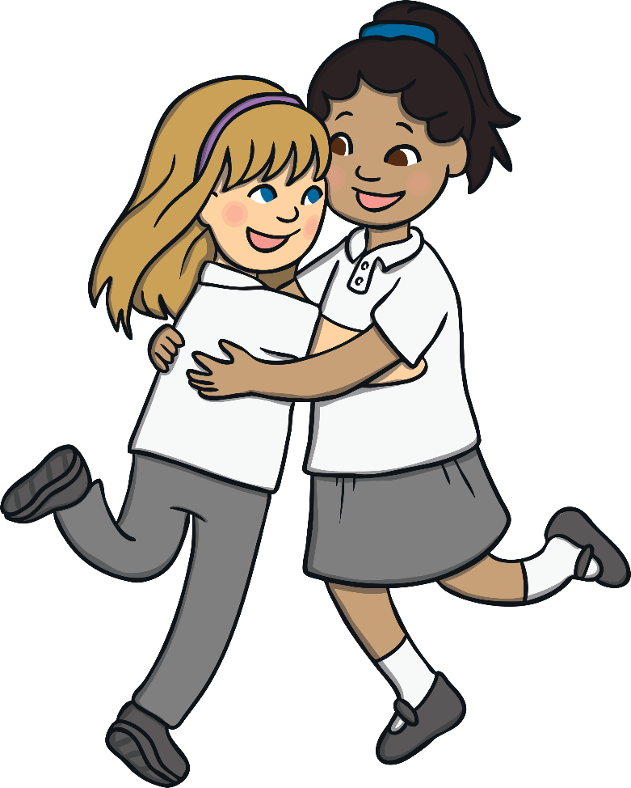
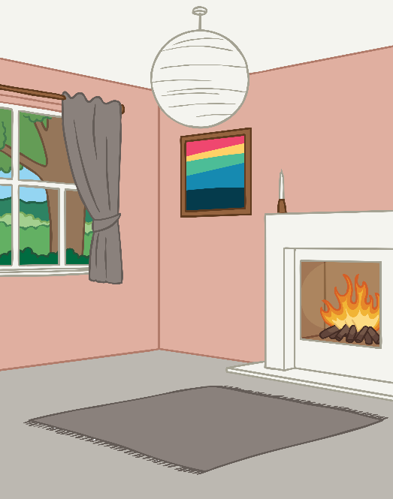
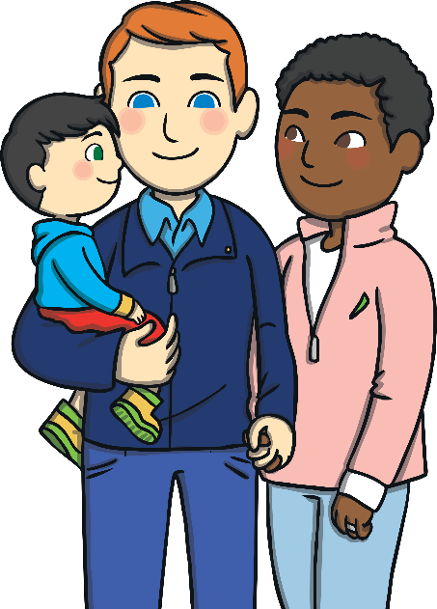
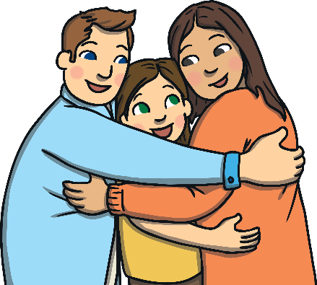
Sharing your worries with others makes them feel a little lighter each time you talk to a friend, Grandad, Mummy or Daddy and a teacher, can you think of other people who are there to listen…….
Working in partnership with:
Northumbria Healthcare NHS Foundation Trust
Cumbria, Northumberland, Tyne and Wear NHS Foundation Trust
Notes:
Ok so now we've gone through, what a worry is, types of worries, what worry looks like and what we can do to help ourselves and others if worries takeover.
Now the last activity can you write on another post it (different colour) who you might go to talk to if you were worried and add it to your characters?
Final discussion going through a couple of the characters such as…. “ok this is suzie, her worry is that she will fail in a test at school. The group decided she felt (read post its)…. The group came up with different ways to help with that worry which were (read Post its)….. We also had great ideas of who we could talk to such as (read post its)…….
We worked together today to look at a problem and find positive solutions. WELL DONE!!!!
( you could possibley ask the children if they know who they could go to if they have a problem in school? Plus you might want to go over the worry box mentioned earlier in the power point. The worry box/worry time is a CBT approach that we use to help children share and be able to have quality time with a trusted adult to share. (this is optional)

Slide 10
Thankyou
Working in partnership with:
Northumbria Healthcare NHS Foundation Trust
Cumbria, Northumberland, Tyne and Wear NHS Foundation Trust

